Slide 1








Year 4 · Spring · Multiplication and division B · Step 8
Informal written methods for multiplication
I do, you do, with a timer. The questions get harder as we go.
Notes:
The Bobas are sitting at their desks, floating up and down, ready to learn. Click a timer in slideshow mode to start it.

Slide 2

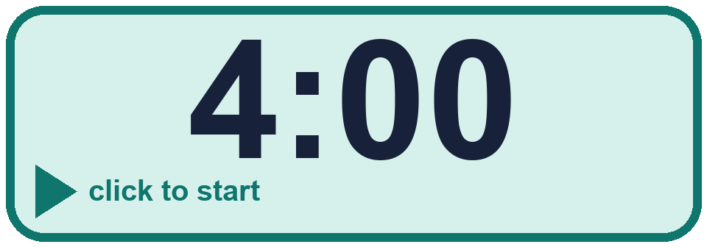
Year 4 · Multiplication and division B · Step 8
Starter
Last lesson: Related facts (multiplication and division)
1. Use the first fact to help you with the others.
a) 3 × 9 = ________
b) 3 × 90 = ________
c) 3 × 900 = ________
2. Complete the number sentences.
a) 9 × 9 tens = ____ tens = ________
b) 4 × 5 tens = ____ tens = ________
a) 27 b) 270 c) 2,700
a) 81, 810 b) 20, 200
3. Use the first fact to help you with the others.
a) 49 ÷ 7 = ________
b) 490 ÷ 7 = ________
c) 4,900 ÷ 7 = ________
4. Complete the number sentences.
a) 72 tens ÷ 9 = ____ tens = ________
b) 32 tens ÷ 8 = ____ tens = ________
a) 7 b) 70 c) 700
a) 8, 80 b) 4, 40
Notes:
Starter: four quick questions to bring back last lesson (Related facts (multiplication and division)). Click the timer, let pupils answer on their whiteboards, then click to show each answer in turn.

Slide 3

Year 4 · Multiplication and division B · Step 8
Today we are learning…
To multiply a 2-digit number by a 1-digit number by partitioning.
I can…
☐ I can partition the 2-digit number into tens and ones.
☐ I can multiply each part.
☐ I can add the parts.
☐ I can use an area model.
Notes:
Read the objective aloud. Then ask: where might we need this outside school? The success criteria can be turned into a quick check at the end of the lesson.

Slide 4
Year 4 · Multiplication and division B · Step 8
Key words
partition
tens
ones
area model
multiply
add
Notes:
Pupils say each word aloud, then use it in a sentence about today's numbers.

Slide 5

Year 4 · Multiplication and division B · Step 8
The key ideas
Split 24 × 3 into 20 × 3 and 4 × 3.
Multiply the tens and then the ones: 60 + 12.
Add the two answers to find the product.
Notes:
Talk through the picture first: ask pupils what they notice. Then click to bring in each statement, and the words under the picture, one at a time.

Slide 6
Year 4 · Multiplication and division B · Step 8
Look out for
Multiply both parts.
Write both calculations.
Add at the end.
Notes:
Talk through the picture first: ask pupils what they notice. Then click to bring in each statement, and the words under the picture, one at a time.

Slide 7

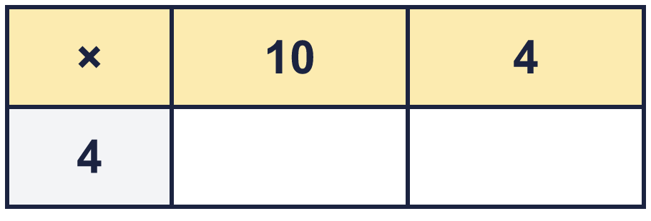
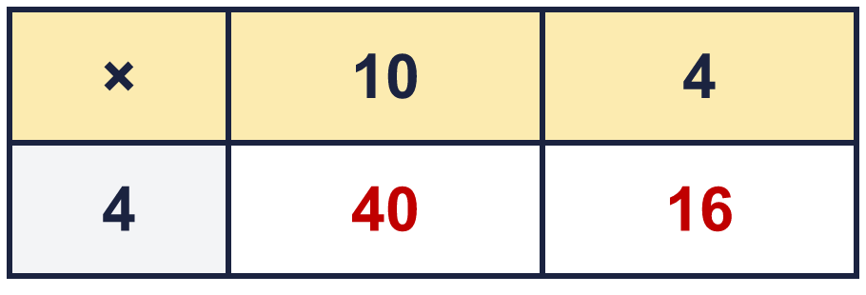
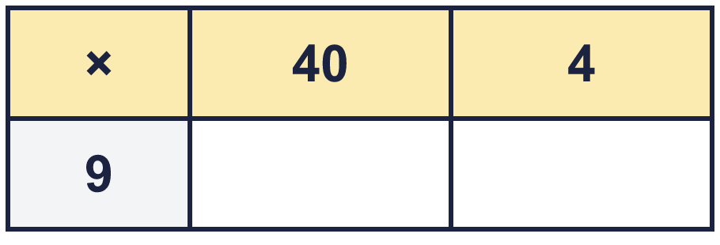
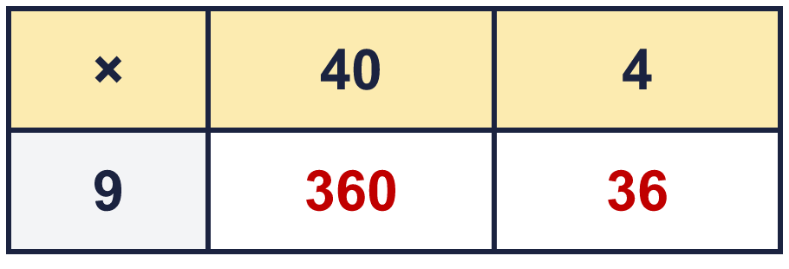
Year 4 · Multiplication and division B · Step 8 · question 1
I do
You do
Complete the area model for 14 × 4.
Complete the area model for 44 × 9.
So 14 × 4 = ________
So 44 × 9 = ________
56
396
1 of 8
Notes:
Question 1 of 8. I DO: model it out loud, thinking through each step. YOU DO: click the timer (1:00, an estimate) and let pupils try the same type of question with new numbers on their whiteboards. Then click to bring in the answers one at a time: the I do working, the I do answer, then the You do answer. Ask someone who got it wrong to say which step went wrong. Top tip: Answers. I do: 56. You do: 396.

Slide 8
Year 4 · Multiplication and division B · Step 8 · question 2
I do
You do
Work out the multiplications. Use any method you like.
Work out the multiplications. Use any method you like.
a) 15 × 8 = ________
a) 23 × 7 = ________
b) 63 × 4 = ________
b) 41 × 9 = ________
c) 37 × 5 = ________
c) 88 × 5 = ________
a) 120
b) 252
c) 185
a) 161
b) 369
c) 440
2 of 8
Notes:
Question 2 of 8. I DO: model it out loud, thinking through each step. YOU DO: click the timer (1:00, an estimate) and let pupils try the same type of question with new numbers on their whiteboards. Then click to bring in the answers one at a time: the I do working, the I do answer, then the You do answer. Ask someone who got it wrong to say which step went wrong. Top tip: Answers. I do: a) 120 | b) 252 | c) 185. You do: a) 161 | b) 369 | c) 440.

Slide 9
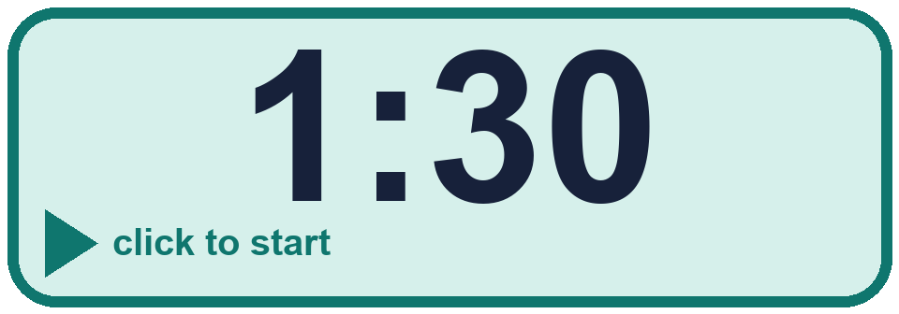
Year 4 · Multiplication and division B · Step 8 · question 3
I do
You do
Write the missing number.
Write the missing number.
a) 19 × ________ = 95
a) 20 × ________ = 60
b) ________ × 5 = 95
b) ________ × 3 = 60
a) 5
b) 19
a) 3
b) 20
3 of 8
Notes:
Question 3 of 8. I DO: model it out loud, thinking through each step. YOU DO: click the timer (1:30, an estimate) and let pupils try the same type of question with new numbers on their whiteboards. Then click to bring in the answers one at a time: the I do working, the I do answer, then the You do answer. Ask someone who got it wrong to say which step went wrong. Top tip: Answers. I do: a) 5 | b) 19. You do: a) 3 | b) 20.

Slide 10
Year 4 · Multiplication and division B · Step 8 · question 4
I do
You do
Work out the multiplications. Use any method you like.
Work out the multiplications. Use any method you like.
a) 12 × 7 = ________
a) 36 × 9 = ________
b) 42 × 5 = ________
b) 83 × 9 = ________
c) 59 × 8 = ________
c) 90 × 4 = ________
a) 84
b) 210
c) 472
a) 324
b) 747
c) 360
4 of 8
Notes:
Question 4 of 8. I DO: model it out loud, thinking through each step. YOU DO: click the timer (1:30, an estimate) and let pupils try the same type of question with new numbers on their whiteboards. Then click to bring in the answers one at a time: the I do working, the I do answer, then the You do answer. Ask someone who got it wrong to say which step went wrong. Top tip: Answers. I do: a) 84 | b) 210 | c) 472. You do: a) 324 | b) 747 | c) 360.

Slide 11

Year 4 · Multiplication and division B · Step 8 · question 5
I do
You do
“77 × 3 = 201.”
“58 × 9 = 432.”
Is Boba correct? Circle yes or no.
Is Boba correct? Circle yes or no.
What is the correct answer? ________
What is the correct answer? ________
Explain Boba’s mistake.
Explain Boba’s mistake.
No
231
77 × 3: 70 × 3 = 210 and 7 × 3 = 21, so the answer is 231. Boba did not count all of the tens.
No
522
58 × 9: 50 × 9 = 450 and 8 × 9 = 72, so the answer is 522. Boba did not count all of the tens.
5 of 8
Notes:
Question 5 of 8. I DO: model it out loud, thinking through each step. YOU DO: click the timer (2:00, an estimate) and let pupils try the same type of question with new numbers on their whiteboards. Then click to bring in the answers one at a time: the I do working, the I do answer, then the You do answer. Ask someone who got it wrong to say which step went wrong. Top tip: Answers. I do: No | 231 | 77 × 3: 70 × 3 = 210 and 7 × 3 = 21, so the answer is 231. Boba did not count all of the tens.. You do: No | 522 | 58 × 9: 50 × 9 = 450 and 8 × 9 = 72, so the answer is 522. Boba did not count all of the tens..

Slide 12

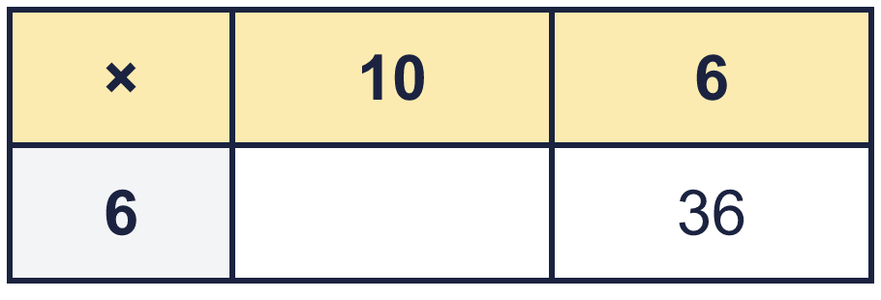
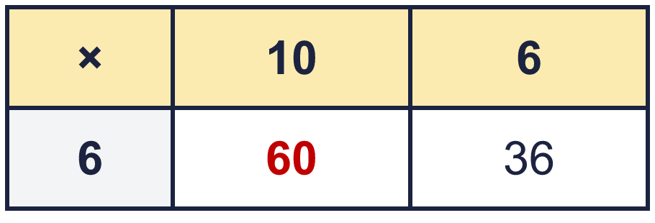
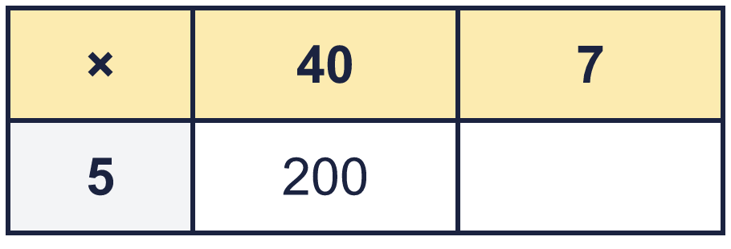
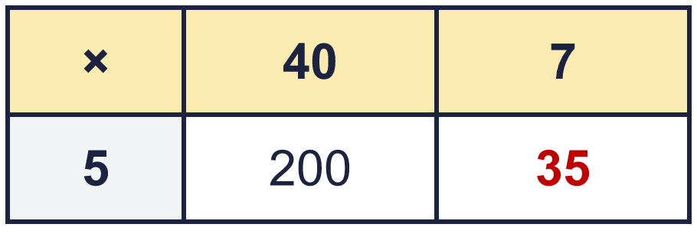
Year 4 · Multiplication and division B · Step 8 · question 6
I do
You do
The area model shows 16 × 6 = 96. Write the missing number.
The area model shows 47 × 5 = 235. Write the missing number.
Missing number: ________
Missing number: ________
60
35
6 of 8
Notes:
Question 6 of 8. I DO: model it out loud, thinking through each step. YOU DO: click the timer (2:30, an estimate) and let pupils try the same type of question with new numbers on their whiteboards. Then click to bring in the answers one at a time: the I do working, the I do answer, then the You do answer. Ask someone who got it wrong to say which step went wrong. Top tip: Answers. I do: 60. You do: 35.

Slide 13

Year 4 · Multiplication and division B · Step 8 · question 7
I do
You do
Write the missing number.
Write the missing number.
a) 12 × ________ = 60
a) 45 × ________ = 225
b) ________ × 5 = 60
b) ________ × 5 = 225
a) 5
b) 12
a) 5
b) 45
7 of 8
Notes:
Question 7 of 8. I DO: model it out loud, thinking through each step. YOU DO: click the timer (3:00, an estimate) and let pupils try the same type of question with new numbers on their whiteboards. Then click to bring in the answers one at a time: the I do working, the I do answer, then the You do answer. Ask someone who got it wrong to say which step went wrong. Top tip: Answers. I do: a) 5 | b) 12. You do: a) 5 | b) 45.

Slide 14
Year 4 · Multiplication and division B · Step 8 · question 8
I do
You do
There are 12 players in a team. 5 teams have signed up for a tournament.
There are 12 players in a team. 4 teams have signed up for a tournament.
a) How many players have signed up? ________
a) How many players have signed up? ________
b) The tournament needs 120 players. How many more teams are needed? _____
b) The tournament needs 84 players. How many more teams are needed? _____
a) 60
b) 5
a) 48
b) 3
8 of 8
Notes:
Question 8 of 8. I DO: model it out loud, thinking through each step. YOU DO: click the timer (4:00, an estimate) and let pupils try the same type of question with new numbers on their whiteboards. Then click to bring in the answers one at a time: the I do working, the I do answer, then the You do answer. Ask someone who got it wrong to say which step went wrong. Top tip: Answers. I do: a) 60 | b) 5. You do: a) 48 | b) 3.

Slide 15


Year 4 · Multiplication and division B · Step 8
Independent application
Challenge
Is Boba correct? Circle yes or no.
What is the correct answer? ________
Explain Boba’s mistake.
Use the Step 8 worksheet.
Finished? Try the challenge.
No 224 32 × 7: 30 × 7 = 210 and 2 × 7 = 14, so the answer is 224. Boba did not count all of the tens.
Notes:
Pupils now work on their own on the Step 8 worksheet from the website (scaffolded or not scaffolded). Click the 20 minute timer to start it. Pupils who finish try the challenge: click to show its answer. The Bobas bounce on their own while the slide is showing. Challenge answers: No | 224 | 32 × 7: 30 × 7 = 210 and 2 × 7 = 14, so the answer is 224. Boba did not count all of the tens.

