Slide 1








Year 4 · Autumn · Place value · Step 4
Thousands
I do, you do, with a timer. The questions get harder as we go.
Notes:
The Bobas are sitting at their desks, floating up and down, ready to learn. Click a timer in slideshow mode to start it.

Slide 2

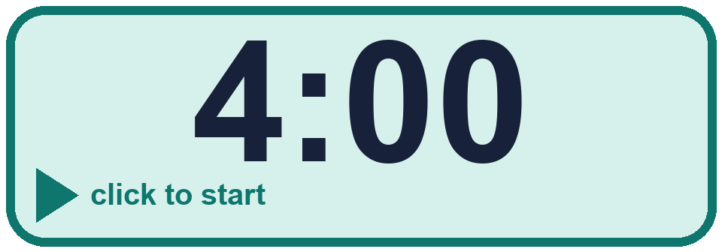
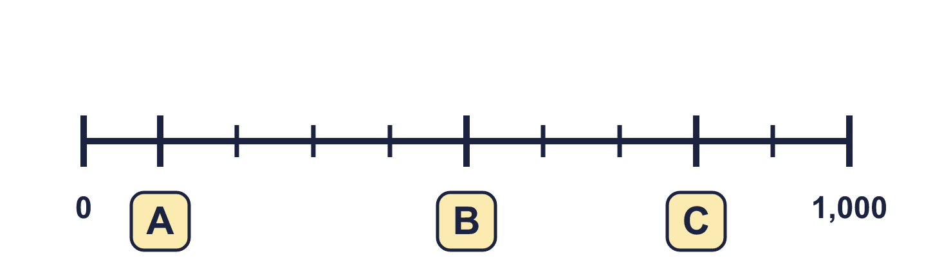
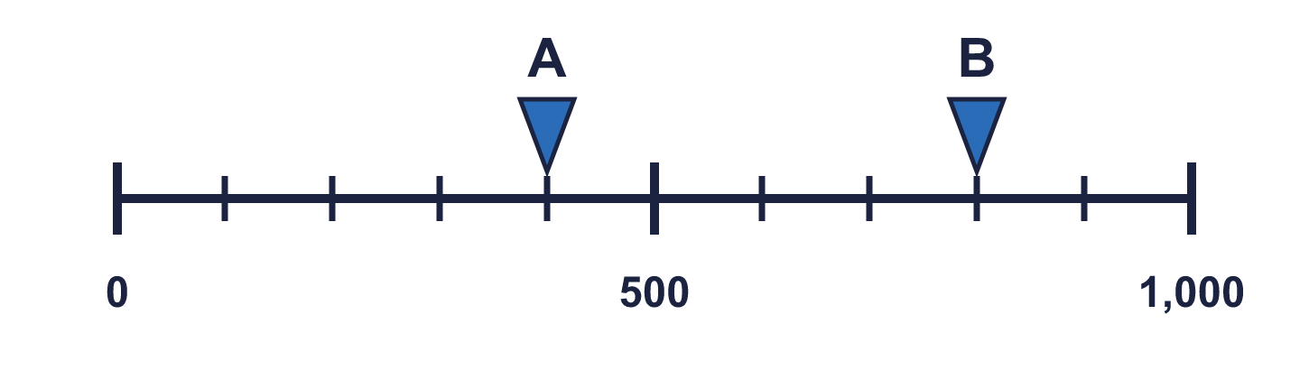
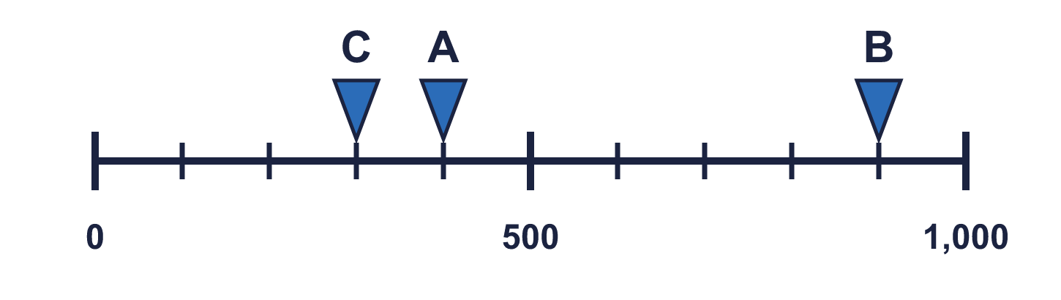
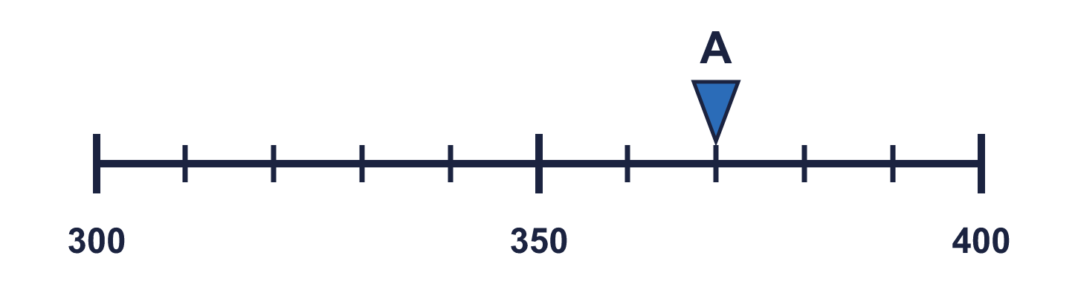
Year 4 · Place value · Step 4
Starter
Last lesson: Number line to 1000
1. Complete the number line.
A = ________ B = ________ C = ________
2. What numbers are the arrows pointing to?
A = ________ B = ________
100, 500, 800
A 400 B 800
3. Which arrow points to 300? Write its letter.
Answer: _____
4. What number is the arrow pointing to?
________
C
370
Notes:
Starter: four quick questions to bring back last lesson (Number line to 1000). Click the timer, let pupils answer on their whiteboards, then click to show each answer in turn.

Slide 3

Year 4 · Place value · Step 4
Today we are learning…
To count in thousands and read and write thousands in numbers and words.
I can…
☐ I can count up and back in thousands.
☐ I can say how many hundreds make a thousand.
☐ I can write thousands as numbers.
☐ I can write thousands in words.
Notes:
Read the objective aloud. Then ask: where might we need this outside school? The success criteria can be turned into a quick check at the end of the lesson.

Slide 4
Year 4 · Place value · Step 4
Key words
thousand
hundred
digit
count
numeral
place value
Notes:
Pupils say each word aloud, then use it in a sentence about today's numbers.

Slide 5

Year 4 · Place value · Step 4
The key ideas
10 hundreds make 1 thousand.
When you count in thousands, only the thousands digit changes: 3,000, 4,000, 5,000.
Say it in words: 6,000 is six thousand.
Notes:
Talk through the picture first: ask pupils what they notice. Then click to bring in each statement, and the words under the picture, one at a time.

Slide 6
Year 4 · Place value · Step 4
Look out for
Count in thousands, not in ones.
A thousand has three zeros.
Check you wrote the comma after the thousands digit.
Notes:
Talk through the picture first: ask pupils what they notice. Then click to bring in each statement, and the words under the picture, one at a time.

Slide 7

Year 4 · Place value · Step 4 · question 1
I do
You do
Count up in thousands. Write the missing numbers.
Count up in thousands. Write the missing numbers.
1,000, 2,000, ____ , 4,000, ____
3,000, 4,000, ____ , 6,000, ____
3,000, 5,000
5,000, 7,000
1 of 8
Notes:
Question 1 of 8. I DO: model it out loud, thinking through each step. YOU DO: click the timer (1:00, an estimate) and let pupils try the same type of question with new numbers on their whiteboards. Then click to bring in the answers one at a time: the I do working, the I do answer, then the You do answer. Ask someone who got it wrong to say which step went wrong. Top tip: Answers. I do: 3,000, 5,000. You do: 5,000, 7,000.

Slide 8
Year 4 · Place value · Step 4 · question 2
I do
You do
Write each number in numerals or in words.
Write each number in numerals or in words.
a) 5,000 = ____________
a) 8,000 = ____________
b) 3,000 = ____________
b) 5,000 = ____________
c) six thousand = ____________
c) three thousand = ____________
a) five thousand
b) three thousand
c) 6,000
a) eight thousand
b) five thousand
c) 3,000
2 of 8
Notes:
Question 2 of 8. I DO: model it out loud, thinking through each step. YOU DO: click the timer (1:00, an estimate) and let pupils try the same type of question with new numbers on their whiteboards. Then click to bring in the answers one at a time: the I do working, the I do answer, then the You do answer. Ask someone who got it wrong to say which step went wrong. Top tip: Answers. I do: a) five thousand | b) three thousand | c) 6,000. You do: a) eight thousand | b) five thousand | c) 3,000.

Slide 9
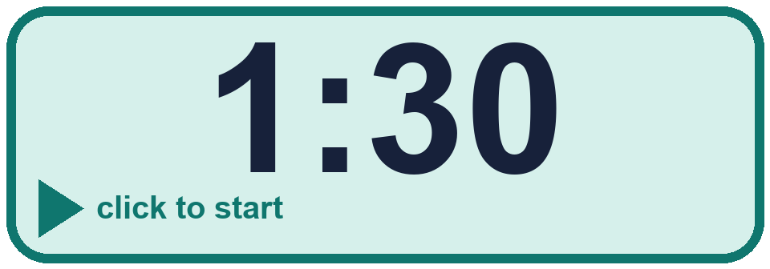
Year 4 · Place value · Step 4 · question 3
I do
You do
Complete the sentences.
Complete the sentences.
a) 5,000 = ____ hundreds
a) 8,000 = ____ hundreds
b) 50 hundreds = ________
b) 40 hundreds = ________
c) 8,000 = ____ hundreds
c) 9,000 = ____ hundreds
a) 50
b) 5,000
c) 80
a) 80
b) 4,000
c) 90
3 of 8
Notes:
Question 3 of 8. I DO: model it out loud, thinking through each step. YOU DO: click the timer (1:30, an estimate) and let pupils try the same type of question with new numbers on their whiteboards. Then click to bring in the answers one at a time: the I do working, the I do answer, then the You do answer. Ask someone who got it wrong to say which step went wrong. Top tip: Answers. I do: a) 50 | b) 5,000 | c) 80. You do: a) 80 | b) 4,000 | c) 90.

Slide 10
Year 4 · Place value · Step 4 · question 4
I do
You do
Write <, > or = in each box.
Write <, > or = in each box.
a) 4 thousands ____ 4,000
a) 3 thousands ____ 3,000
b) 70 hundreds ____ 700
b) 45 hundreds ____ 450
c) 4 thousands ____ 56 hundreds
c) 2 thousands ____ 58 hundreds
a) =
b) >
c) <
a) =
b) >
c) <
4 of 8
Notes:
Question 4 of 8. I DO: model it out loud, thinking through each step. YOU DO: click the timer (1:30, an estimate) and let pupils try the same type of question with new numbers on their whiteboards. Then click to bring in the answers one at a time: the I do working, the I do answer, then the You do answer. Ask someone who got it wrong to say which step went wrong. Top tip: Answers. I do: a) = | b) > | c) <. You do: a) = | b) > | c) <.

Slide 11

Year 4 · Place value · Step 4 · question 5
I do
You do
“My number is 3 thousands and 13 hundreds.”
“My number is 3 thousands and 15 hundreds.”
What number am I thinking of? ________
What number am I thinking of? ________
4,300
4,500
5 of 8
Notes:
Question 5 of 8. I DO: model it out loud, thinking through each step. YOU DO: click the timer (2:00, an estimate) and let pupils try the same type of question with new numbers on their whiteboards. Then click to bring in the answers one at a time: the I do working, the I do answer, then the You do answer. Ask someone who got it wrong to say which step went wrong. Top tip: Answers. I do: 4,300. You do: 4,500.

Slide 12

Year 4 · Place value · Step 4 · question 6
I do
You do
Class 4B fills 3 jars with 1,000 pennies in each jar. They also have 100 spare pennies.
Class 4B fills 5 jars with 1,000 pennies in each jar. They also have 800 spare pennies.
a) How many pennies do they have altogether? ________
a) How many pennies do they have altogether? ________
b) They need 9,000 pennies to buy a game. How many more pennies do they need? ________
b) They need 8,000 pennies to buy a game. How many more pennies do they need? ________
a) 3,100
b) 5,900
a) 5,800
b) 2,200
6 of 8
Notes:
Question 6 of 8. I DO: model it out loud, thinking through each step. YOU DO: click the timer (2:30, an estimate) and let pupils try the same type of question with new numbers on their whiteboards. Then click to bring in the answers one at a time: the I do working, the I do answer, then the You do answer. Ask someone who got it wrong to say which step went wrong. Top tip: Answers. I do: a) 3,100 | b) 5,900. You do: a) 5,800 | b) 2,200.

Slide 13
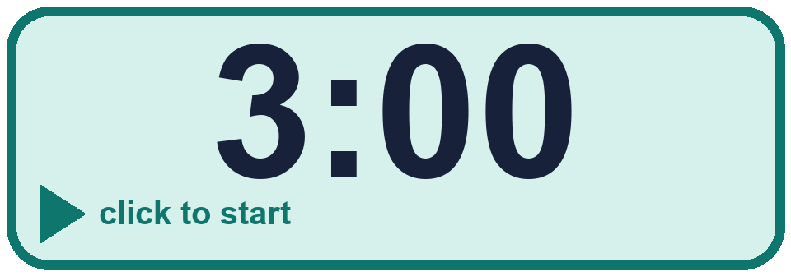
Year 4 · Place value · Step 4 · question 7
I do
You do
Three of these cards show the same number. Which card is different?
Three of these cards show the same number. Which card is different?
a) 7 thousands
a) 9 thousands
b) 7,000
b) 90 hundreds
c) 70 hundreds
c) 90 tens
d) 70 tens
d) 9,000
The different card is ________
The different card is ________
70 tens
90 tens
7 of 8
Notes:
Question 7 of 8. I DO: model it out loud, thinking through each step. YOU DO: click the timer (3:00, an estimate) and let pupils try the same type of question with new numbers on their whiteboards. Then click to bring in the answers one at a time: the I do working, the I do answer, then the You do answer. Ask someone who got it wrong to say which step went wrong. Top tip: Answers. I do: 70 tens. You do: 90 tens.

Slide 14
Year 4 · Place value · Step 4 · question 8
I do
You do
“There are 90 hundreds in 9,000.”
“There are 7 hundreds in 7,000.”
Is Boba correct? Circle yes or no.
Is Boba correct? Circle yes or no.
Explain how you know.
Explain how you know.
Yes
Yes. 1,000 is 10 hundreds, so 9,000 is 90 hundreds.
No
No. 1,000 is 10 hundreds, so 7,000 is 70 hundreds.
8 of 8
Notes:
Question 8 of 8. I DO: model it out loud, thinking through each step. YOU DO: click the timer (4:00, an estimate) and let pupils try the same type of question with new numbers on their whiteboards. Then click to bring in the answers one at a time: the I do working, the I do answer, then the You do answer. Ask someone who got it wrong to say which step went wrong. Top tip: Answers. I do: Yes | Yes. 1,000 is 10 hundreds, so 9,000 is 90 hundreds.. You do: No | No. 1,000 is 10 hundreds, so 7,000 is 70 hundreds..

Slide 15



Year 4 · Place value · Step 4
Independent application
Challenge
Write three different ways to make 8,000 using thousands and hundreds. For example, 6 thousands and 20 hundreds.
Use the Step 4 worksheet.
Finished? Try the challenge.
for example 8 thousands; 80 hundreds; 7 thousands and 10 hundreds
Notes:
Pupils now work on their own on the Step 4 worksheet from the website (scaffolded or not scaffolded). Click the 20 minute timer to start it. Pupils who finish try the challenge: click to show its answer. The Bobas bounce on their own while the slide is showing. Challenge answers: for example 8 thousands; 80 hundreds; 7 thousands and 10 hundreds

