Slide 1






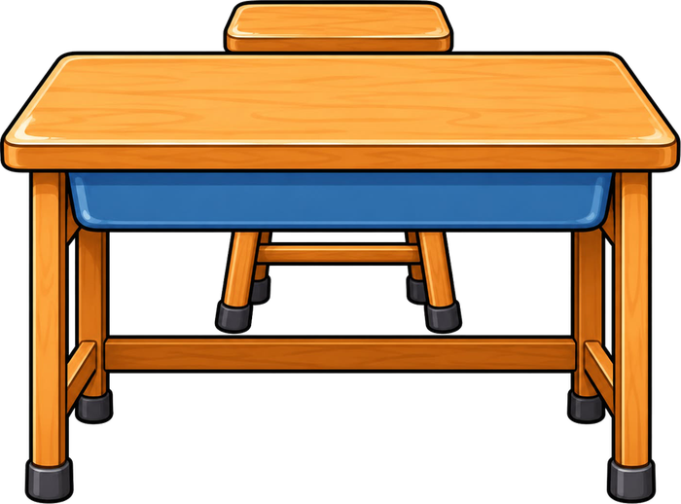

Year 4 · Autumn · Place value · Step 17
Round to the nearest 10, 100 or 1,000
I do, you do, with a timer. The questions get harder as we go.
Notes:
The Bobas are sitting at their desks, floating up and down, ready to learn. Click a timer in slideshow mode to start it.

Slide 2

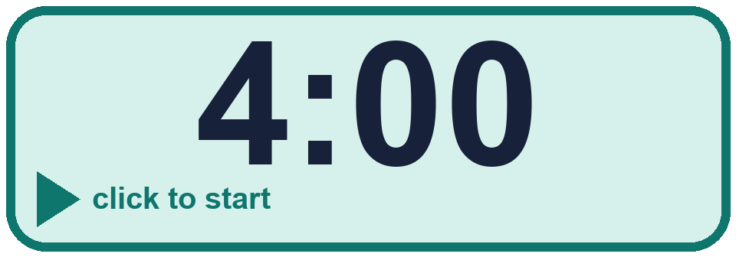
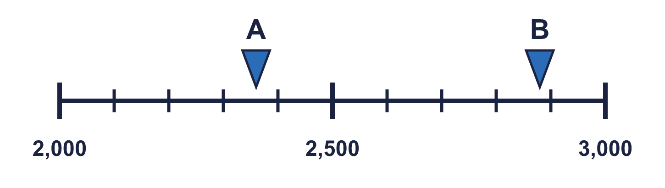
Year 4 · Place value · Step 17
Starter
Last lesson: Round to the nearest 1,000
1. Round 1,100 to each place.
a) the nearest 10 = ________
b) the nearest 100 = ________
c) the nearest 1,000 = ________
2. The arrows show two numbers: A is 2,360 and B is 2,880. Round each to the nearest 1,000.
A rounds to _____ B rounds to _____
a) 1,100 b) 1,100 c) 1,000
A 2,000 B 3,000
Notes:
Starter: four quick questions to bring back last lesson (Round to the nearest 1,000). Click the timer, let pupils answer on their whiteboards, then click to show each answer in turn.

Slide 3

Year 4 · Place value · Step 17
Today we are learning…
To choose whether to round to the nearest 10, 100 or 1,000.
I can…
☐ I can round one number to 10, 100 and 1,000.
☐ I can choose the place to round to.
☐ I can compare the three answers.
☐ I can use rounding to estimate.
Notes:
Read the objective aloud. Then ask: where might we need this outside school? The success criteria can be turned into a quick check at the end of the lesson.

Slide 4
Year 4 · Place value · Step 17
Key words
round
nearest
ten
hundred
thousand
estimate
Notes:
Pupils say each word aloud, then use it in a sentence about today's numbers.

Slide 5
Year 4 · Place value · Step 17
The key ideas
Look at the digit to the right of the place you are rounding to.
0 to 4 rounds down. 5 to 9 rounds up.
One number can round to three different answers.
Notes:
Talk through the picture first: ask pupils what they notice. Then click to bring in each statement, and the words under the picture, one at a time.

Slide 6

Year 4 · Place value · Step 17
Look out for
Check which place you are rounding to.
Fill the other places with zeros.
Check halfway numbers round up.
Notes:
Talk through the picture first: ask pupils what they notice. Then click to bring in each statement, and the words under the picture, one at a time.

Slide 7

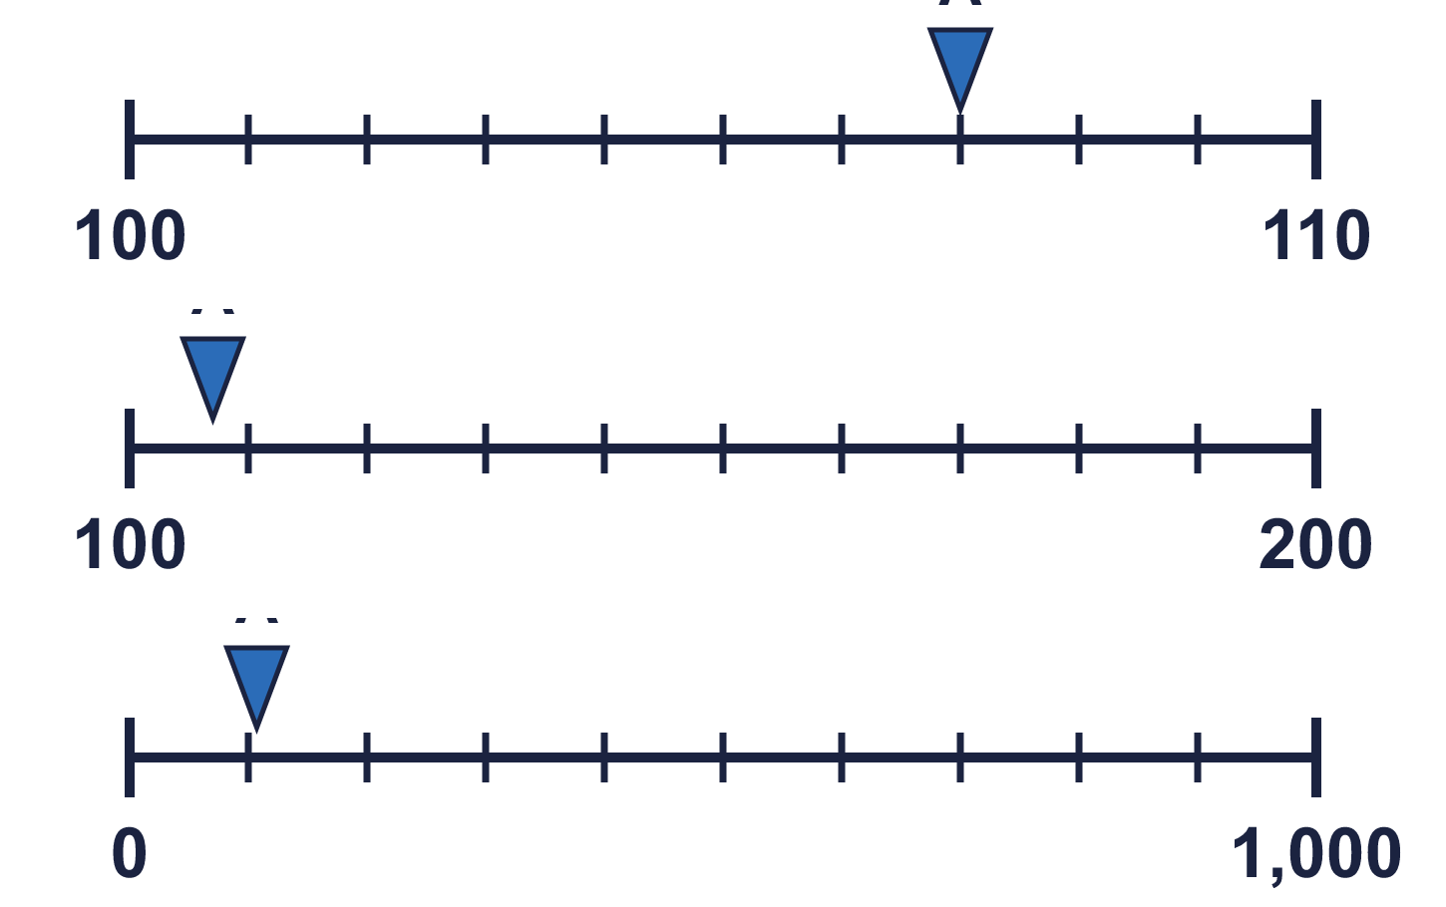
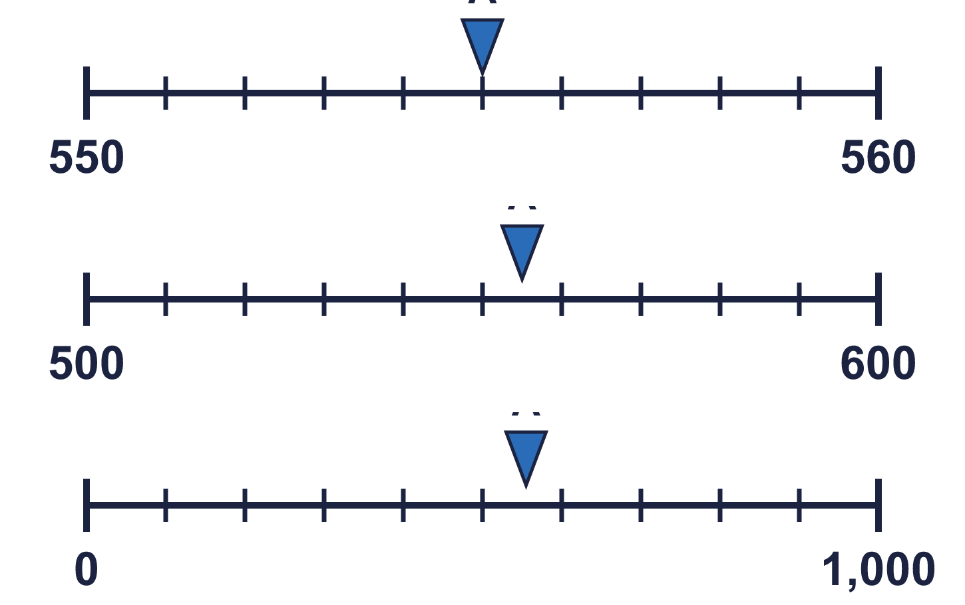
Year 4 · Place value · Step 17 · question 1
I do
You do
The arrow shows 107 on each number line. Complete the sentences.
The arrow shows 555 on each number line. Complete the sentences.
a) 107 rounded to the nearest 10 is ________
a) 555 rounded to the nearest 10 is ________
b) 107 rounded to the nearest 100 is ________
b) 555 rounded to the nearest 100 is ________
c) 107 rounded to the nearest 1,000 is ________
c) 555 rounded to the nearest 1,000 is ________
a) 110
b) 100
c) 0
a) 560
b) 600
c) 1,000
1 of 8
Notes:
Question 1 of 8. I DO: model it out loud, thinking through each step. YOU DO: click the timer (1:00, an estimate) and let pupils try the same type of question with new numbers on their whiteboards. Then click to bring in the answers one at a time: the I do working, the I do answer, then the You do answer. Ask someone who got it wrong to say which step went wrong. Top tip: Answers. I do: a) 110 | b) 100 | c) 0. You do: a) 560 | b) 600 | c) 1,000.

Slide 8
Year 4 · Place value · Step 17 · question 2
I do
You do
Complete the sentences.
Complete the sentences.
a) 526 rounded to the nearest 100 is ________
a) 742 rounded to the nearest 100 is ________
b) 9,200 rounded to the nearest 100 is ________
b) 2,041 rounded to the nearest 100 is ________
c) 9,450 rounded to the nearest 10 is ________
c) 3,835 rounded to the nearest 10 is ________
d) 7,539 rounded to the nearest 1,000 is ________
d) 9,114 rounded to the nearest 1,000 is ________
e) 6,940 rounded to the nearest 10 is ________
e) 1,058 rounded to the nearest 10 is ________
f) 8,205 rounded to the nearest 1,000 is ________
f) 2,368 rounded to the nearest 1,000 is ________
a) 500
b) 9,200
c) 9,450
d) 8,000
e) 6,940
f) 8,000
a) 700
b) 2,000
c) 3,840
d) 9,000
e) 1,060
f) 2,000
2 of 8
Notes:
Question 2 of 8. I DO: model it out loud, thinking through each step. YOU DO: click the timer (1:00, an estimate) and let pupils try the same type of question with new numbers on their whiteboards. Then click to bring in the answers one at a time: the I do working, the I do answer, then the You do answer. Ask someone who got it wrong to say which step went wrong. Top tip: Answers. I do: a) 500 | b) 9,200 | c) 9,450 | d) 8,000 | e) 6,940 | f) 8,000. You do: a) 700 | b) 2,000 | c) 3,840 | d) 9,000 | e) 1,060 | f) 2,000.

Slide 9
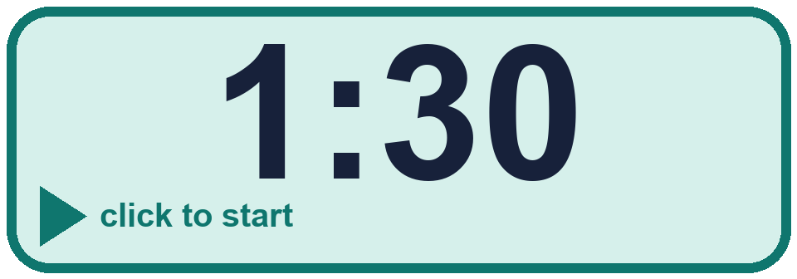
Year 4 · Place value · Step 17 · question 3
I do
You do
Circle the numbers that round to 5,000 to the nearest 1,000. Write their letters.
Circle the numbers that round to 2,000 to the nearest 1,000. Write their letters.
a) 4,635
a) 3,405
b) 4,500
b) 1,500
c) 3,589
c) 2,412
d) 5,055
d) 2,500
e) 6,122
e) 1,510
f) 5,500
f) 570
________
________
a, b, d
b, c, e
3 of 8
Notes:
Question 3 of 8. I DO: model it out loud, thinking through each step. YOU DO: click the timer (1:30, an estimate) and let pupils try the same type of question with new numbers on their whiteboards. Then click to bring in the answers one at a time: the I do working, the I do answer, then the You do answer. Ask someone who got it wrong to say which step went wrong. Top tip: Answers. I do: a, b, d. You do: b, c, e.

Slide 10
Year 4 · Place value · Step 17 · question 4
I do
You do
Round each number to the nearest 100.
Round each number to the nearest 1,000.
a) 8,076 to the nearest 100 = ________
a) 4,838 to the nearest 1,000 = ________
b) 7,647 to the nearest 100 = ________
c) 8,397 to the nearest 100 = ________
b) 2,483 to the nearest 1,000 = ________
c) 5,779 to the nearest 1,000 = ________
a) 8,100
b) 7,600
c) 8,400
a) 5,000
b) 2,000
c) 6,000
4 of 8
Notes:
Question 4 of 8. I DO: model it out loud, thinking through each step. YOU DO: click the timer (1:30, an estimate) and let pupils try the same type of question with new numbers on their whiteboards. Then click to bring in the answers one at a time: the I do working, the I do answer, then the You do answer. Ask someone who got it wrong to say which step went wrong. Top tip: Answers. I do: a) 8,100 | b) 7,600 | c) 8,400. You do: a) 5,000 | b) 2,000 | c) 6,000.

Slide 11

Year 4 · Place value · Step 17 · question 5
I do
You do
“2,857 rounded to the nearest 100 is 2,800.”
“4,181 rounded to the nearest 100 is 4,100.”
Is Boba correct? Circle yes or no.
Is Boba correct? Circle yes or no.
Explain how you know.
Explain how you know.
No
The digit to the right of the rounding column is 5, which is 5 or more, so we round up. 2,857 rounds to 2,900, not 2,800.
No
The digit to the right of the rounding column is 8, which is 5 or more, so we round up. 4,181 rounds to 4,200, not 4,100.
5 of 8
Notes:
Question 5 of 8. I DO: model it out loud, thinking through each step. YOU DO: click the timer (2:00, an estimate) and let pupils try the same type of question with new numbers on their whiteboards. Then click to bring in the answers one at a time: the I do working, the I do answer, then the You do answer. Ask someone who got it wrong to say which step went wrong. Top tip: Answers. I do: No | The digit to the right of the rounding column is 5, which is 5 or more, so we round up. 2,857 rounds to 2,900, not 2,800.. You do: No | The digit to the right of the rounding column is 8, which is 5 or more, so we round up. 4,181 rounds to 4,200, not 4,100..

Slide 12

Year 4 · Place value · Step 17 · question 6
I do
You do
7,359 fans attend a music concert.
9,723 fans attend a music concert.
a) Round it to the nearest 10 ________
a) Round it to the nearest 10 ________
b) Round it to the nearest 100 ________
b) Round it to the nearest 100 ________
c) Round it to the nearest 1,000 ________
c) Round it to the nearest 1,000 ________
d) The organiser keeps a record of the approximate number of fans at each concert. Which place is the most appropriate? Write 10, 100 or 1,000. _____
d) The organiser keeps a record of the approximate number of fans at each concert. Which place is the most appropriate? Write 10, 100 or 1,000. _____
a) 7,360
b) 7,400
c) 7,000
d) 100
a) 9,720
b) 9,700
c) 10,000
d) 100
6 of 8
Notes:
Question 6 of 8. I DO: model it out loud, thinking through each step. YOU DO: click the timer (2:30, an estimate) and let pupils try the same type of question with new numbers on their whiteboards. Then click to bring in the answers one at a time: the I do working, the I do answer, then the You do answer. Ask someone who got it wrong to say which step went wrong. Top tip: Answers. I do: a) 7,360 | b) 7,400 | c) 7,000 | d) 100. You do: a) 9,720 | b) 9,700 | c) 10,000 | d) 100.

Slide 13
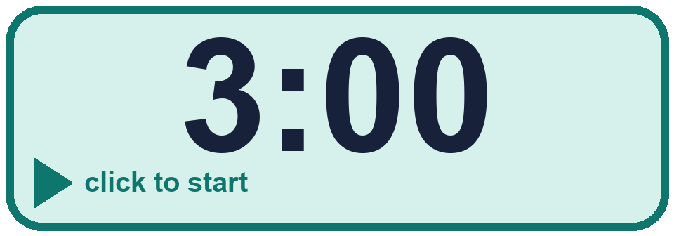
Year 4 · Place value · Step 17 · question 7
I do
You do
Write a number that rounds to 5,700 to the nearest 100 and to 6,000 to the nearest 1,000.
Write a number that rounds to 4,900 to the nearest 100 and to 5,000 to the nearest 1,000.
Any number from 5,650 to 5,749, for example 5,699
Any number from 4,850 to 4,949, for example 4,899
7 of 8
Notes:
Question 7 of 8. I DO: model it out loud, thinking through each step. YOU DO: click the timer (3:00, an estimate) and let pupils try the same type of question with new numbers on their whiteboards. Then click to bring in the answers one at a time: the I do working, the I do answer, then the You do answer. Ask someone who got it wrong to say which step went wrong. Top tip: Answers. I do: Any number from 5,650 to 5,749, for example 5,699. You do: Any number from 4,850 to 4,949, for example 4,899.

Slide 14
Year 4 · Place value · Step 17 · question 8
I do
You do
Write a number that rounds to 7,880 to the nearest 10 and to 7,900 to the nearest 100.
Write a number that rounds to 4,290 to the nearest 10 and to 4,300 to the nearest 100.
Any number from 7,875 to 7,884, for example 7,879
Any number from 4,285 to 4,294, for example 4,289
8 of 8
Notes:
Question 8 of 8. I DO: model it out loud, thinking through each step. YOU DO: click the timer (4:00, an estimate) and let pupils try the same type of question with new numbers on their whiteboards. Then click to bring in the answers one at a time: the I do working, the I do answer, then the You do answer. Ask someone who got it wrong to say which step went wrong. Top tip: Answers. I do: Any number from 7,875 to 7,884, for example 7,879. You do: Any number from 4,285 to 4,294, for example 4,289.

Slide 15
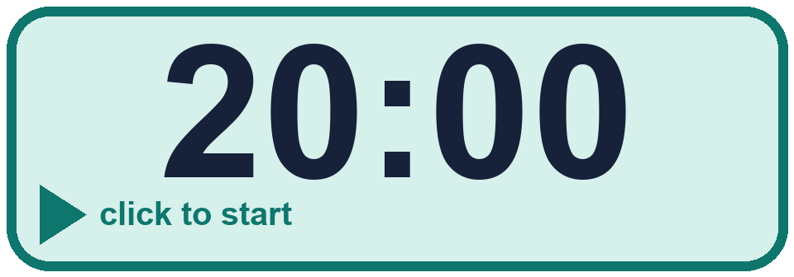


Year 4 · Place value · Step 17
Independent application
Challenge
A whole number rounds to 8,000 to the nearest 1,000.
a) What is the greatest it could be? ________
b) What is the smallest it could be? ________
Use the Step 17 worksheet.
Finished? Try the challenge.
a) 8,499 b) 7,500
Notes:
Pupils now work on their own on the Step 17 worksheet from the website (scaffolded or not scaffolded). Click the 20 minute timer to start it. Pupils who finish try the challenge: click to show its answer. The Bobas bounce on their own while the slide is showing. Challenge answers: a) 8,499 | b) 7,500

