Slide 1








Year 4 · Autumn · Place value · Step 13
Roman numerals
I do, you do, with a timer. The questions get harder as we go.
Notes:
The Bobas are sitting at their desks, floating up and down, ready to learn. Click a timer in slideshow mode to start it.

Slide 2


Year 4 · Place value · Step 13
Starter
Last lesson: Order numbers to 10,000
1. Write the numbers in order. Start with the greatest number.
6,640 6,660 6,510
____________________
2. Circle the greatest number. Write it.
a) 9,205 4,906 6,430 5,035 ________
6,660, 6,640, 6,510
a) 9,205
3. Write the numbers in order.
a) smallest first: 2,893 513 4,739 1,271 439
____________________
439, 513, 1,271, 2,893, 4,739
Notes:
Starter: four quick questions to bring back last lesson (Order numbers to 10,000). Click the timer, let pupils answer on their whiteboards, then click to show each answer in turn.

Slide 3

Year 4 · Place value · Step 13
Today we are learning…
To read and write Roman numerals up to 100.
I can…
☐ I can read the Roman numeral symbols I, V, X, L and C.
☐ I can write numbers up to 100 as Roman numerals.
☐ I can read Roman numerals as numbers.
☐ I can use Roman numerals in a sentence.
Notes:
Read the objective aloud. Then ask: where might we need this outside school? The success criteria can be turned into a quick check at the end of the lesson.

Slide 4
Year 4 · Place value · Step 13
Key words
Roman numeral
symbol
add
subtract
numeral
value
Notes:
Pupils say each word aloud, then use it in a sentence about today's numbers.

Slide 5
Year 4 · Place value · Step 13
The key ideas
I = 1, V = 5, X = 10, L = 50, C = 100.
Add symbols from biggest to smallest: XVI = 16.
A smaller symbol before a bigger one is taken away: IV = 4 and IX = 9.
Notes:
Talk through the picture first: ask pupils what they notice. Then click to bring in each statement, and the words under the picture, one at a time.

Slide 6

Year 4 · Place value · Step 13
Look out for
Never write the same symbol more than three times in a row.
Only I, X and C can go before a bigger symbol.
Read left to right.
Notes:
Talk through the picture first: ask pupils what they notice. Then click to bring in each statement, and the words under the picture, one at a time.

Slide 7


Year 4 · Place value · Step 13 · question 1
I do
You do
Write each Roman numeral as a number.
Write each Roman numeral as a number.
a) XIX = _____
a) XVI = _____
b) XXIX = _____
b) XXXIV = _____
c) XXXIX = _____
c) XXXVI = _____
a) 19
b) 29
c) 39
a) 16
b) 34
c) 36
1 of 8
Notes:
Question 1 of 8. I DO: model it out loud, thinking through each step. YOU DO: click the timer (1:00, an estimate) and let pupils try the same type of question with new numbers on their whiteboards. Then click to bring in the answers one at a time: the I do working, the I do answer, then the You do answer. Ask someone who got it wrong to say which step went wrong. Top tip: Answers. I do: a) 19 | b) 29 | c) 39. You do: a) 16 | b) 34 | c) 36.

Slide 8
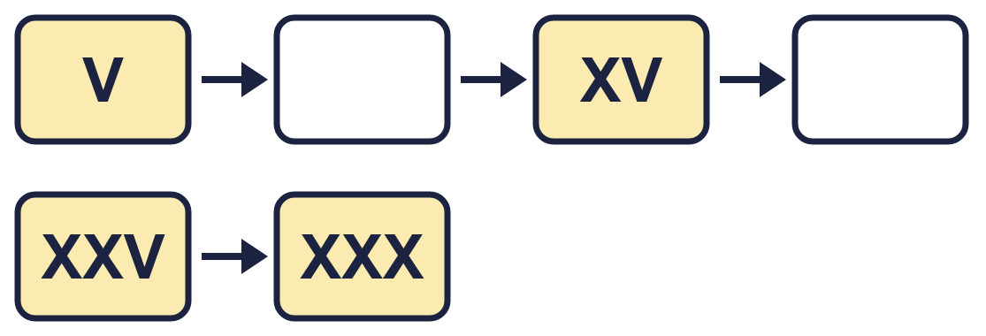
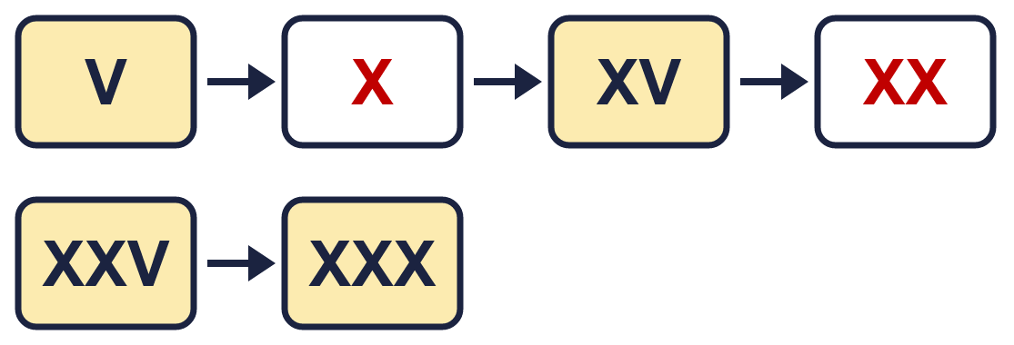
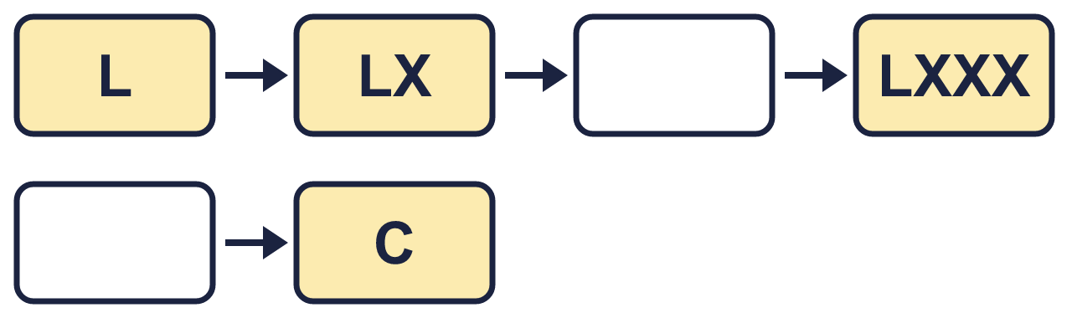
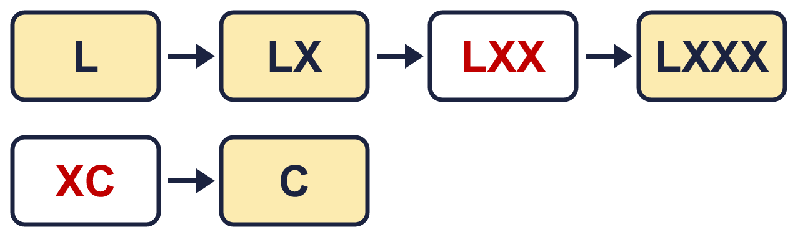
Year 4 · Place value · Step 13 · question 2
I do
You do
Complete the Roman numeral number track.
Complete the Roman numeral number track.
2 of 8
Notes:
Question 2 of 8. I DO: model it out loud, thinking through each step. YOU DO: click the timer (1:00, an estimate) and let pupils try the same type of question with new numbers on their whiteboards. Then click to bring in the answers one at a time: the I do working, the I do answer, then the You do answer. Ask someone who got it wrong to say which step went wrong. Top tip: Answers. I do: . You do: .

Slide 9

Year 4 · Place value · Step 13 · question 3
I do
You do
Write each number in Roman numerals.
Write each number in Roman numerals.
a) fifty-eight = ________
a) ninety-five = ________
b) nineteen = ________
b) eighty-two = ________
c) thirty-six = ________
c) sixty-nine = ________
a) LVIII
b) XIX
c) XXXVI
a) XCV
b) LXXXII
c) LXIX
3 of 8
Notes:
Question 3 of 8. I DO: model it out loud, thinking through each step. YOU DO: click the timer (1:30, an estimate) and let pupils try the same type of question with new numbers on their whiteboards. Then click to bring in the answers one at a time: the I do working, the I do answer, then the You do answer. Ask someone who got it wrong to say which step went wrong. Top tip: Answers. I do: a) LVIII | b) XIX | c) XXXVI. You do: a) XCV | b) LXXXII | c) LXIX.

Slide 10
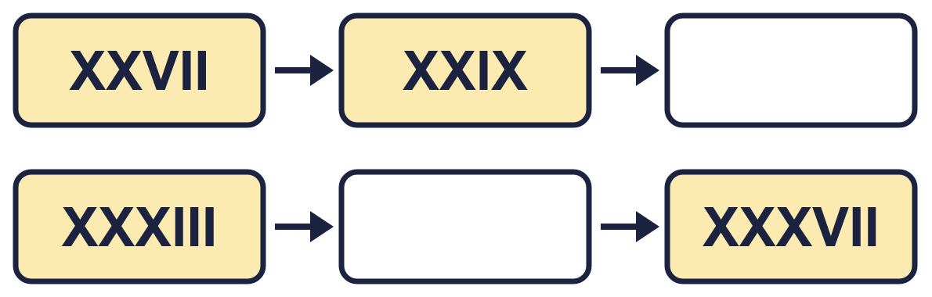
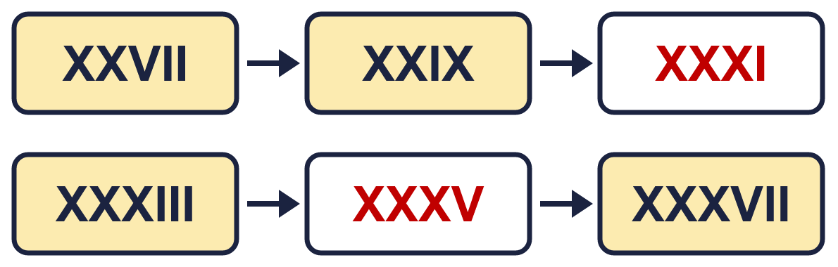
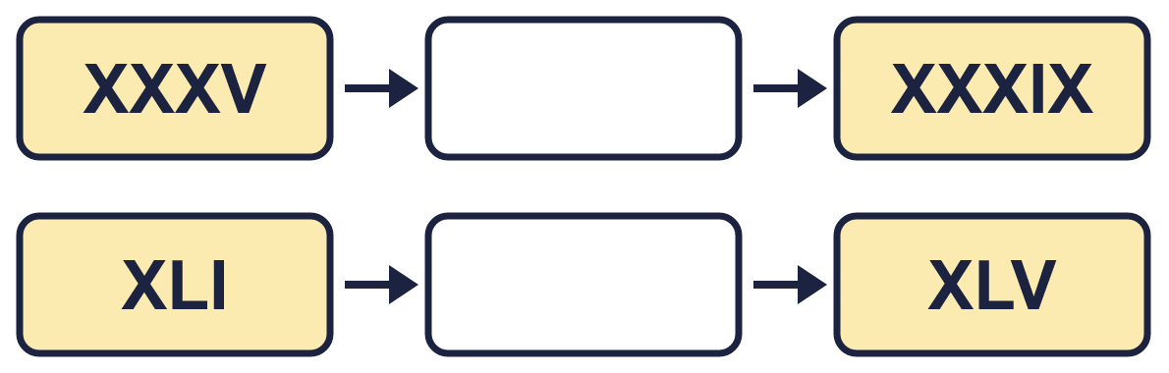
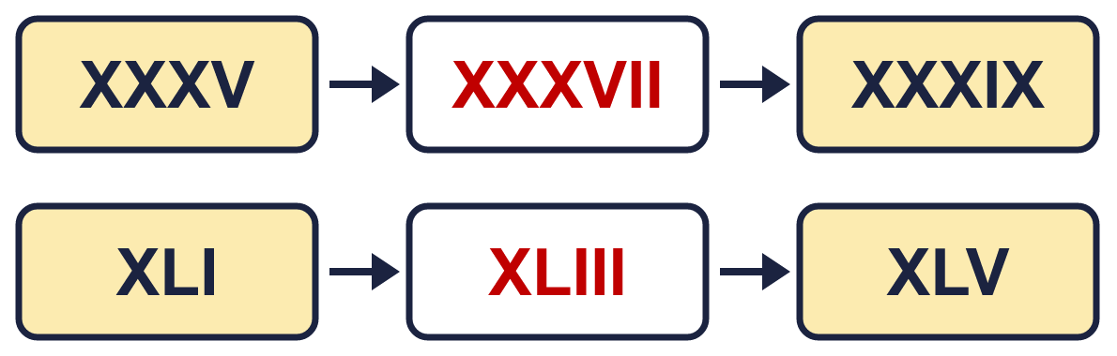
Year 4 · Place value · Step 13 · question 4
I do
You do
House numbers go up in 2s. Complete the Roman numeral number track.
House numbers go up in 2s. Complete the Roman numeral number track.
4 of 8
Notes:
Question 4 of 8. I DO: model it out loud, thinking through each step. YOU DO: click the timer (1:30, an estimate) and let pupils try the same type of question with new numbers on their whiteboards. Then click to bring in the answers one at a time: the I do working, the I do answer, then the You do answer. Ask someone who got it wrong to say which step went wrong. Top tip: Answers. I do: . You do: .

Slide 11

Year 4 · Place value · Step 13 · question 5
I do
You do
“Callum writes 78 as XLXVIII. Hana writes 78 as LXXVIII.”
“Callum writes 77 as XLXVII. Theo writes 77 as LXXVII.”
a) Who is correct? ________
a) Who is correct? ________
b) What mistake has the other child made?
b) What mistake has the other child made?
Explain how you know.
Explain how you know.
a) Hana
Callum wrote the smaller letter first. In XLXVIII the X is smaller than the L, and XL is not one of the special pairs (IV, IX, XL, XC). The biggest letter comes first, so 78 is LXXVIII.
a) Theo
Callum wrote the smaller letter first. In XLXVII the X is smaller than the L, and XL is not one of the special pairs (IV, IX, XL, XC). The biggest letter comes first, so 77 is LXXVII.
5 of 8
Notes:
Question 5 of 8. I DO: model it out loud, thinking through each step. YOU DO: click the timer (2:00, an estimate) and let pupils try the same type of question with new numbers on their whiteboards. Then click to bring in the answers one at a time: the I do working, the I do answer, then the You do answer. Ask someone who got it wrong to say which step went wrong. Top tip: Answers. I do: a) Hana | Callum wrote the smaller letter first. In XLXVIII the X is smaller than the L, and XL is not one of the special pairs (IV, IX, XL, XC). The biggest letter comes first, so 78 is LXXVIII.. You do: a) Theo | Callum wrote the smaller letter first. In XLXVII the X is smaller than the L, and XL is not one of the special pairs (IV, IX, XL, XC). The biggest letter comes first, so 77 is LXXVII..

Slide 12

Year 4 · Place value · Step 13 · question 6
I do
You do
Put these Roman numerals in order. Start with the smallest.
Put these Roman numerals in order. Start with the largest.
XCVIII LX XXII XL
XXX LXXVIII LXIX XVIII
____________________
____________________
XXII, XL, LX, XCVIII
LXXVIII, LXIX, XXX, XVIII
6 of 8
Notes:
Question 6 of 8. I DO: model it out loud, thinking through each step. YOU DO: click the timer (2:30, an estimate) and let pupils try the same type of question with new numbers on their whiteboards. Then click to bring in the answers one at a time: the I do working, the I do answer, then the You do answer. Ask someone who got it wrong to say which step went wrong. Top tip: Answers. I do: XXII, XL, LX, XCVIII. You do: LXXVIII, LXIX, XXX, XVIII.

Slide 13

Year 4 · Place value · Step 13 · question 7
I do
You do
“Malachi lives at house LXXIX. House numbers go up in 2s.”
“Zach lives at house LIII. House numbers go up in 2s.”
a) What number does Malachi live at? _____
a) What number does Zach live at? _____
b) The house 4 doors further up is number... (write it in Roman numerals) ________
b) The house 2 doors further up is number... (write it in Roman numerals) ________
a) 79
b) LXXXIII
a) 53
b) LXI
7 of 8
Notes:
Question 7 of 8. I DO: model it out loud, thinking through each step. YOU DO: click the timer (3:00, an estimate) and let pupils try the same type of question with new numbers on their whiteboards. Then click to bring in the answers one at a time: the I do working, the I do answer, then the You do answer. Ask someone who got it wrong to say which step went wrong. Top tip: Answers. I do: a) 79 | b) LXXXIII. You do: a) 53 | b) LXI.

Slide 14
Year 4 · Place value · Step 13 · question 8
I do
You do
“I wrote 94 as LXXXXIIII.”
“I wrote 59 as LVIIII.”
a) Write the number the standard way. ________
a) Write the number the standard way. ________
b) Explain what Boba did.
b) Explain what Boba did.
a) XCIV
Boba added the letters without using the shorter forms. We write 4 as IV, 9 as IX, 40 as XL and 90 as XC. 94 is XCIV.
a) LIX
Boba added the letters without using the shorter forms. We write 4 as IV, 9 as IX, 40 as XL and 90 as XC. 59 is LIX.
8 of 8
Notes:
Question 8 of 8. I DO: model it out loud, thinking through each step. YOU DO: click the timer (4:00, an estimate) and let pupils try the same type of question with new numbers on their whiteboards. Then click to bring in the answers one at a time: the I do working, the I do answer, then the You do answer. Ask someone who got it wrong to say which step went wrong. Top tip: Answers. I do: a) XCIV | Boba added the letters without using the shorter forms. We write 4 as IV, 9 as IX, 40 as XL and 90 as XC. 94 is XCIV.. You do: a) LIX | Boba added the letters without using the shorter forms. We write 4 as IV, 9 as IX, 40 as XL and 90 as XC. 59 is LIX..

Slide 15


Year 4 · Place value · Step 13
Independent application
Challenge
Write three different Roman numerals that are greater than XXX and less than L.
Use the Step 13 worksheet.
Finished? Try the challenge.
Any three correct numerals, for example XXXIII, XLI, XLVII
Notes:
Pupils now work on their own on the Step 13 worksheet from the website (scaffolded or not scaffolded). Click the 20 minute timer to start it. Pupils who finish try the challenge: click to show its answer. The Bobas bounce on their own while the slide is showing. Challenge answers: Any three correct numerals, for example XXXIII, XLI, XLVII

