Slide 1






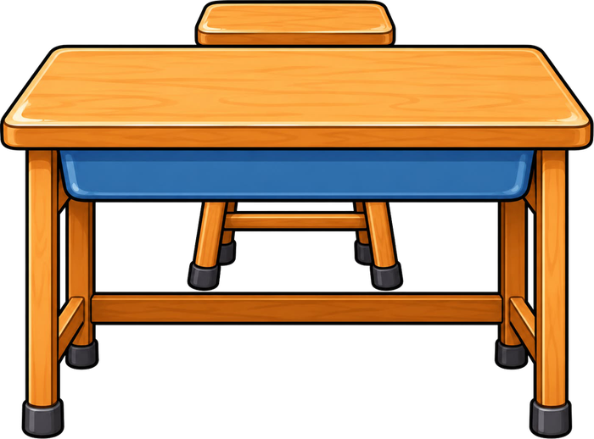

Year 4 · Autumn · Place value · Step 1
Represent numbers to 1000
I do, you do, with a timer. The questions get harder as we go.
Notes:
The Bobas are sitting at their desks, floating up and down, ready to learn. Click a timer in slideshow mode to start it.

Slide 2

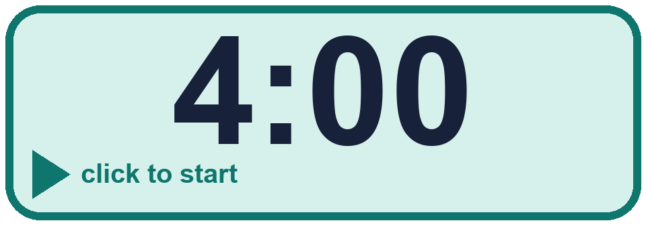
Year 4 · Place value · Step 1
Starter
Last lesson: Count in 50s
1. Count in 50s. Write the missing numbers.
150, ____ , 250, ____ , 350, 400
2. Count back in 50s. Write the missing numbers.
700, 650, 600, ____ , ____ , 450
200, 300
550, 500
3. Write the numbers you say when you count in 50s from 0.
150 300 75 120 50
Numbers: ____________
4. Work out each answer.
a) 50 more than 350 = ____
b) 50 less than 550 = ____
c) 50 more than 450 = ____
150, 300, 50
a) 400 b) 500 c) 500
Notes:
Starter: four quick questions to bring back last lesson (Count in 50s). Click the timer, let pupils answer on their whiteboards, then click to show each answer in turn.

Slide 3

Year 4 · Place value · Step 1
Today we are learning…
To read and make numbers up to 1,000 using blocks and place value charts.
I can…
☐ I can read a 3-digit number from base ten blocks.
☐ I can make a number with hundreds, tens and ones.
☐ I can read a place value chart.
☐ I can write the number in digits.
Notes:
Read the objective aloud. Then ask: where might we need this outside school? The success criteria can be turned into a quick check at the end of the lesson.

Slide 4
Year 4 · Place value · Step 1
Key words
hundreds
tens
ones
digit
place value
base ten
Notes:
Pupils say each word aloud, then use it in a sentence about today's numbers.

Slide 5

Year 4 · Place value · Step 1
The key ideas
A 3-digit number has hundreds, tens and ones.
243 is 2 hundreds, 4 tens and 3 ones.
Use 0 when a place is empty.
Notes:
Talk through the picture first: ask pupils what they notice. Then click to bring in each statement, and the words under the picture, one at a time.

Slide 6
Year 4 · Place value · Step 1
Look out for
Start with the hundreds.
Use 0 for empty places.
Count the blocks carefully.
Notes:
Talk through the picture first: ask pupils what they notice. Then click to bring in each statement, and the words under the picture, one at a time.

Slide 7


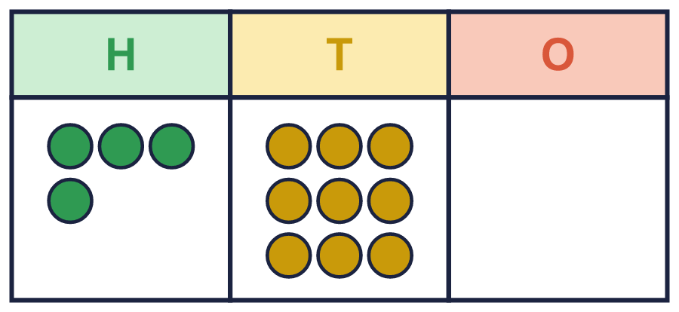
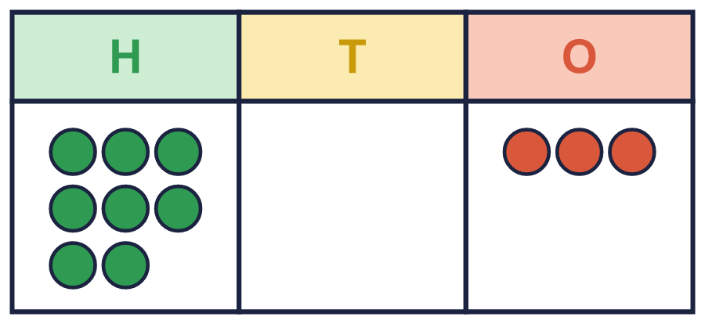
Year 4 · Place value · Step 1 · question 1
I do
You do
What number is shown in the place value chart?
What number is shown in the place value chart?
The number is ____
The number is ____
490
803
1 of 8
Notes:
Question 1 of 8. I DO: model it out loud, thinking through each step. YOU DO: click the timer (1:00, an estimate) and let pupils try the same type of question with new numbers on their whiteboards. Then click to bring in the answers one at a time: the I do working, the I do answer, then the You do answer. Ask someone who got it wrong to say which step went wrong. Top tip: Answers. I do: 490. You do: 803.

Slide 8
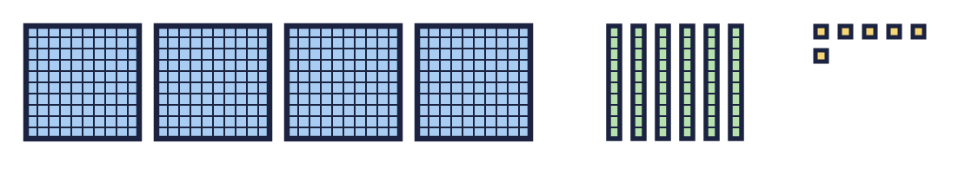
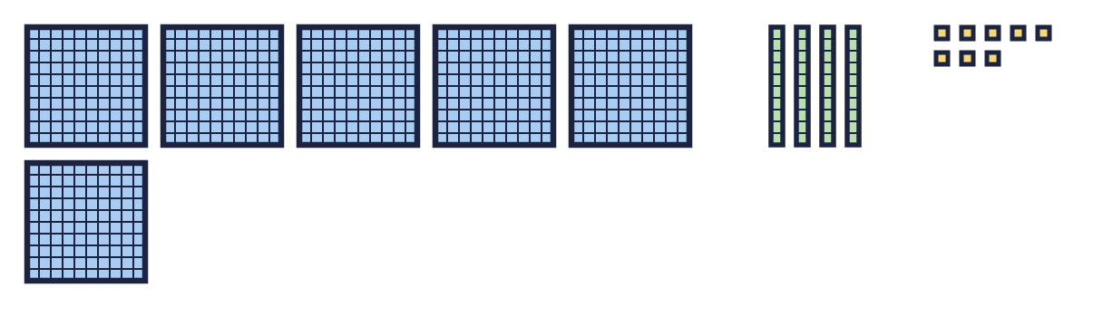
Year 4 · Place value · Step 1 · question 2
I do
You do
Here are some sweets, shown with base ten blocks. Ben takes 199 of the sweets.
Here are some sweets, shown with base ten blocks. Ben takes 548 of the sweets.
a) How many sweets are there? ________
a) How many sweets are there? ________
b) Kim takes the rest. How many sweets does Kim take? ________
b) Kim takes the rest. How many sweets does Kim take? ________
a) 466
b) 267
a) 648
b) 100
2 of 8
Notes:
Question 2 of 8. I DO: model it out loud, thinking through each step. YOU DO: click the timer (1:00, an estimate) and let pupils try the same type of question with new numbers on their whiteboards. Then click to bring in the answers one at a time: the I do working, the I do answer, then the You do answer. Ask someone who got it wrong to say which step went wrong. Top tip: Answers. I do: a) 466 | b) 267. You do: a) 648 | b) 100.

Slide 9
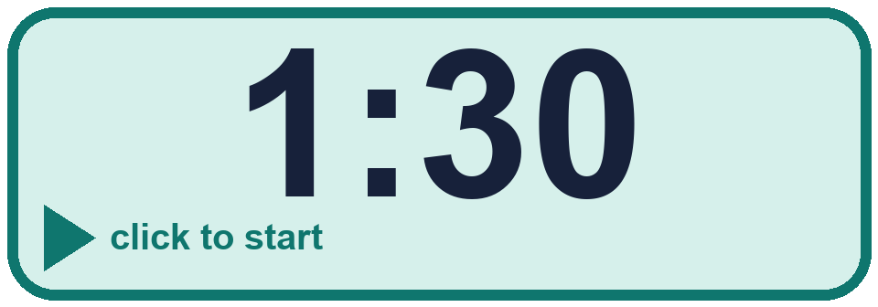
Year 4 · Place value · Step 1 · question 3
I do
You do
Write each number.
Write each number.
a) 9 hundreds, 0 tens and 4 ones = ____
a) 5 hundreds, 0 tens and 5 ones = ____
b) 5 hundreds, 5 tens and 0 ones = ____
b) 5 hundreds, 3 tens and 0 ones = ____
c) 9 hundreds, 7 tens and 1 one = ____
c) 8 hundreds, 5 tens and 9 ones = ____
a) 904
b) 550
c) 971
a) 505
b) 530
c) 859
3 of 8
Notes:
Question 3 of 8. I DO: model it out loud, thinking through each step. YOU DO: click the timer (1:30, an estimate) and let pupils try the same type of question with new numbers on their whiteboards. Then click to bring in the answers one at a time: the I do working, the I do answer, then the You do answer. Ask someone who got it wrong to say which step went wrong. Top tip: Answers. I do: a) 904 | b) 550 | c) 971. You do: a) 505 | b) 530 | c) 859.

Slide 10
Year 4 · Place value · Step 1 · question 4
I do
You do
Look at the number 104.
Look at the number 128.
a) How many hundreds does it have? ____
a) How many hundreds does it have? ____
b) How many tens does it have? ____
b) How many tens does it have? ____
c) How many ones does it have? ____
c) How many ones does it have? ____
a) 1
b) 0
c) 4
a) 1
b) 2
c) 8
4 of 8
Notes:
Question 4 of 8. I DO: model it out loud, thinking through each step. YOU DO: click the timer (1:30, an estimate) and let pupils try the same type of question with new numbers on their whiteboards. Then click to bring in the answers one at a time: the I do working, the I do answer, then the You do answer. Ask someone who got it wrong to say which step went wrong. Top tip: Answers. I do: a) 1 | b) 0 | c) 4. You do: a) 1 | b) 2 | c) 8.

Slide 11

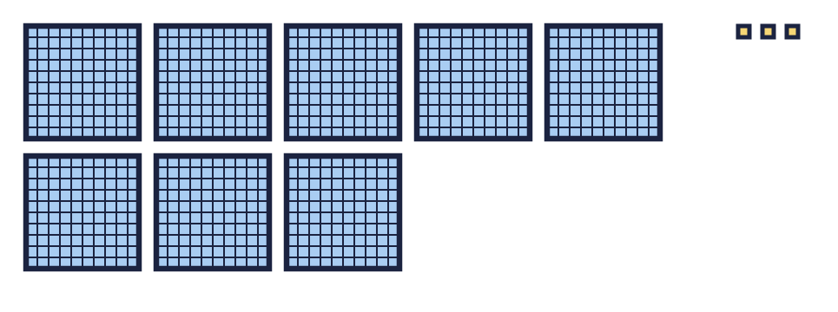
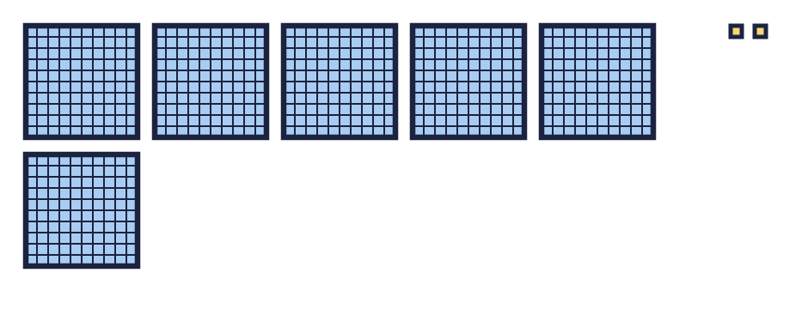
Year 4 · Place value · Step 1 · question 5
I do
You do
“Dora: This is the number 803.”
“Whitney: This is the number 62.”
Three children look at these blocks.
Three children look at these blocks.
“Whitney: This is the number 830.”
“Dora: This is the number 620.”
“Tommy: This is the number 83.”
“Tommy: This is the number 602.”
Who is correct? ________
Who is correct? ________
Explain the mistakes the other two have made.
Explain the mistakes the other two have made.
Dora
Dora is correct: 8 hundreds, 0 tens and 3 ones make 803. The others have not used a zero in the tens place, or have put the digits in the wrong places.
Tommy
Tommy is correct: 6 hundreds, 0 tens and 2 ones make 602. The others have not used a zero in the tens place, or have put the digits in the wrong places.
5 of 8
Notes:
Question 5 of 8. I DO: model it out loud, thinking through each step. YOU DO: click the timer (2:00, an estimate) and let pupils try the same type of question with new numbers on their whiteboards. Then click to bring in the answers one at a time: the I do working, the I do answer, then the You do answer. Ask someone who got it wrong to say which step went wrong. Top tip: Answers. I do: Dora | Dora is correct: 8 hundreds, 0 tens and 3 ones make 803. The others have not used a zero in the tens place, or have put the digits in the wrong places.. You do: Tommy | Tommy is correct: 6 hundreds, 0 tens and 2 ones make 602. The others have not used a zero in the tens place, or have put the digits in the wrong places..

Slide 12

Year 4 · Place value · Step 1 · question 6
I do
You do
A number is made with place value counters. There are more than 9 tens, so some tens can be exchanged for a hundred.
A number is made with place value counters. There are more than 9 tens, so some tens can be exchanged for a hundred.
a) 7 hundreds, 16 tens and 8 ones = ____
a) 6 hundreds, 13 tens and 7 ones = ____
a) 868
a) 737
6 of 8
Notes:
Question 6 of 8. I DO: model it out loud, thinking through each step. YOU DO: click the timer (2:30, an estimate) and let pupils try the same type of question with new numbers on their whiteboards. Then click to bring in the answers one at a time: the I do working, the I do answer, then the You do answer. Ask someone who got it wrong to say which step went wrong. Top tip: Answers. I do: a) 868. You do: a) 737.

Slide 13
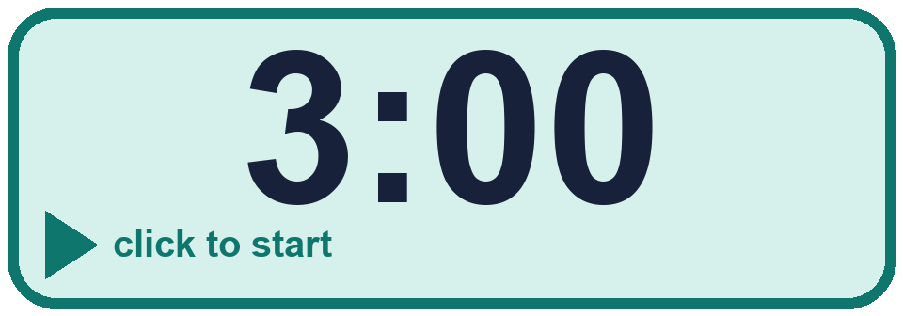
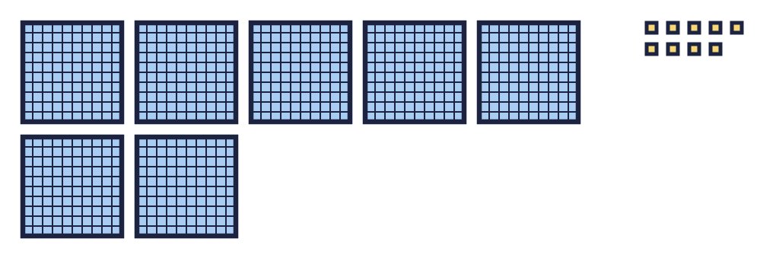
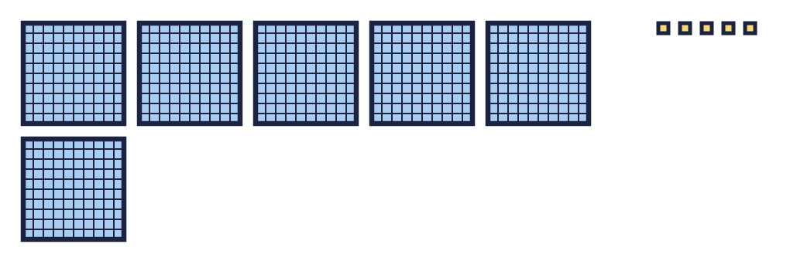
Year 4 · Place value · Step 1 · question 7
I do
You do
“Tommy: The blocks show 79.”
“Dora: The blocks show 65.”
Is Tommy correct? Circle yes or no.
Is Dora correct? Circle yes or no.
Explain how you know.
Explain how you know.
No
No. There are 7 hundreds, 0 tens and 9 ones, so the blocks show 709.
No
No. There are 6 hundreds, 0 tens and 5 ones, so the blocks show 605.
7 of 8
Notes:
Question 7 of 8. I DO: model it out loud, thinking through each step. YOU DO: click the timer (3:00, an estimate) and let pupils try the same type of question with new numbers on their whiteboards. Then click to bring in the answers one at a time: the I do working, the I do answer, then the You do answer. Ask someone who got it wrong to say which step went wrong. Top tip: Answers. I do: No | No. There are 7 hundreds, 0 tens and 9 ones, so the blocks show 709.. You do: No | No. There are 6 hundreds, 0 tens and 5 ones, so the blocks show 605..

Slide 14
Year 4 · Place value · Step 1 · question 8
I do
You do
Write three different ways to make 710 using hundreds and tens counters. For example, 5 hundreds and 21 tens.
Write three different ways to make 540 using hundreds and tens counters. For example, 3 hundreds and 24 tens.
for example 7 hundreds and 1 tens; 6 hundreds and 11 tens; 71 tens
for example 5 hundreds and 4 tens; 4 hundreds and 14 tens; 54 tens
8 of 8
Notes:
Question 8 of 8. I DO: model it out loud, thinking through each step. YOU DO: click the timer (4:00, an estimate) and let pupils try the same type of question with new numbers on their whiteboards. Then click to bring in the answers one at a time: the I do working, the I do answer, then the You do answer. Ask someone who got it wrong to say which step went wrong. Top tip: Answers. I do: for example 7 hundreds and 1 tens; 6 hundreds and 11 tens; 71 tens. You do: for example 5 hundreds and 4 tens; 4 hundreds and 14 tens; 54 tens.

Slide 15
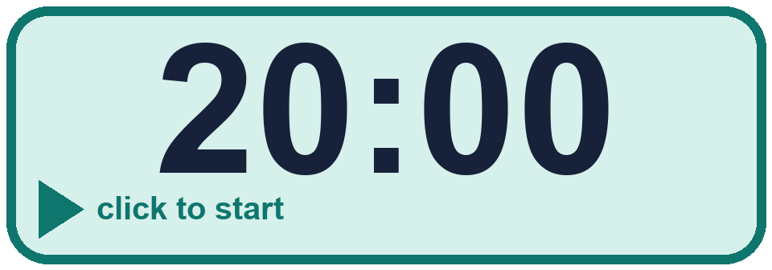

Year 4 · Place value · Step 1
Independent application
Challenge
Write three different ways to make 860 using hundreds and tens counters. For example, 6 hundreds and 26 tens.
Use the Step 1 worksheet.
Finished? Try the challenge.
for example 8 hundreds and 6 tens; 7 hundreds and 16 tens; 86 tens
Notes:
Pupils now work on their own on the Step 1 worksheet from the website (scaffolded or not scaffolded). Click the 20 minute timer to start it. Pupils who finish try the challenge: click to show its answer. The Bobas bounce on their own while the slide is showing. Challenge answers: for example 8 hundreds and 6 tens; 7 hundreds and 16 tens; 86 tens

