Slide 1








Year 4 · Autumn · Place value · Step 2
Partition numbers to 1000
I do, you do, with a timer. The questions get harder as we go.
Notes:
The Bobas are sitting at their desks, floating up and down, ready to learn. Click a timer in slideshow mode to start it.

Slide 2

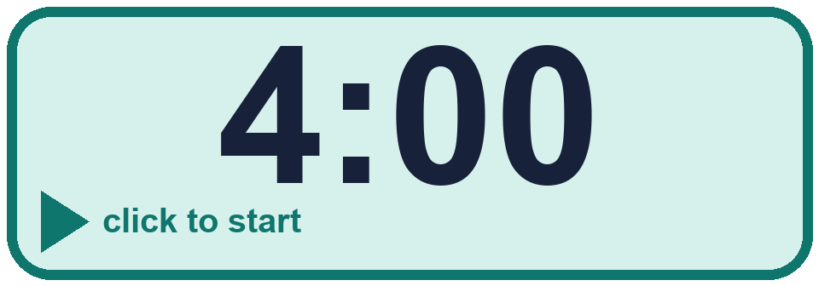
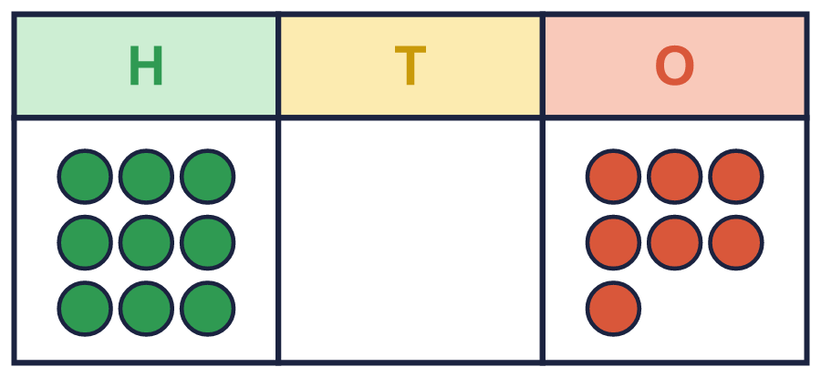
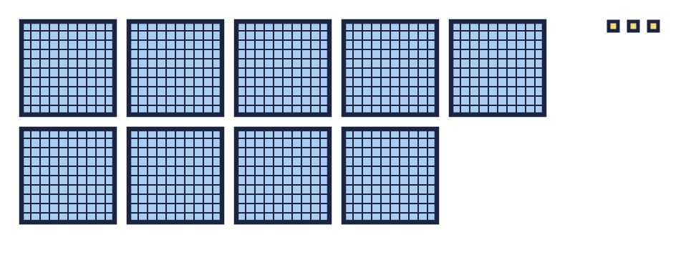
Year 4 · Place value · Step 2
Starter
Last lesson: Represent numbers to 1000
1. Write each number.
a) 8 hundreds, 0 tens and 9 ones = ____
b) 4 hundreds, 6 tens and 0 ones = ____
c) 1 hundreds, 9 tens and 9 ones = ____
2. Look at the number 580.
a) How many hundreds does it have? ____
b) How many tens does it have? ____
c) How many ones does it have? ____
a) 809 b) 460 c) 199
a) 5 b) 8 c) 0
3. What number is shown in the place value chart?
The number is ____
4. What number do the base ten blocks show?
The number is ____
907
903
Notes:
Starter: four quick questions to bring back last lesson (Represent numbers to 1000). Click the timer, let pupils answer on their whiteboards, then click to show each answer in turn.

Slide 3

Year 4 · Place value · Step 2
Today we are learning…
To partition numbers up to 1,000 into hundreds, tens and ones.
I can…
☐ I can split a number into hundreds, tens and ones.
☐ I can write a number sentence for the parts.
☐ I can find a missing part.
☐ I can partition a number in more than one way.
Notes:
Read the objective aloud. Then ask: where might we need this outside school? The success criteria can be turned into a quick check at the end of the lesson.

Slide 4
Year 4 · Place value · Step 2
Key words
partition
hundreds
tens
ones
part
number sentence
Notes:
Pupils say each word aloud, then use it in a sentence about today's numbers.

Slide 5
Year 4 · Place value · Step 2
The key ideas
358 = 300 + 50 + 8.
You can also say 358 = 200 + 150 + 8.
The parts add up to the whole number.
Notes:
Talk through the picture first: ask pupils what they notice. Then click to bring in each statement, and the words under the picture, one at a time.

Slide 6

Year 4 · Place value · Step 2
Look out for
Write the value of each digit.
Use 0 for empty places.
Check by adding the parts.
Notes:
Talk through the picture first: ask pupils what they notice. Then click to bring in each statement, and the words under the picture, one at a time.

Slide 7


Year 4 · Place value · Step 2 · question 1
I do
You do
Complete the number sentence.
Complete the number sentence.
266 = 200 + _____ + _____
568 = 500 + _____ + _____
60 and 6
60 and 8
1 of 8
Notes:
Question 1 of 8. I DO: model it out loud, thinking through each step. YOU DO: click the timer (1:00, an estimate) and let pupils try the same type of question with new numbers on their whiteboards. Then click to bring in the answers one at a time: the I do working, the I do answer, then the You do answer. Ask someone who got it wrong to say which step went wrong. Top tip: Answers. I do: 60 and 6. You do: 60 and 8.

Slide 8
Year 4 · Place value · Step 2 · question 2
I do
You do
Fill in the missing part of each number sentence.
Fill in the missing part of each number sentence.
a) 685 = 600 + 80 + _____
a) 838 = 800 + _____ + 8
b) 364 = 300 + _____
b) 198 = 100 + _____
c) 641 = _____ + 40 + 1
c) 266 = 200 + _____ + 6
a) 5
b) 64
c) 600
a) 30
b) 98
c) 60
2 of 8
Notes:
Question 2 of 8. I DO: model it out loud, thinking through each step. YOU DO: click the timer (1:00, an estimate) and let pupils try the same type of question with new numbers on their whiteboards. Then click to bring in the answers one at a time: the I do working, the I do answer, then the You do answer. Ask someone who got it wrong to say which step went wrong. Top tip: Answers. I do: a) 5 | b) 64 | c) 600. You do: a) 30 | b) 98 | c) 60.

Slide 9
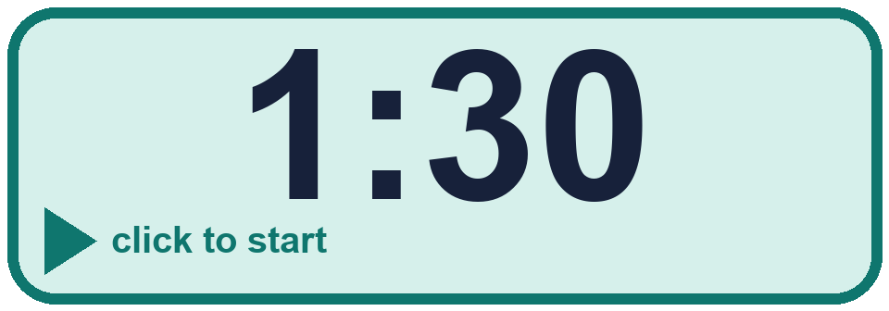
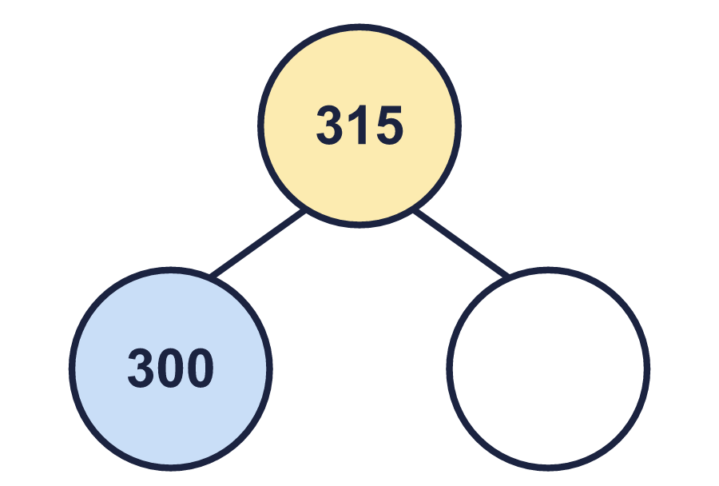
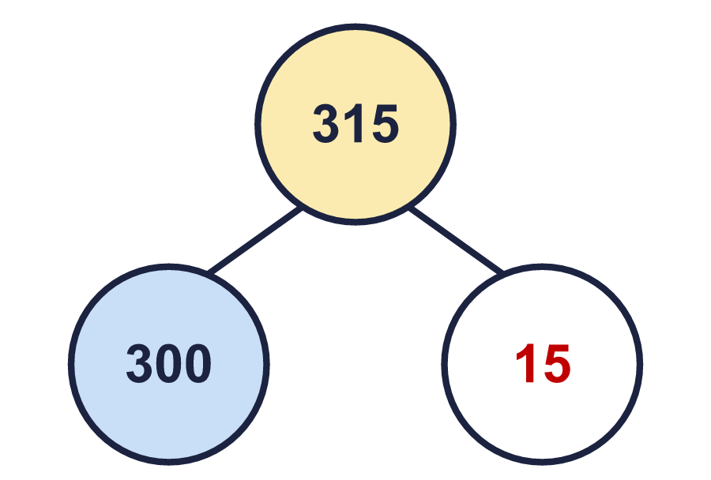
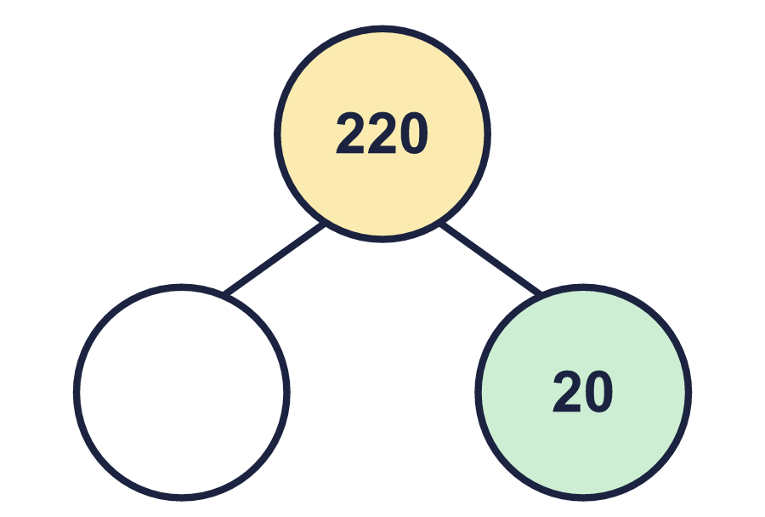
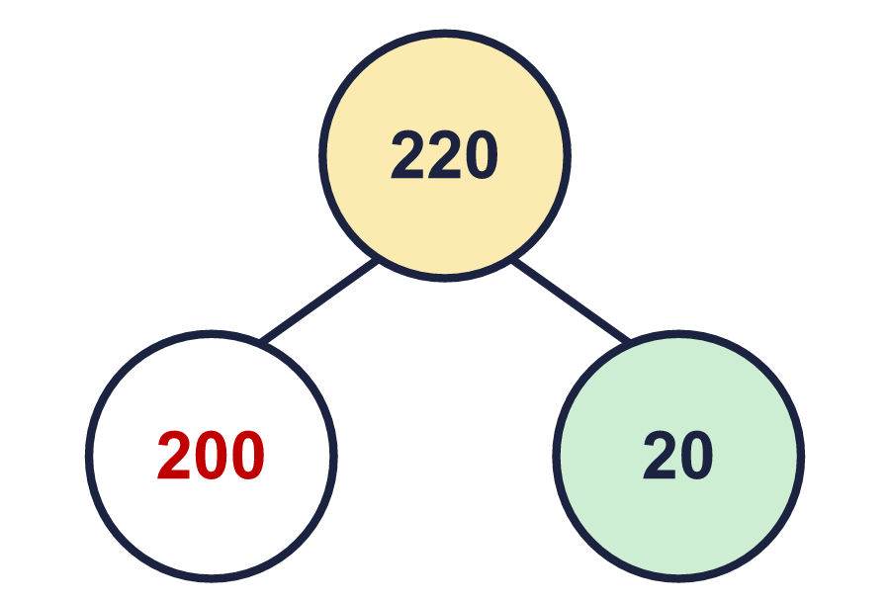
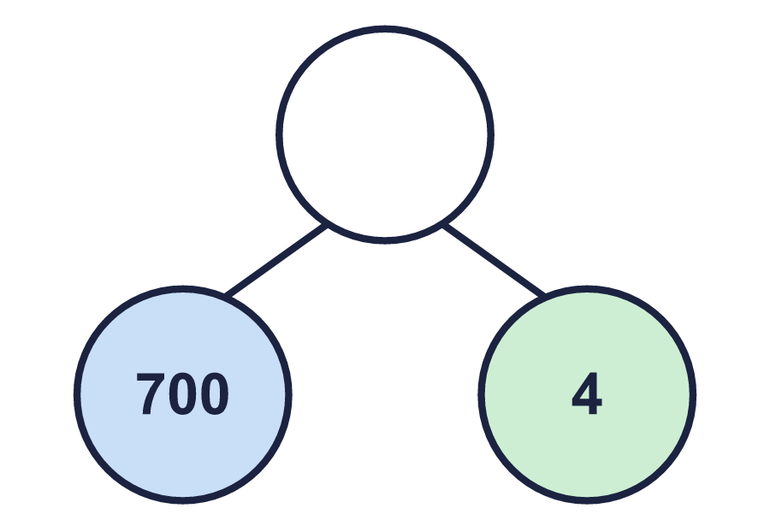
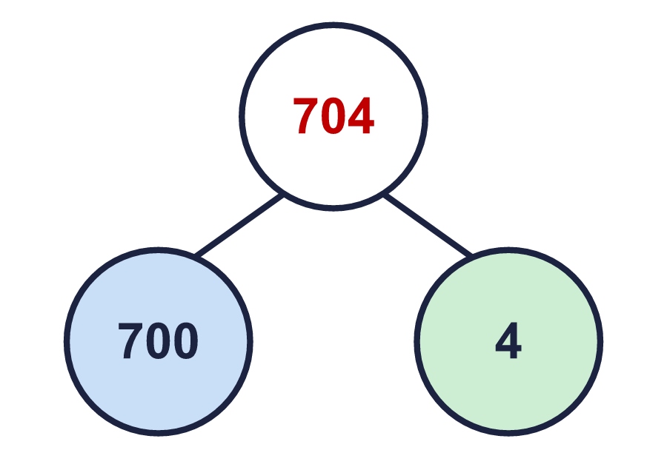
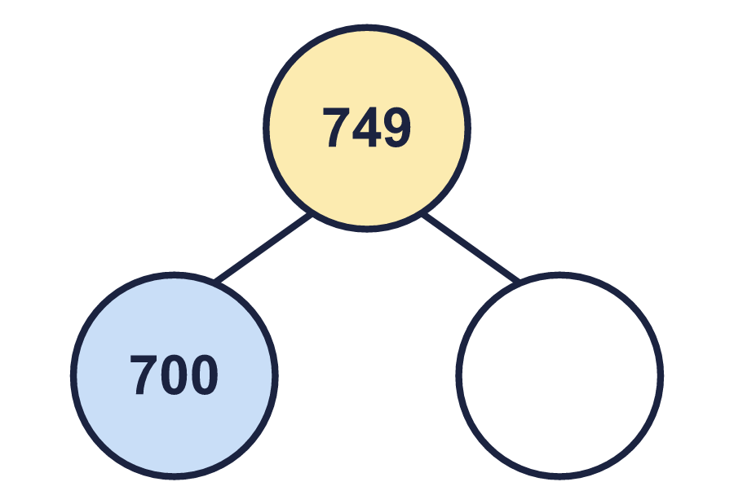
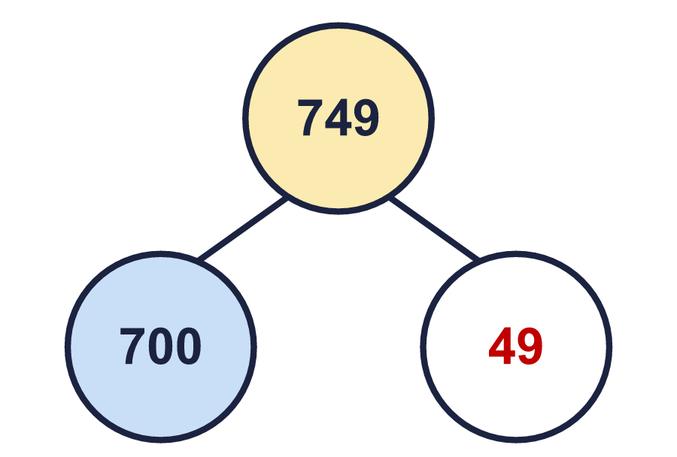

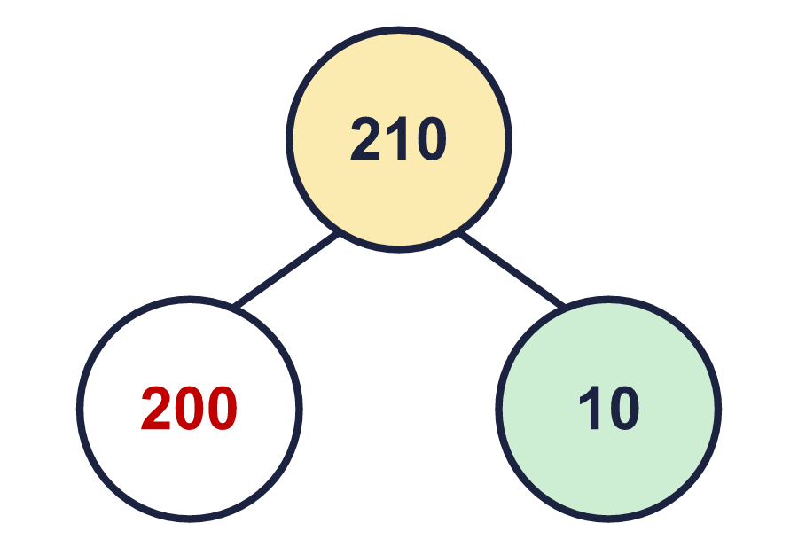
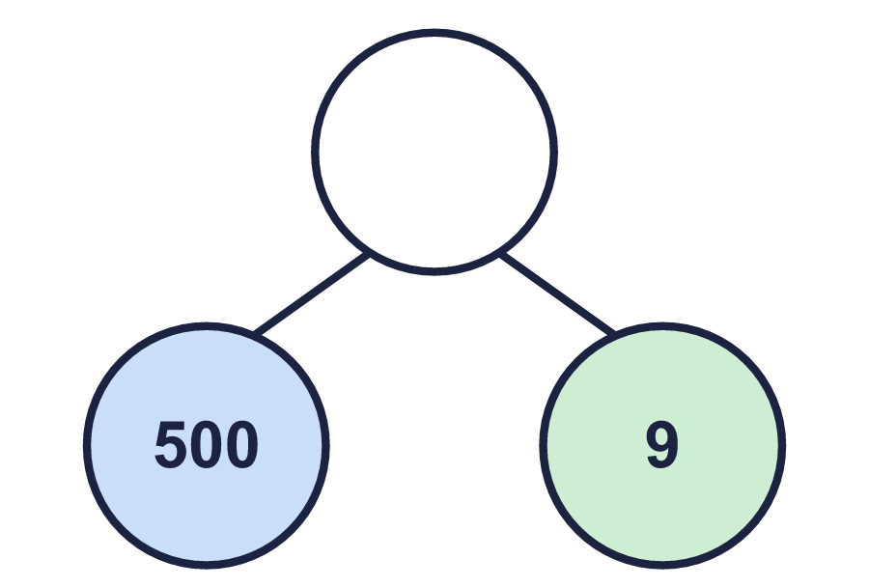
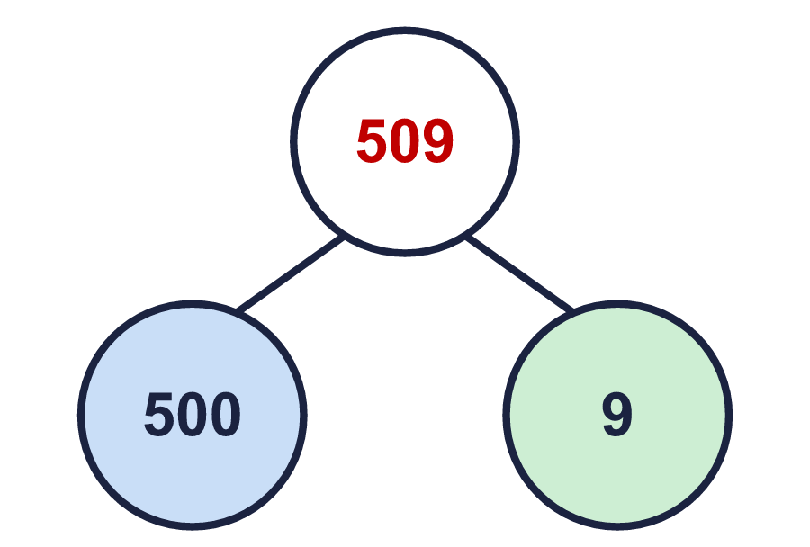
Year 4 · Place value · Step 2 · question 3
I do
You do
Complete the part-whole models.
Complete the part-whole models.
a) ________ b) ________ c) ________
a) ________ b) ________ c) ________
a)
b)
c)
a)
b)
c)
a) 15 b) 200 c) 704
a) 49 b) 200 c) 509
3 of 8
Notes:
Question 3 of 8. I DO: model it out loud, thinking through each step. YOU DO: click the timer (1:30, an estimate) and let pupils try the same type of question with new numbers on their whiteboards. Then click to bring in the answers one at a time: the I do working, the I do answer, then the You do answer. Ask someone who got it wrong to say which step went wrong. Top tip: Answers. I do: a) 15 b) 200 c) 704. You do: a) 49 b) 200 c) 509.

Slide 10
Year 4 · Place value · Step 2 · question 4
I do
You do
A number is made of 4 hundreds, 16 tens and 5 ones. What is the number?
A number is made of 5 hundreds, 19 tens and 2 ones. What is the number?
________
________
565
692
4 of 8
Notes:
Question 4 of 8. I DO: model it out loud, thinking through each step. YOU DO: click the timer (1:30, an estimate) and let pupils try the same type of question with new numbers on their whiteboards. Then click to bring in the answers one at a time: the I do working, the I do answer, then the You do answer. Ask someone who got it wrong to say which step went wrong. Top tip: Answers. I do: 565. You do: 692.

Slide 11

Year 4 · Place value · Step 2 · question 5
I do
You do
“Tiny partitions 267 like this: 200 + 600 + 7.”
“Dani partitions 452 like this: 40 + 50 + 2.”
a) Which part is wrong? ________
a) Which part is wrong? ________
b) What should it be? ________
b) What should it be? ________
a) 600
b) 60
a) 40
b) 400
5 of 8
Notes:
Question 5 of 8. I DO: model it out loud, thinking through each step. YOU DO: click the timer (2:00, an estimate) and let pupils try the same type of question with new numbers on their whiteboards. Then click to bring in the answers one at a time: the I do working, the I do answer, then the You do answer. Ask someone who got it wrong to say which step went wrong. Top tip: Answers. I do: a) 600 | b) 60. You do: a) 40 | b) 400.

Slide 12

Year 4 · Place value · Step 2 · question 6
I do
You do
“Tom has three digit cards: 2 7 4.”
“Tom has three digit cards: 5 7 2.”
Tom makes a 3-digit number greater than 300. What number could he have made? Partition your number.
Tom makes a 3-digit number greater than 500. What number could he have made? Partition your number.
for example 742 = 700 + 40 + 2
for example 752 = 700 + 50 + 2
6 of 8
Notes:
Question 6 of 8. I DO: model it out loud, thinking through each step. YOU DO: click the timer (2:30, an estimate) and let pupils try the same type of question with new numbers on their whiteboards. Then click to bring in the answers one at a time: the I do working, the I do answer, then the You do answer. Ask someone who got it wrong to say which step went wrong. Top tip: Answers. I do: for example 742 = 700 + 40 + 2. You do: for example 752 = 700 + 50 + 2.

Slide 13
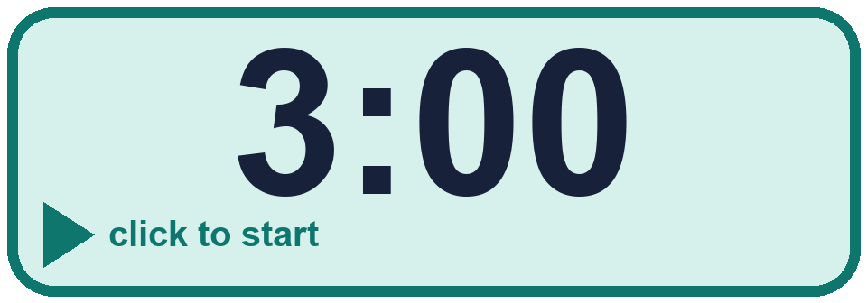
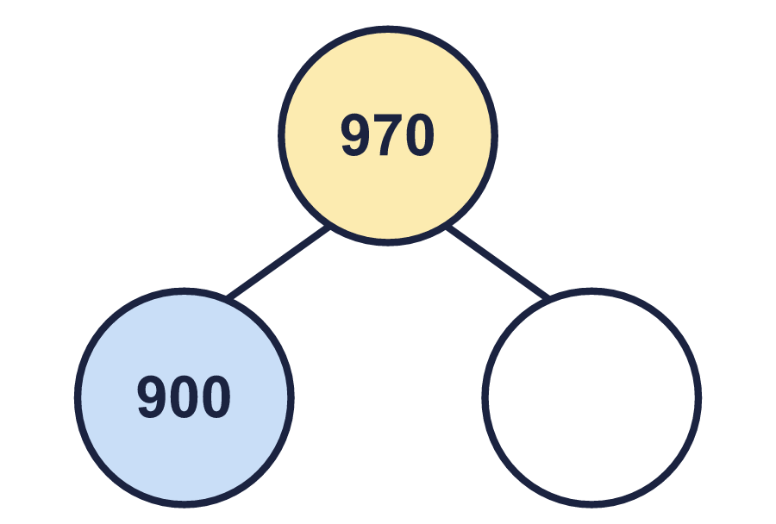

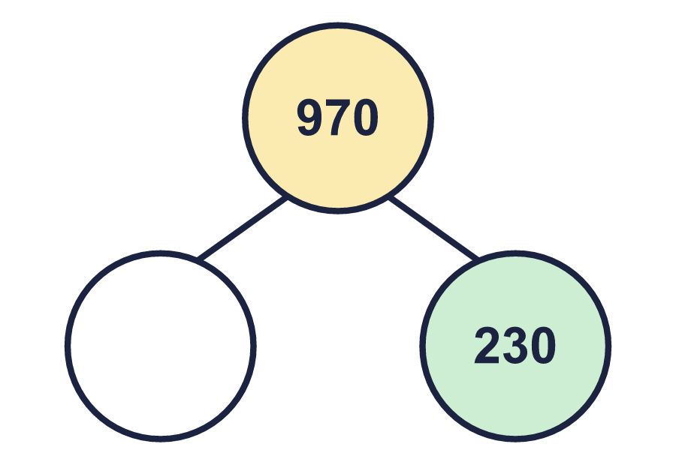
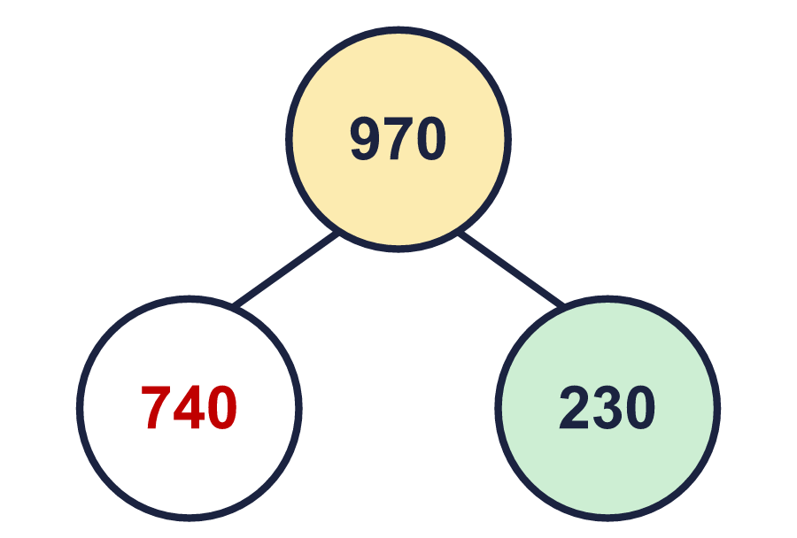
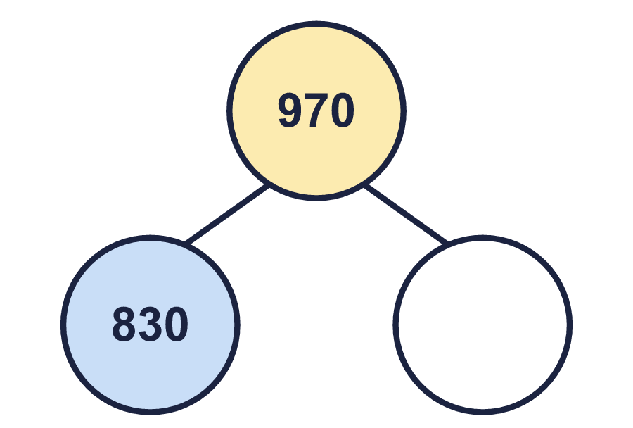
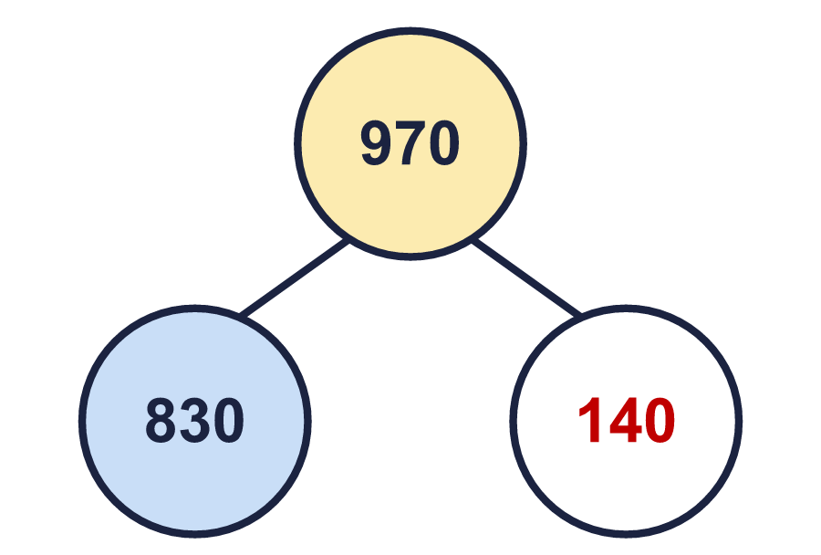

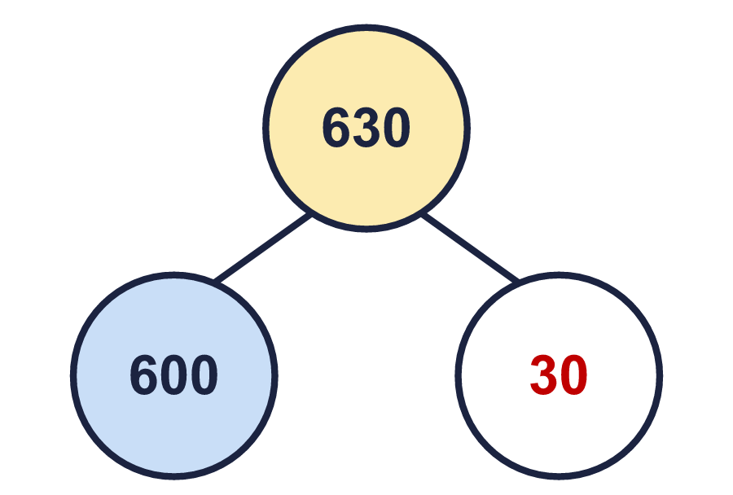
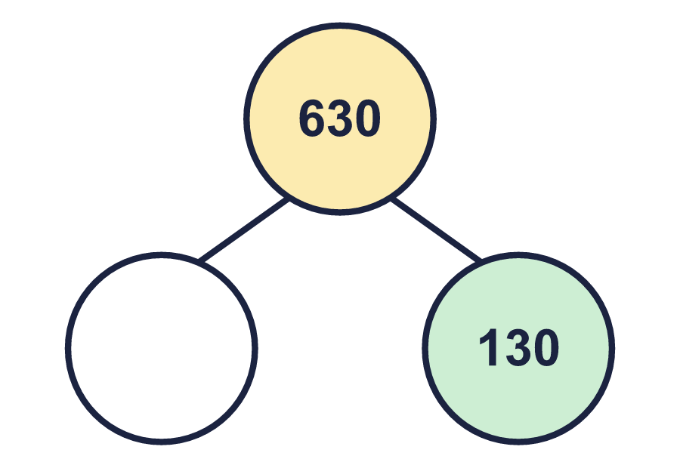


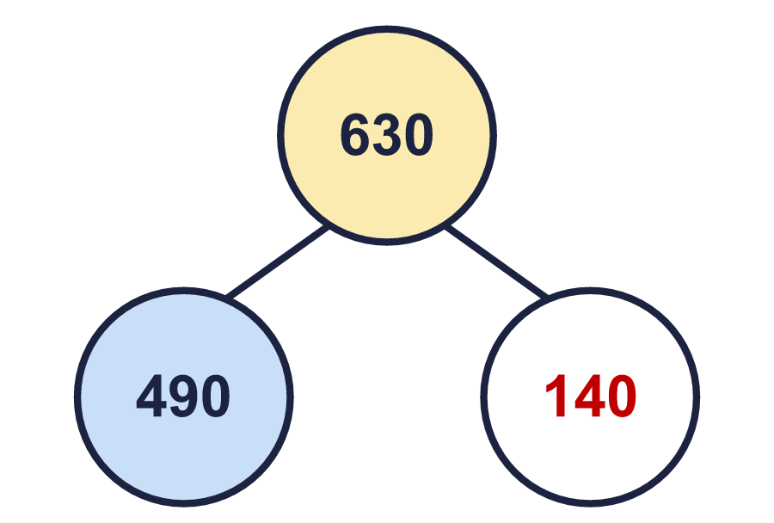
Year 4 · Place value · Step 2 · question 7
I do
You do
Complete the part-whole models. Each one shows 970 split in a different way.
Complete the part-whole models. Each one shows 630 split in a different way.
a) ________ b) ________ c) ________
a) ________ b) ________ c) ________
a)
b)
c)
a)
b)
c)
a) 70 b) 740 c) 140
a) 30 b) 500 c) 140
7 of 8
Notes:
Question 7 of 8. I DO: model it out loud, thinking through each step. YOU DO: click the timer (3:00, an estimate) and let pupils try the same type of question with new numbers on their whiteboards. Then click to bring in the answers one at a time: the I do working, the I do answer, then the You do answer. Ask someone who got it wrong to say which step went wrong. Top tip: Answers. I do: a) 70 b) 740 c) 140. You do: a) 30 b) 500 c) 140.

Slide 14
Year 4 · Place value · Step 2 · question 8
I do
You do
526 = 500 + ___ + ___
178 = 100 + ___ + ___
Write two different pairs of numbers that make this number sentence correct.
Write two different pairs of numbers that make this number sentence correct.
Any two pairs that add to 26, for example 20 and 6; 10 and 16
Any two pairs that add to 78, for example 70 and 8; 60 and 18
8 of 8
Notes:
Question 8 of 8. I DO: model it out loud, thinking through each step. YOU DO: click the timer (4:00, an estimate) and let pupils try the same type of question with new numbers on their whiteboards. Then click to bring in the answers one at a time: the I do working, the I do answer, then the You do answer. Ask someone who got it wrong to say which step went wrong. Top tip: Answers. I do: Any two pairs that add to 26, for example 20 and 6; 10 and 16. You do: Any two pairs that add to 78, for example 70 and 8; 60 and 18.

Slide 15
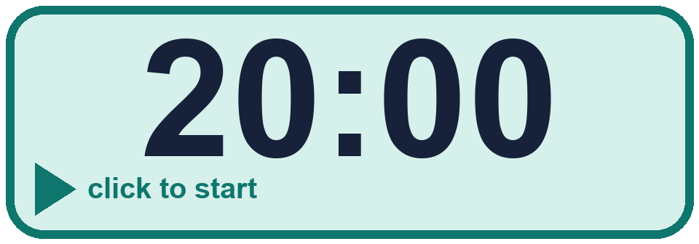
Year 4 · Place value · Step 2
Independent application
Challenge
Write 461 in three different ways using hundreds, tens and ones. For example, 4 hundreds, 6 tens and 1 ones.
Use the Step 2 worksheet.
Finished? Try the challenge.
for example 4 hundreds and 61 ones; 3 hundreds and 161 ones; 46 tens and 1 ones
Notes:
Pupils now work on their own on the Step 2 worksheet from the website (scaffolded or not scaffolded). Click the 20 minute timer to start it. Pupils who finish try the challenge: click to show its answer. The Bobas bounce on their own while the slide is showing. Challenge answers: for example 4 hundreds and 61 ones; 3 hundreds and 161 ones; 46 tens and 1 ones

