Slide 1








Year 4 · Autumn · Place value · Step 12
Order numbers to 10,000
I do, you do, with a timer. The questions get harder as we go.
Notes:
The Bobas are sitting at their desks, floating up and down, ready to learn. Click a timer in slideshow mode to start it.

Slide 2

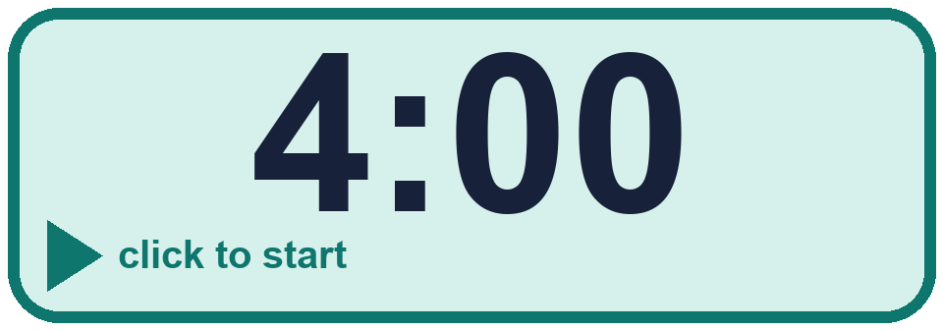
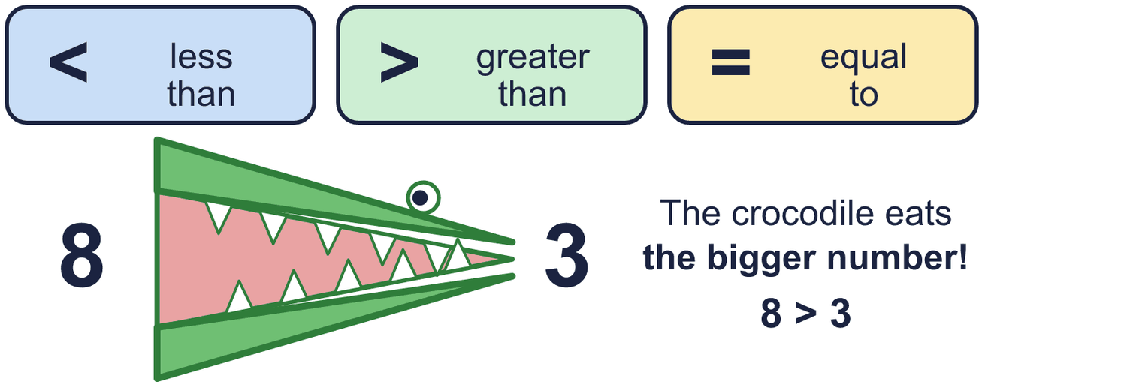
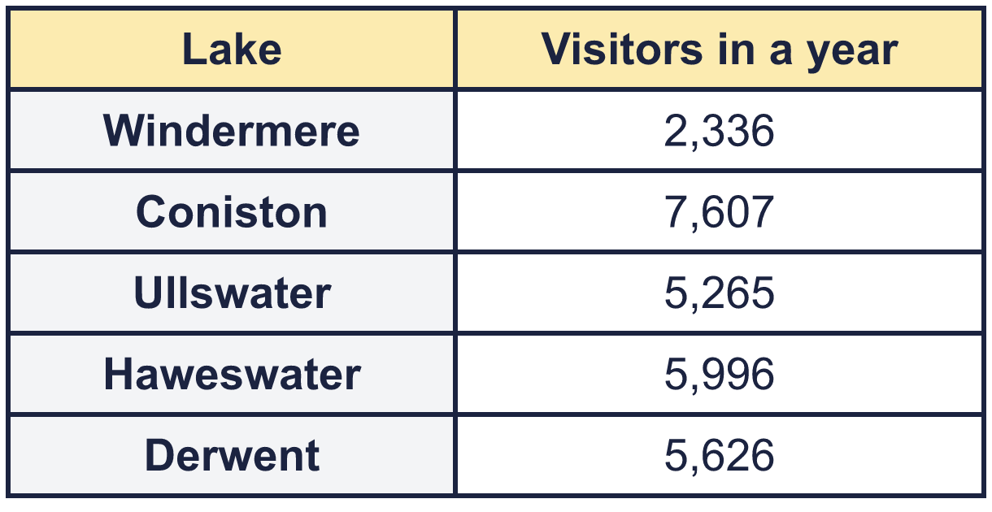
Year 4 · Place value · Step 12
Starter
Last lesson: Compare numbers to 10,000
1. Write <, > or = in each box.
a) 383 _____ 384
b) 8,549 _____ 8,469
c) 4,871 _____ 5,571
2. Work out the left side. Then write <, > or = in each box.
a) 5,000 + 800 + 15 _____ 5,815
b) 999 + 1 _____ 1,000
a) < b) > c) <
a) = b) =
3. a) Write the lakes in order, fewest visitors first. ____________________
b) Which lake had the most visitors? ________
4. Write <, > or = in each box.
a) XXXV _____ 38
b) LXVII _____ 70
c) LXVI _____ 66
a) Windermere, Ullswater, Derwent, Haweswater, Coniston b) Coniston
a) < b) < c) =
Notes:
Starter: four quick questions to bring back last lesson (Compare numbers to 10,000). Click the timer, let pupils answer on their whiteboards, then click to show each answer in turn.

Slide 3
Year 4 · Place value · Step 12
Today we are learning…
To order numbers up to 10,000.
I can…
☐ I can order numbers from smallest to largest.
☐ I can order numbers from largest to smallest.
☐ I can order numbers with the same thousands digit.
☐ I can order numbers in a table.
Notes:
Read the objective aloud. Then ask: where might we need this outside school? The success criteria can be turned into a quick check at the end of the lesson.

Slide 4
Year 4 · Place value · Step 12
Key words
order
smallest
largest
ascending
descending
compare
Notes:
Pupils say each word aloud, then use it in a sentence about today's numbers.

Slide 5

Year 4 · Place value · Step 12
The key ideas
Compare the thousands first, then the hundreds, then the tens and ones.
Numbers with fewer digits are usually smaller.
Smallest first is ascending. Largest first is descending.
Notes:
Talk through the picture first: ask pupils what they notice. Then click to bring in each statement, and the words under the picture, one at a time.

Slide 6

Year 4 · Place value · Step 12
Look out for
Check which way to order.
Compare digit by digit from the left.
Read your list again.
Notes:
Talk through the picture first: ask pupils what they notice. Then click to bring in each statement, and the words under the picture, one at a time.

Slide 7

Year 4 · Place value · Step 12 · question 1
I do
You do
Write the numbers in order. Start with the greatest number.
Write the numbers in order. Start with the greatest number.
8,650 8,500 8,510
3,520 3,680 3,580
____________________
____________________
8,650, 8,510, 8,500
3,680, 3,580, 3,520
1 of 8
Notes:
Question 1 of 8. I DO: model it out loud, thinking through each step. YOU DO: click the timer (1:00, an estimate) and let pupils try the same type of question with new numbers on their whiteboards. Then click to bring in the answers one at a time: the I do working, the I do answer, then the You do answer. Ask someone who got it wrong to say which step went wrong. Top tip: Answers. I do: 8,650, 8,510, 8,500. You do: 3,680, 3,580, 3,520.

Slide 8
Year 4 · Place value · Step 12 · question 2
I do
You do
Circle the greatest number. Write it.
Circle the greatest number. Write it.
a) 1,170 7,623 2,920 3,915 ________
a) 9,912 9,263 3,975 8,769 ________
a) 7,623
a) 9,912
2 of 8
Notes:
Question 2 of 8. I DO: model it out loud, thinking through each step. YOU DO: click the timer (1:00, an estimate) and let pupils try the same type of question with new numbers on their whiteboards. Then click to bring in the answers one at a time: the I do working, the I do answer, then the You do answer. Ask someone who got it wrong to say which step went wrong. Top tip: Answers. I do: a) 7,623. You do: a) 9,912.

Slide 9
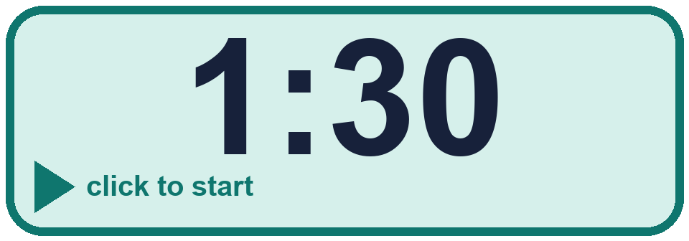
Year 4 · Place value · Step 12 · question 3
I do
You do
Write the numbers in order.
Write the numbers in order.
a) smallest first: 5,165 780 8,343 4,483 547
a) smallest first: 5,080 6,843 898 2,703 441
____________________
____________________
547, 780, 4,483, 5,165, 8,343
441, 898, 2,703, 5,080, 6,843
3 of 8
Notes:
Question 3 of 8. I DO: model it out loud, thinking through each step. YOU DO: click the timer (1:30, an estimate) and let pupils try the same type of question with new numbers on their whiteboards. Then click to bring in the answers one at a time: the I do working, the I do answer, then the You do answer. Ask someone who got it wrong to say which step went wrong. Top tip: Answers. I do: 547, 780, 4,483, 5,165, 8,343. You do: 441, 898, 2,703, 5,080, 6,843.

Slide 10
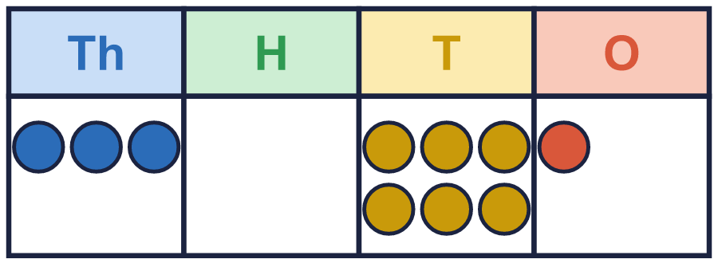
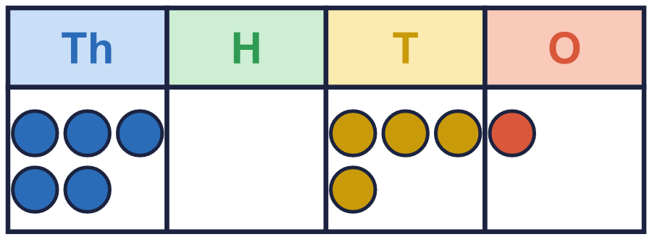
Year 4 · Place value · Step 12 · question 4
I do
You do
Teddy uses ten counters to make 3,061 on a place value chart.
Teddy uses ten counters to make 5,041 on a place value chart.
a) Rearrange the counters to make a number that is less than Teddy’s. Use all ten counters.
a) Rearrange the counters to make a number that is less than Teddy’s. Use all ten counters.
b) Rearrange the counters to make a number that is greater than Teddy’s. Use all ten counters.
b) Rearrange the counters to make a number that is greater than Teddy’s. Use all ten counters.
for example 2,062
for example 4,051
for example 4,042
for example 6,031
4 of 8
Notes:
Question 4 of 8. I DO: model it out loud, thinking through each step. YOU DO: click the timer (1:30, an estimate) and let pupils try the same type of question with new numbers on their whiteboards. Then click to bring in the answers one at a time: the I do working, the I do answer, then the You do answer. Ask someone who got it wrong to say which step went wrong. Top tip: Answers. I do: for example 2,062 | for example 4,051. You do: for example 4,042 | for example 6,031.

Slide 11

Year 4 · Place value · Step 12 · question 5
I do
You do
“Dexter is comparing numbers: 849 is greater than 3,487 because 849 starts with a 8 and 3,487 starts with a 3.”
“Jack is comparing numbers: 579 is greater than 2,316 because 579 starts with a 5 and 2,316 starts with a 2.”
Is Dexter correct? Circle yes or no.
Is Jack correct? Circle yes or no.
Explain the mistake.
Explain the mistake.
No
Dexter has only looked at the first digit. 3,487 has 3 thousands and 849 has 0 thousands, so 3,487 is greater.
No
Jack has only looked at the first digit. 2,316 has 2 thousands and 579 has 0 thousands, so 2,316 is greater.
5 of 8
Notes:
Question 5 of 8. I DO: model it out loud, thinking through each step. YOU DO: click the timer (2:00, an estimate) and let pupils try the same type of question with new numbers on their whiteboards. Then click to bring in the answers one at a time: the I do working, the I do answer, then the You do answer. Ask someone who got it wrong to say which step went wrong. Top tip: Answers. I do: No | Dexter has only looked at the first digit. 3,487 has 3 thousands and 849 has 0 thousands, so 3,487 is greater.. You do: No | Jack has only looked at the first digit. 2,316 has 2 thousands and 579 has 0 thousands, so 2,316 is greater..

Slide 12

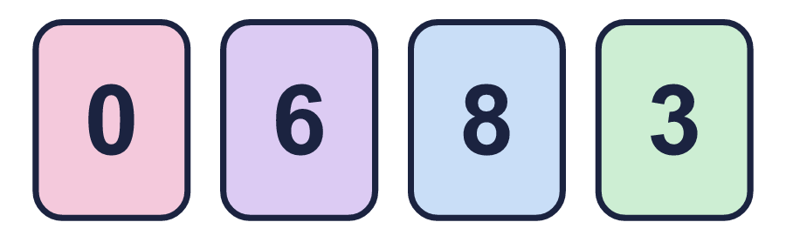
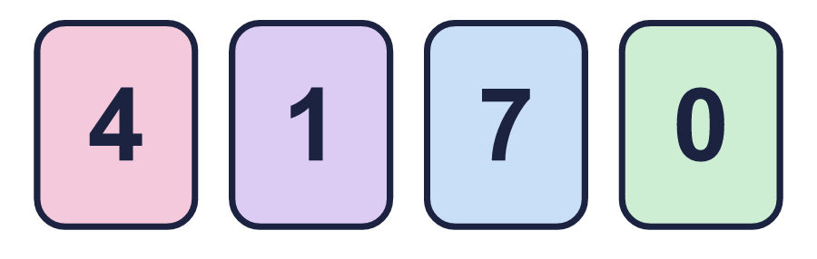
Year 4 · Place value · Step 12 · question 6
I do
You do
“I have four digit cards. I use all four cards each time.”
“I have four digit cards. I use all four cards each time.”
a) What is the largest 4-digit number I can make? ________
a) What is the largest 4-digit number I can make? ________
b) What is the smallest 4-digit number I can make? ________
b) What is the smallest 4-digit number I can make? ________
c) How much greater is the largest than the smallest? ________
c) How much greater is the largest than the smallest? ________
a) 8,630
b) 3,068
c) 5,562
a) 7,410
b) 1,047
c) 6,363
6 of 8
Notes:
Question 6 of 8. I DO: model it out loud, thinking through each step. YOU DO: click the timer (2:30, an estimate) and let pupils try the same type of question with new numbers on their whiteboards. Then click to bring in the answers one at a time: the I do working, the I do answer, then the You do answer. Ask someone who got it wrong to say which step went wrong. Top tip: Answers. I do: a) 8,630 | b) 3,068 | c) 5,562. You do: a) 7,410 | b) 1,047 | c) 6,363.

Slide 13
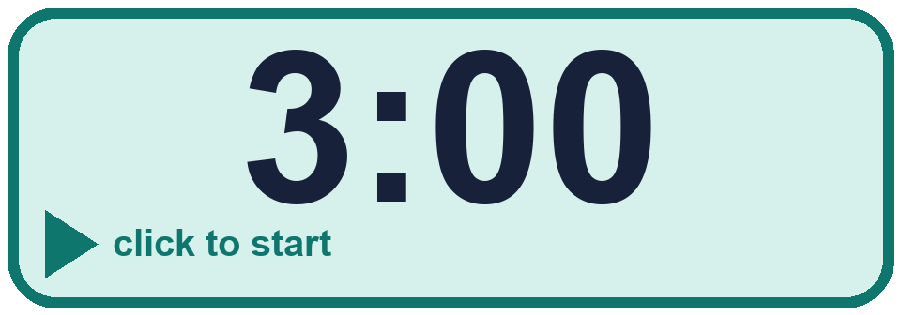
Year 4 · Place value · Step 12 · question 7
I do
You do
“I put these five numbers in order, starting with the smallest.”
“I put these five numbers in order, starting with the smallest.”
230 3,194 2,696 6,997 9,513
110 1,470 7,062 5,942 8,788
Is Tiara correct? Circle yes or no.
Is Tiara correct? Circle yes or no.
Explain how you know.
Explain how you know.
No
3,194 is bigger than 2,696, so it should come after it. The numbers should be: 230, 2,696, 3,194, 6,997, 9,513.
No
7,062 is bigger than 5,942, so it should come after it. The numbers should be: 110, 1,470, 5,942, 7,062, 8,788.
7 of 8
Notes:
Question 7 of 8. I DO: model it out loud, thinking through each step. YOU DO: click the timer (3:00, an estimate) and let pupils try the same type of question with new numbers on their whiteboards. Then click to bring in the answers one at a time: the I do working, the I do answer, then the You do answer. Ask someone who got it wrong to say which step went wrong. Top tip: Answers. I do: No | 3,194 is bigger than 2,696, so it should come after it. The numbers should be: 230, 2,696, 3,194, 6,997, 9,513.. You do: No | 7,062 is bigger than 5,942, so it should come after it. The numbers should be: 110, 1,470, 5,942, 7,062, 8,788..

Slide 14
Year 4 · Place value · Step 12 · question 8
I do
You do
These numbers are all close to 2,000. Write them in order.
These numbers are all close to 6,000. Write them in order.
a) smallest first: 1,990 1,999 2,010 2,001
a) smallest first: 5,999 6,010 6,001 5,990
____________________
____________________
b) largest first: 2,009 2,100 1,991 1,900
b) largest first: 5,900 6,009 5,991 6,100
____________________
____________________
1,990, 1,999, 2,001, 2,010
2,100, 2,009, 1,991, 1,900
5,990, 5,999, 6,001, 6,010
6,100, 6,009, 5,991, 5,900
8 of 8
Notes:
Question 8 of 8. I DO: model it out loud, thinking through each step. YOU DO: click the timer (4:00, an estimate) and let pupils try the same type of question with new numbers on their whiteboards. Then click to bring in the answers one at a time: the I do working, the I do answer, then the You do answer. Ask someone who got it wrong to say which step went wrong. Top tip: Answers. I do: 1,990, 1,999, 2,001, 2,010 | 2,100, 2,009, 1,991, 1,900. You do: 5,990, 5,999, 6,001, 6,010 | 6,100, 6,009, 5,991, 5,900.

Slide 15
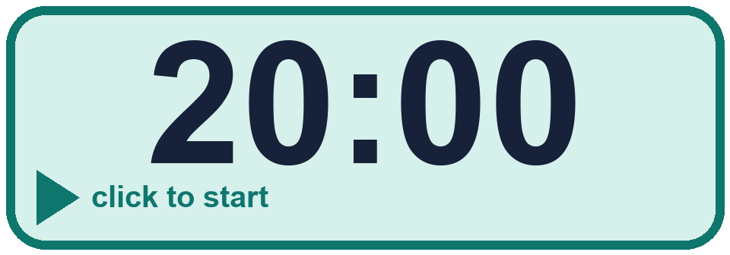
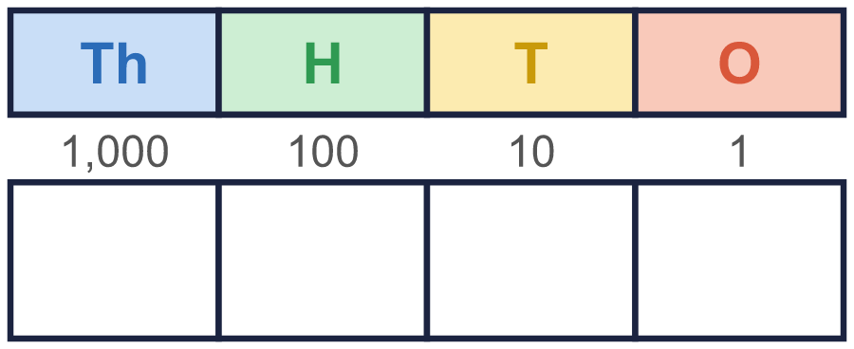


Year 4 · Place value · Step 12
Independent application
Challenge
Use five counters to make four different numbers in a place value chart. Write your numbers in order, smallest first.
Use the Step 12 worksheet.
Finished? Try the challenge.
Any four different numbers whose digits add up to 5, for example 1,013, 2,003, 3,101, 4,001
Notes:
Pupils now work on their own on the Step 12 worksheet from the website (scaffolded or not scaffolded). Click the 20 minute timer to start it. Pupils who finish try the challenge: click to show its answer. The Bobas bounce on their own while the slide is showing. Challenge answers: Any four different numbers whose digits add up to 5, for example 1,013, 2,003, 3,101, 4,001

