Slide 1








Year 4 · Autumn · Place value · Step 3
Number line to 1000
I do, you do, with a timer. The questions get harder as we go.
Notes:
The Bobas are sitting at their desks, floating up and down, ready to learn. Click a timer in slideshow mode to start it.

Slide 2

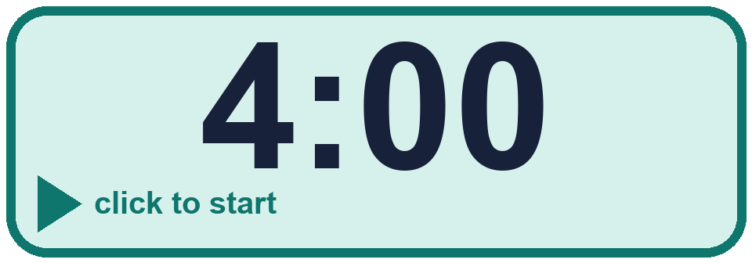
Year 4 · Place value · Step 3
Starter
Last lesson: Partition numbers to 1000
1. Complete the number sentence.
861 = 800 + _____ + _____
2. Complete the number sentence. One of the places is empty, so there are only two parts.
406 = _____ + _____
60 and 1
400 and 6
3. Fill in the missing part of each number sentence.
a) 136 = _____ + 30 + 6
b) 998 = 900 + _____
c) 126 = 100 + _____ + 6
4. Complete the sentences about 995.
a) The number of hundreds is ____
b) The number of tens in the tens place is ____
c) The number of ones is ____
a) 100 b) 98 c) 20
a) 9 b) 9 c) 5
Notes:
Starter: four quick questions to bring back last lesson (Partition numbers to 1000). Click the timer, let pupils answer on their whiteboards, then click to show each answer in turn.

Slide 3
Year 4 · Place value · Step 3
Today we are learning…
To read and mark numbers on number lines up to 1,000.
I can…
☐ I can find what each step is worth.
☐ I can read a number on a number line.
☐ I can mark a number on a number line.
☐ I can fill in missing numbers.
Notes:
Read the objective aloud. Then ask: where might we need this outside school? The success criteria can be turned into a quick check at the end of the lesson.

Slide 4
Year 4 · Place value · Step 3
Key words
number line
step
count
hundreds
scale
mark
Notes:
Pupils say each word aloud, then use it in a sentence about today's numbers.

Slide 5
Year 4 · Place value · Step 3
The key ideas
Count the steps to find what each one is worth.
Lines can go up in 100s, 50s, 25s or 10s.
Count on from a number you know.
Notes:
Talk through the picture first: ask pupils what they notice. Then click to bring in each statement, and the words under the picture, one at a time.

Slide 6

Year 4 · Place value · Step 3
Look out for
Count the spaces, not the marks.
Check the numbers at the ends.
Check your count.
Notes:
Talk through the picture first: ask pupils what they notice. Then click to bring in each statement, and the words under the picture, one at a time.

Slide 7


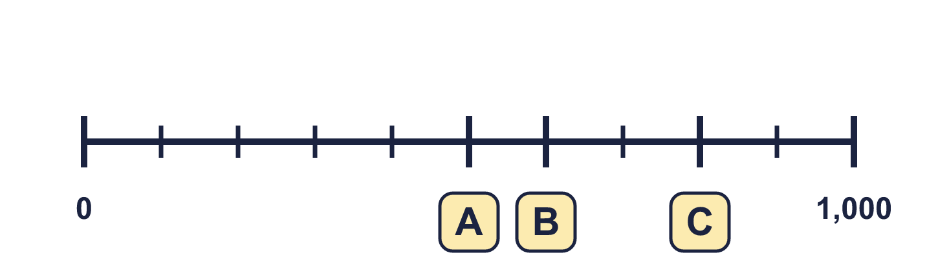
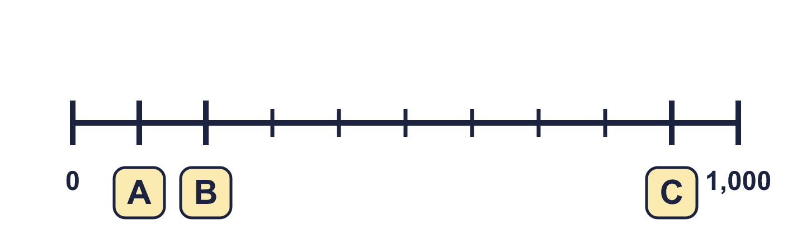
Year 4 · Place value · Step 3 · question 1
I do
You do
Complete the number line.
Complete the number line.
A = ________ B = ________ C = ________
A = ________ B = ________ C = ________
500, 600, 800
100, 200, 900
1 of 8
Notes:
Question 1 of 8. I DO: model it out loud, thinking through each step. YOU DO: click the timer (1:00, an estimate) and let pupils try the same type of question with new numbers on their whiteboards. Then click to bring in the answers one at a time: the I do working, the I do answer, then the You do answer. Ask someone who got it wrong to say which step went wrong. Top tip: Answers. I do: 500, 600, 800. You do: 100, 200, 900.

Slide 8
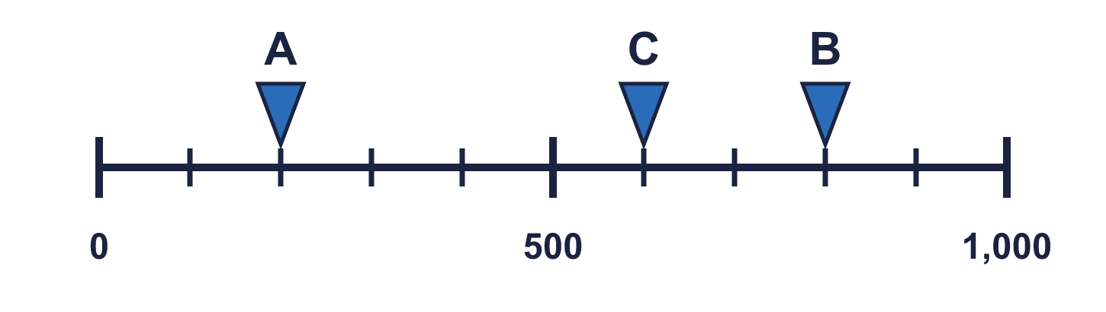
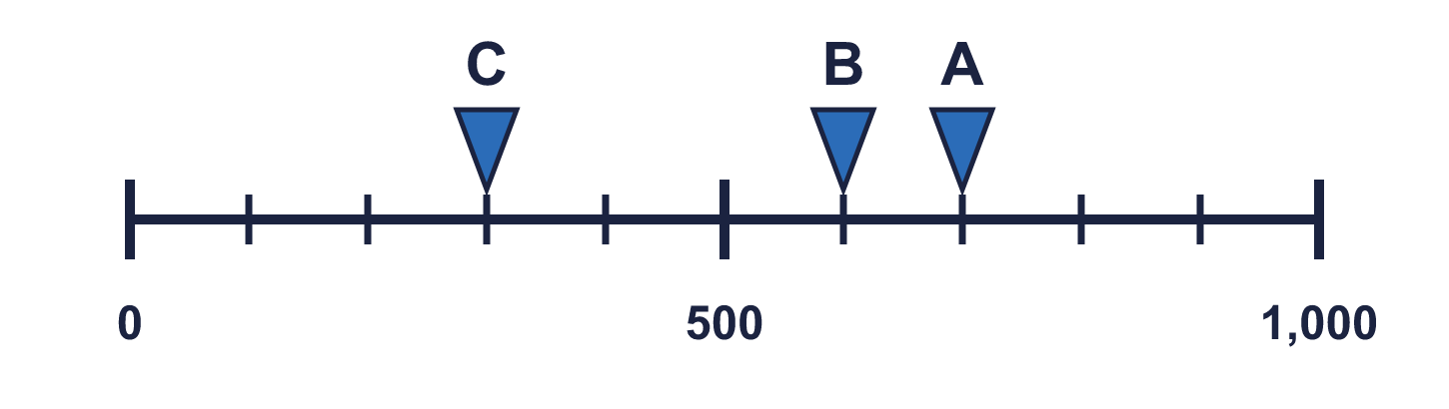
Year 4 · Place value · Step 3 · question 2
I do
You do
Which arrow points to 200? Write its letter.
Which arrow points to 700? Write its letter.
Answer: _____
Answer: _____
A
A
2 of 8
Notes:
Question 2 of 8. I DO: model it out loud, thinking through each step. YOU DO: click the timer (1:00, an estimate) and let pupils try the same type of question with new numbers on their whiteboards. Then click to bring in the answers one at a time: the I do working, the I do answer, then the You do answer. Ask someone who got it wrong to say which step went wrong. Top tip: Answers. I do: A. You do: A.

Slide 9
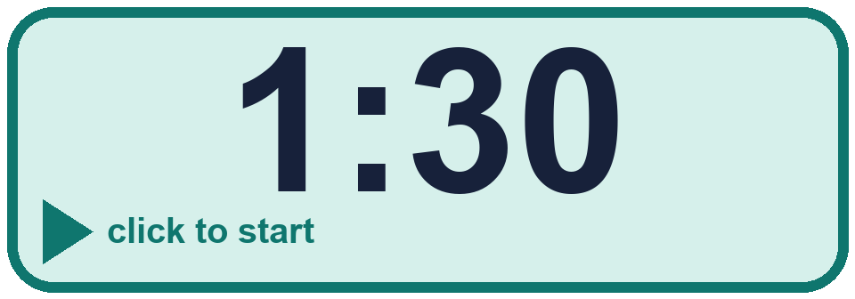
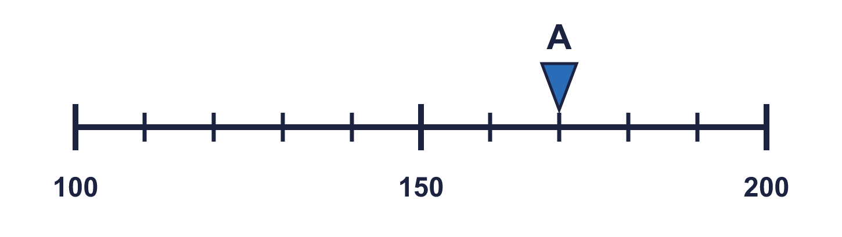
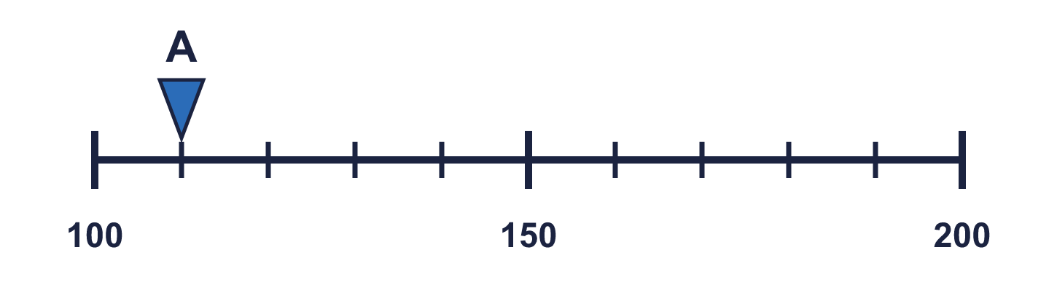
Year 4 · Place value · Step 3 · question 3
I do
You do
What number is the arrow pointing to?
What number is the arrow pointing to?
________
________
170
110
3 of 8
Notes:
Question 3 of 8. I DO: model it out loud, thinking through each step. YOU DO: click the timer (1:30, an estimate) and let pupils try the same type of question with new numbers on their whiteboards. Then click to bring in the answers one at a time: the I do working, the I do answer, then the You do answer. Ask someone who got it wrong to say which step went wrong. Top tip: Answers. I do: 170. You do: 110.

Slide 10
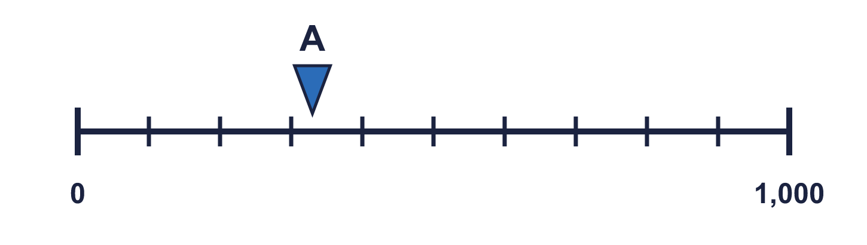
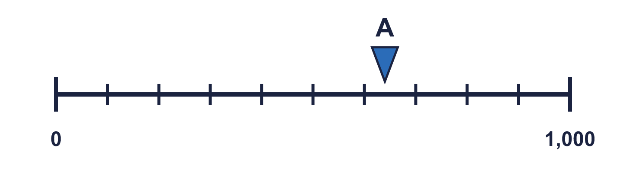
Year 4 · Place value · Step 3 · question 4
I do
You do
The arrow is between two marks. Which number is it closest to? Write the letter.
The arrow is between two marks. Which number is it closest to? Write the letter.
a) 0
a) 300
b) 600
b) 600
c) 300
c) 900
Answer: _____
Answer: _____
c
b
4 of 8
Notes:
Question 4 of 8. I DO: model it out loud, thinking through each step. YOU DO: click the timer (1:30, an estimate) and let pupils try the same type of question with new numbers on their whiteboards. Then click to bring in the answers one at a time: the I do working, the I do answer, then the You do answer. Ask someone who got it wrong to say which step went wrong. Top tip: Answers. I do: c. You do: b.

Slide 11

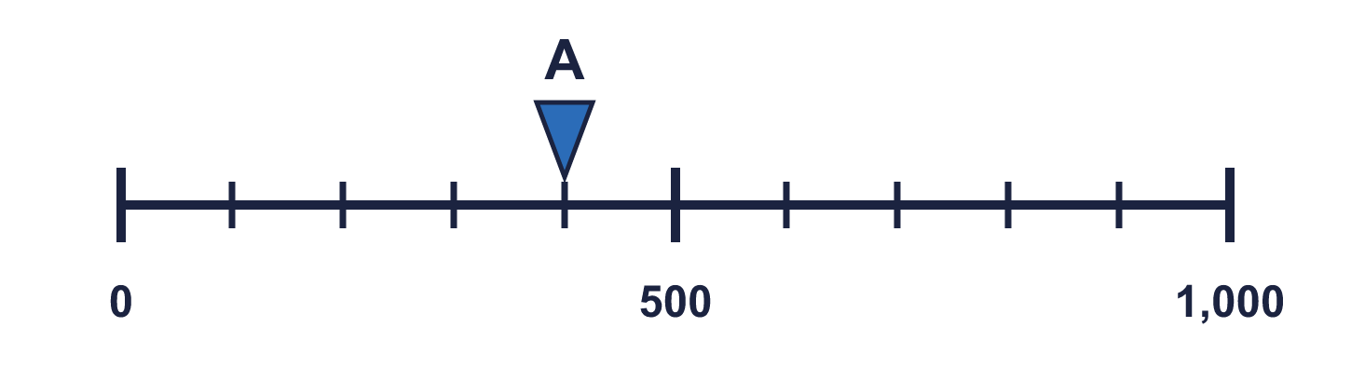
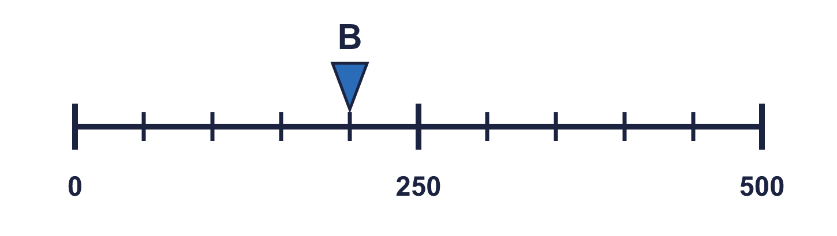
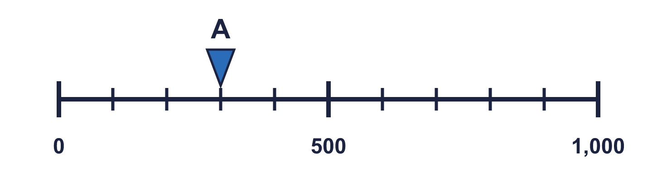
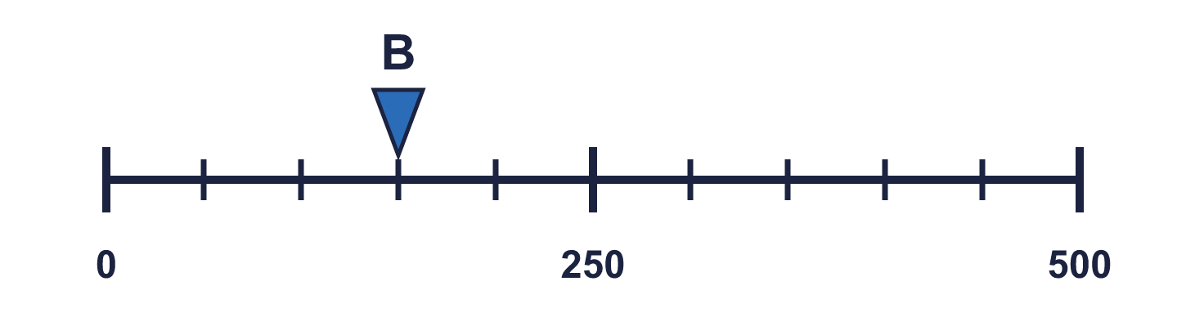
Year 4 · Place value · Step 3 · question 5
I do
You do
“The two arrows point to the same number.”
“The two arrows point to the same number.”
Is Boba correct? Circle yes or no.
Is Boba correct? Circle yes or no.
Explain how you know.
Explain how you know.
No
Arrow A points to 400 and arrow B points to 200. The lines have different scales: line A ends at 1,000 and line B ends at 500.
No
Arrow A points to 300 and arrow B points to 150. The lines have different scales: line A ends at 1,000 and line B ends at 500.
5 of 8
Notes:
Question 5 of 8. I DO: model it out loud, thinking through each step. YOU DO: click the timer (2:00, an estimate) and let pupils try the same type of question with new numbers on their whiteboards. Then click to bring in the answers one at a time: the I do working, the I do answer, then the You do answer. Ask someone who got it wrong to say which step went wrong. Top tip: Answers. I do: No | Arrow A points to 400 and arrow B points to 200. The lines have different scales: line A ends at 1,000 and line B ends at 500.. You do: No | Arrow A points to 300 and arrow B points to 150. The lines have different scales: line A ends at 1,000 and line B ends at 500..

Slide 12

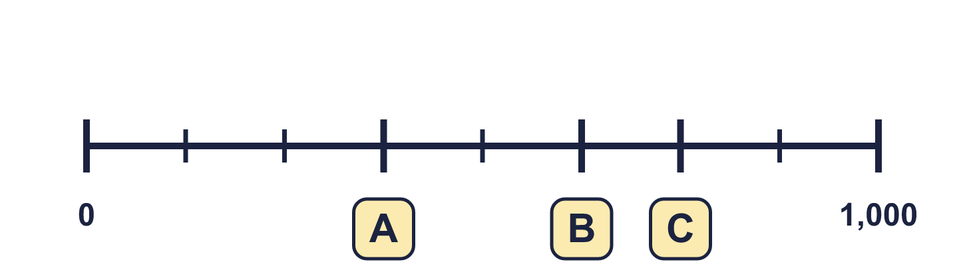
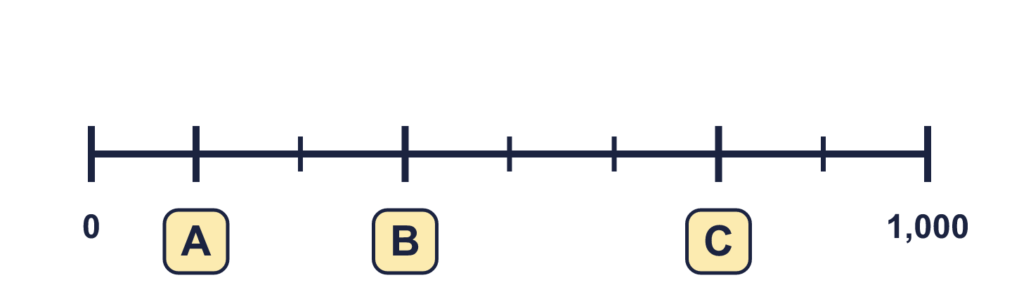
Year 4 · Place value · Step 3 · question 6
I do
You do
“I forgot to write three numbers on my number line.”
“I forgot to write three numbers on my number line.”
A = ________ B = ________ C = ________
A = ________ B = ________ C = ________
375, 625, 750
125, 375, 750
6 of 8
Notes:
Question 6 of 8. I DO: model it out loud, thinking through each step. YOU DO: click the timer (2:30, an estimate) and let pupils try the same type of question with new numbers on their whiteboards. Then click to bring in the answers one at a time: the I do working, the I do answer, then the You do answer. Ask someone who got it wrong to say which step went wrong. Top tip: Answers. I do: 375, 625, 750. You do: 125, 375, 750.

Slide 13
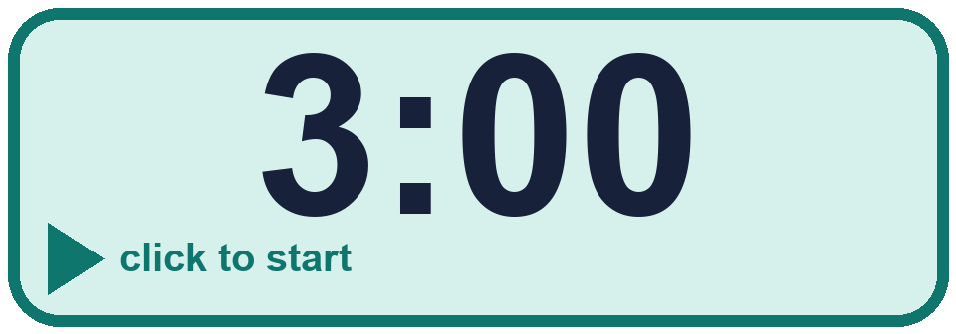
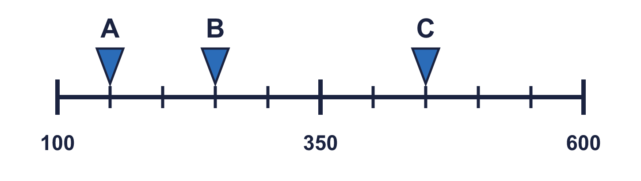
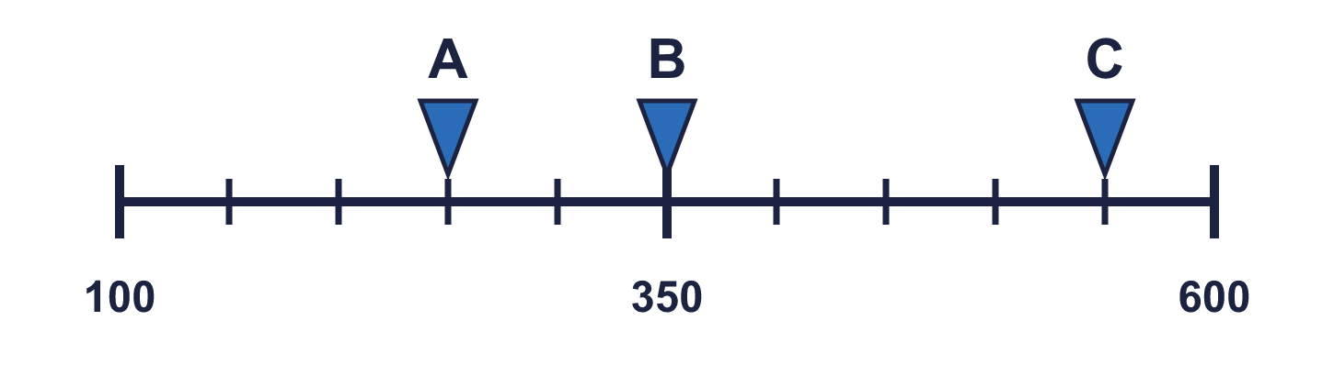
Year 4 · Place value · Step 3 · question 7
I do
You do
What numbers are the arrows pointing to?
What numbers are the arrows pointing to?
A = ________ B = ________ C = ________
A = ________ B = ________ C = ________
150, 250, 450
250, 350, 550
7 of 8
Notes:
Question 7 of 8. I DO: model it out loud, thinking through each step. YOU DO: click the timer (3:00, an estimate) and let pupils try the same type of question with new numbers on their whiteboards. Then click to bring in the answers one at a time: the I do working, the I do answer, then the You do answer. Ask someone who got it wrong to say which step went wrong. Top tip: Answers. I do: 150, 250, 450. You do: 250, 350, 550.

Slide 14
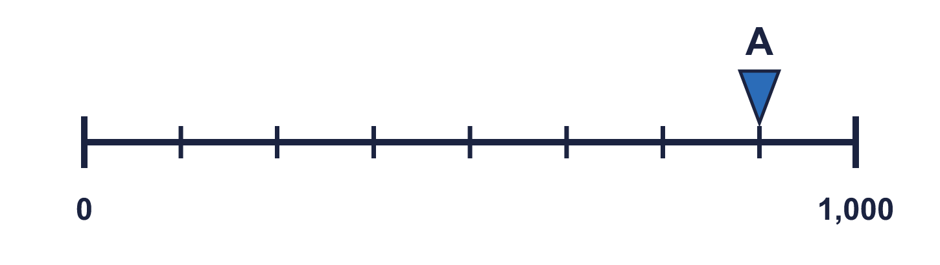
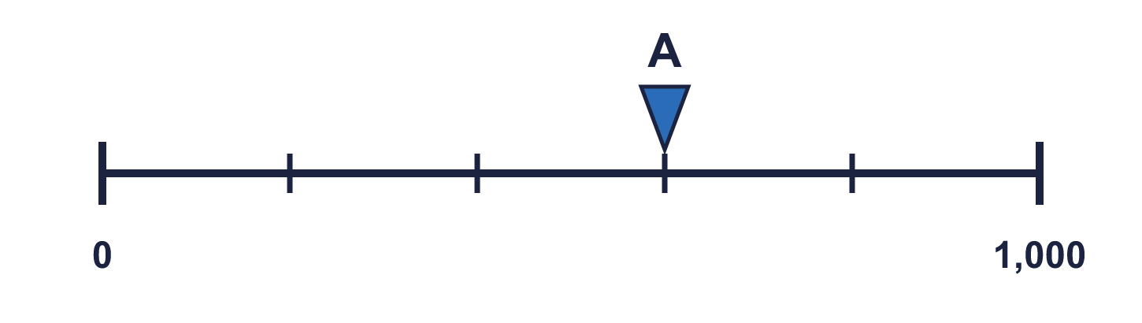
Year 4 · Place value · Step 3 · question 8
I do
You do
“I cut a number line from 0 to 1,000 into 8 equal steps.”
“I cut a number line from 0 to 1,000 into 5 equal steps.”
a) What is each step worth? ________
a) What is each step worth? ________
b) What number is arrow A pointing to? ________
b) What number is arrow A pointing to? ________
a) 125
b) 875
a) 200
b) 600
8 of 8
Notes:
Question 8 of 8. I DO: model it out loud, thinking through each step. YOU DO: click the timer (4:00, an estimate) and let pupils try the same type of question with new numbers on their whiteboards. Then click to bring in the answers one at a time: the I do working, the I do answer, then the You do answer. Ask someone who got it wrong to say which step went wrong. Top tip: Answers. I do: a) 125 | b) 875. You do: a) 200 | b) 600.

Slide 15
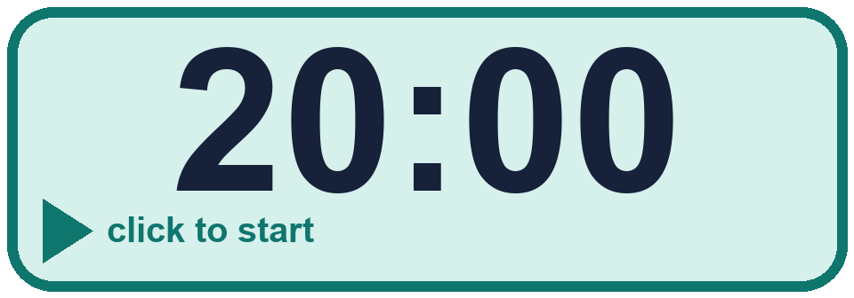
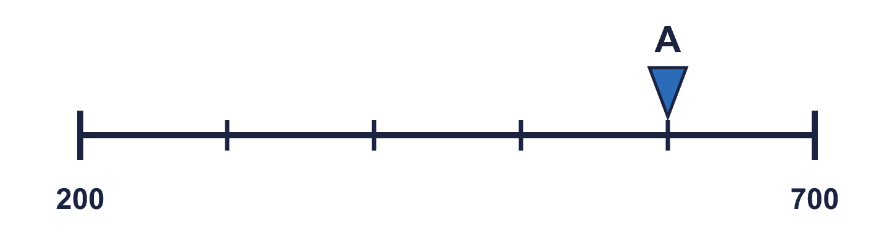


Year 4 · Place value · Step 3
Independent application
Challenge
a) What mistake has Boba made?
Explain how you know.
b) What number is arrow A pointing to? ________
Use the Step 3 worksheet.
Finished? Try the challenge.
Boba divided the end number. The line does not start at 0, so each step is (700 − 200) ÷ 5 = 100. b) 600
Notes:
Pupils now work on their own on the Step 3 worksheet from the website (scaffolded or not scaffolded). Click the 20 minute timer to start it. Pupils who finish try the challenge: click to show its answer. The Bobas bounce on their own while the slide is showing. Challenge answers: Boba divided the end number. The line does not start at 0, so each step is (700 − 200) ÷ 5 = 100. | b) 600

