Slide 1








Year 4 · Autumn · Place value · Step 9
Number line to 10,000
I do, you do, with a timer. The questions get harder as we go.
Notes:
The Bobas are sitting at their desks, floating up and down, ready to learn. Click a timer in slideshow mode to start it.

Slide 2

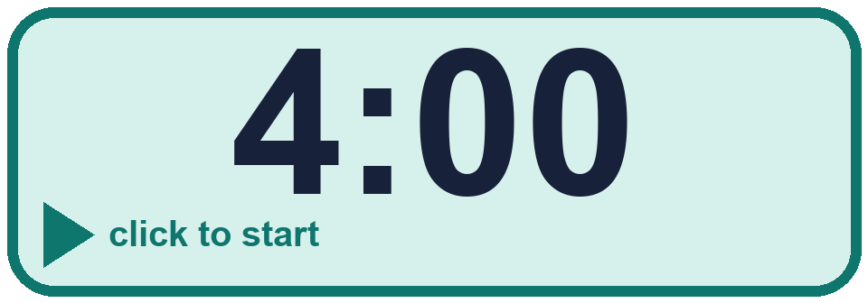
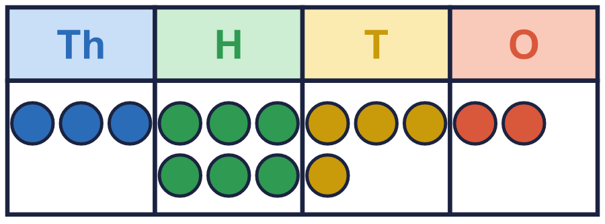
Year 4 · Place value · Step 9
Starter
Last lesson: Find 1, 10, 100 and 1,000 more or less
1. Work out the missing numbers.
a) 1,000 more than 3,971 = ________
b) 100 less than 8,092 = ________
c) 10 more than 5,594 = ________
2. Start with 5,675. Write the number that is...
a) 10 more = ________
b) 100 more = ________
c) 1,000 more = ________
d) 1 less = ________
a) 4,971 b) 7,992 c) 5,604
a) 5,685 b) 5,775 c) 6,675 d) 5,674
3. This number is shown in the place value chart.
Work out the missing numbers.
a) 1,000 more than 3,642 = ________
b) 100 more than 3,642 = ________
c) 1 less than 3,642 = ________
d) 10 more than 3,642 = ________
a) 4,642 b) 3,742 c) 3,641 d) 3,652
Notes:
Starter: four quick questions to bring back last lesson (Find 1, 10, 100 and 1,000 more or less). Click the timer, let pupils answer on their whiteboards, then click to show each answer in turn.

Slide 3

Year 4 · Place value · Step 9
Today we are learning…
To read and complete number lines up to 10,000.
I can…
☐ I can find what each step is worth.
☐ I can read a number on a number line.
☐ I can fill in missing numbers.
☐ I can read lines that do not start at zero.
Notes:
Read the objective aloud. Then ask: where might we need this outside school? The success criteria can be turned into a quick check at the end of the lesson.

Slide 4
Year 4 · Place value · Step 9
Key words
number line
step
interval
scale
thousands
mark
Notes:
Pupils say each word aloud, then use it in a sentence about today's numbers.

Slide 5

Year 4 · Place value · Step 9
The key ideas
Count the gaps to find what each step is worth.
Lines can go up in 1,000s, 2,000s, 500s or 100s.
A line does not have to start at 0.
Notes:
Talk through the picture first: ask pupils what they notice. Then click to bring in each statement, and the words under the picture, one at a time.

Slide 6

Year 4 · Place value · Step 9
Look out for
Count the gaps, not the marks.
Check the numbers at both ends.
Count on from a number you know.
Notes:
Talk through the picture first: ask pupils what they notice. Then click to bring in each statement, and the words under the picture, one at a time.

Slide 7

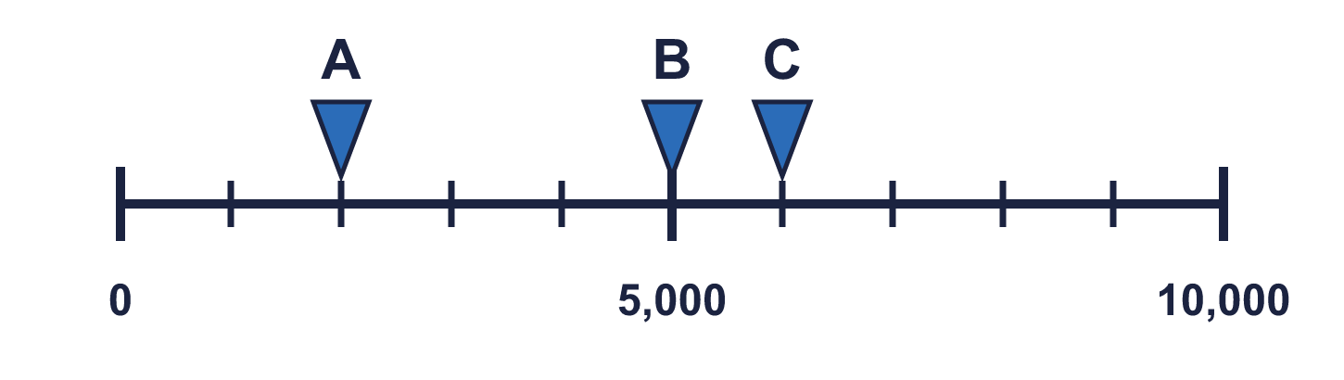
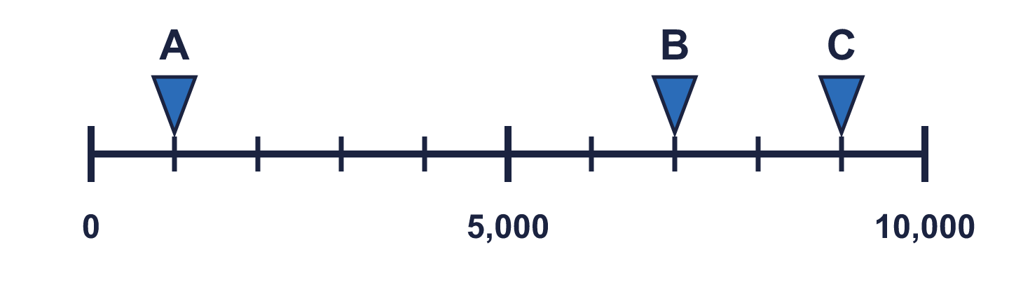
Year 4 · Place value · Step 9 · question 1
I do
You do
What numbers are the arrows pointing to?
What numbers are the arrows pointing to?
A = ________ B = ________ C = ________
A = ________ B = ________ C = ________
2,000, 5,000, 6,000
1,000, 7,000, 9,000
1 of 8
Notes:
Question 1 of 8. I DO: model it out loud, thinking through each step. YOU DO: click the timer (1:00, an estimate) and let pupils try the same type of question with new numbers on their whiteboards. Then click to bring in the answers one at a time: the I do working, the I do answer, then the You do answer. Ask someone who got it wrong to say which step went wrong. Top tip: Answers. I do: 2,000, 5,000, 6,000. You do: 1,000, 7,000, 9,000.

Slide 8
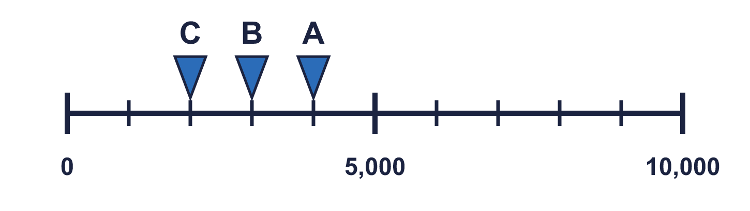
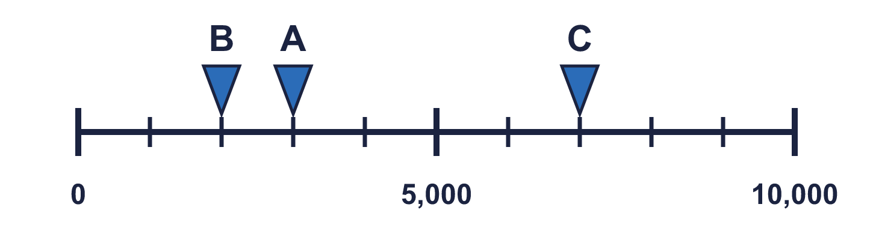
Year 4 · Place value · Step 9 · question 2
I do
You do
Which arrow points to 3,000? Write its letter.
Which arrow points to 3,000? Write its letter.
Answer: _____
Answer: _____
B
A
2 of 8
Notes:
Question 2 of 8. I DO: model it out loud, thinking through each step. YOU DO: click the timer (1:00, an estimate) and let pupils try the same type of question with new numbers on their whiteboards. Then click to bring in the answers one at a time: the I do working, the I do answer, then the You do answer. Ask someone who got it wrong to say which step went wrong. Top tip: Answers. I do: B. You do: A.

Slide 9
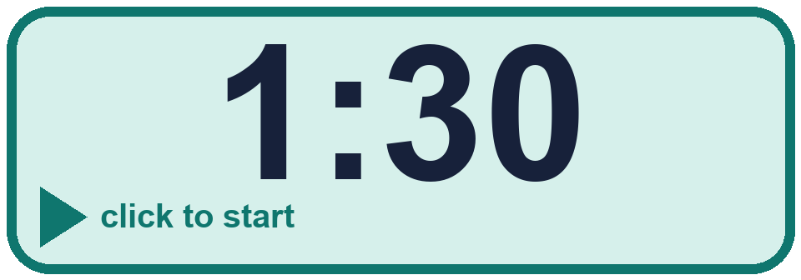
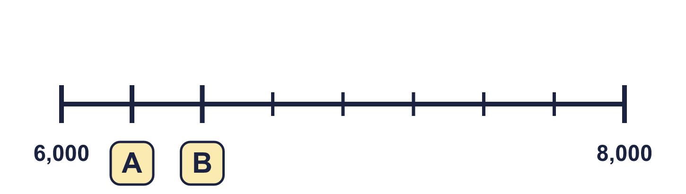
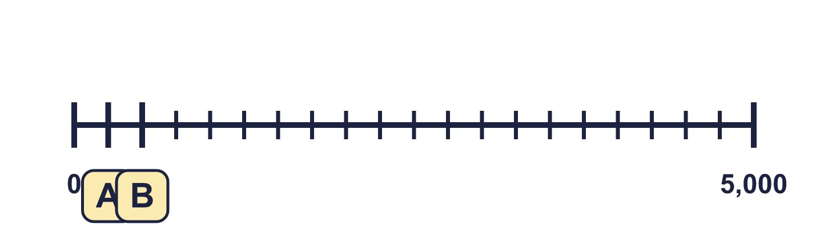
Year 4 · Place value · Step 9 · question 3
I do
You do
Complete the number line.
Complete the number line.
A = ________ B = ________
A = ________ B = ________
6,250, 6,500
250, 500
3 of 8
Notes:
Question 3 of 8. I DO: model it out loud, thinking through each step. YOU DO: click the timer (1:30, an estimate) and let pupils try the same type of question with new numbers on their whiteboards. Then click to bring in the answers one at a time: the I do working, the I do answer, then the You do answer. Ask someone who got it wrong to say which step went wrong. Top tip: Answers. I do: 6,250, 6,500. You do: 250, 500.

Slide 10
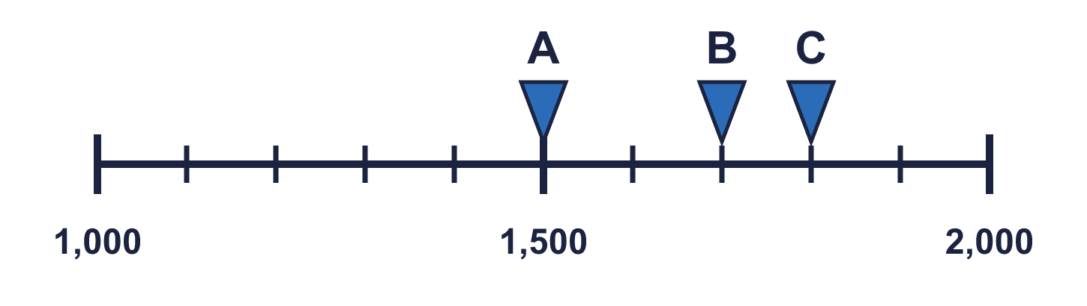
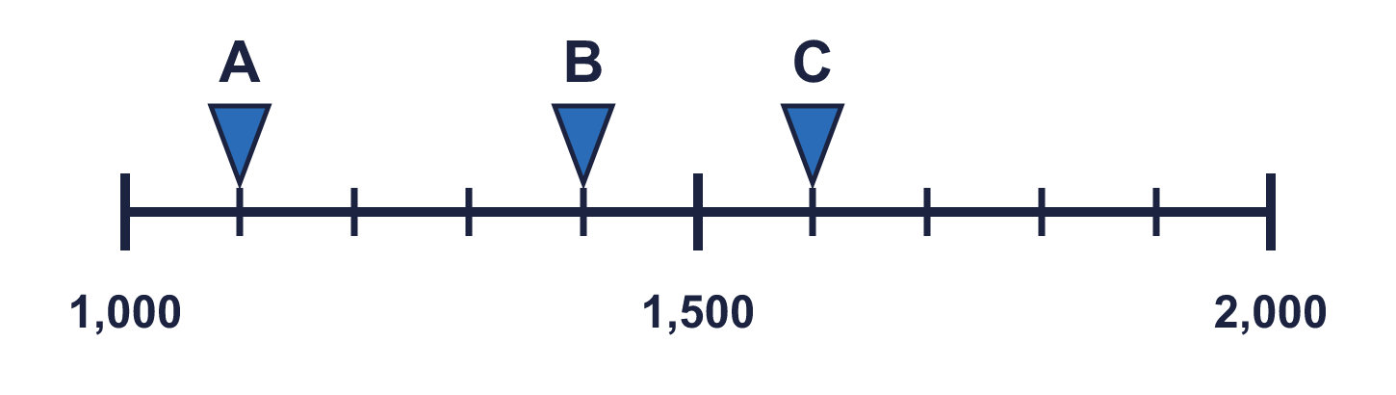
Year 4 · Place value · Step 9 · question 4
I do
You do
What numbers are the arrows pointing to?
What numbers are the arrows pointing to?
A = ________ B = ________ C = ________
A = ________ B = ________ C = ________
1,500, 1,700, 1,800
1,100, 1,400, 1,600
4 of 8
Notes:
Question 4 of 8. I DO: model it out loud, thinking through each step. YOU DO: click the timer (1:30, an estimate) and let pupils try the same type of question with new numbers on their whiteboards. Then click to bring in the answers one at a time: the I do working, the I do answer, then the You do answer. Ask someone who got it wrong to say which step went wrong. Top tip: Answers. I do: 1,500, 1,700, 1,800. You do: 1,100, 1,400, 1,600.

Slide 11

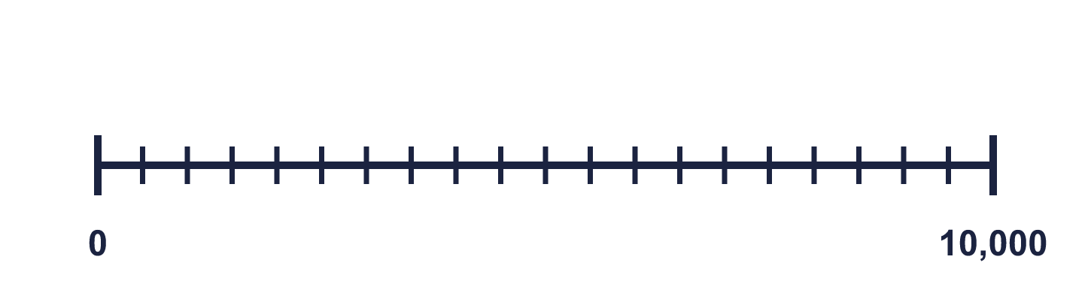
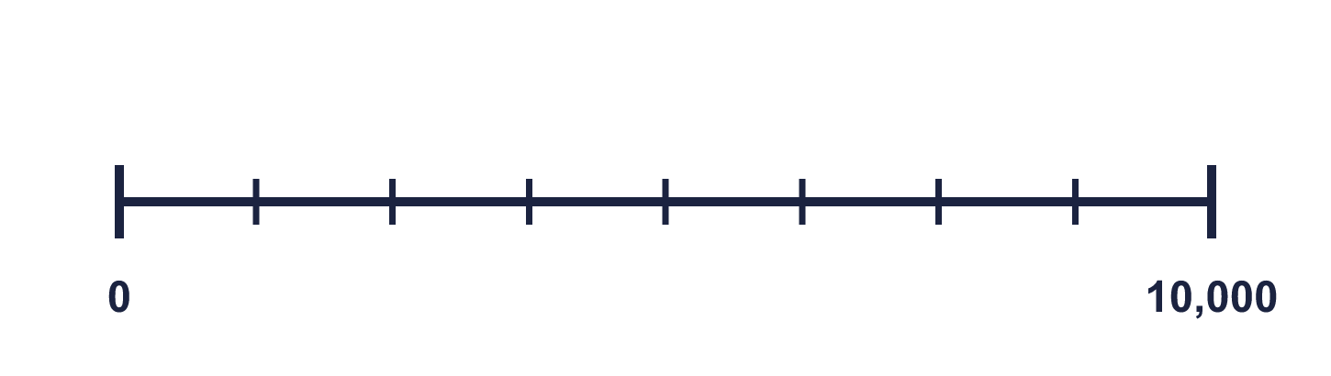
Year 4 · Place value · Step 9 · question 5
I do
You do
“Annie: This number line goes up in 1,000s.”
“Annie: This number line goes up in 1,000s.”
Is Annie correct? Circle yes or no.
Is Annie correct? Circle yes or no.
Explain how you know.
Explain how you know.
No
No. If it went up in 1,000s there would be 10 intervals between 0 and 10,000. There are 20 intervals on the number line, so it goes up in 500s.
No
No. If it went up in 1,000s there would be 10 intervals between 0 and 10,000. There are 8 intervals on the number line, so it goes up in 1,250s.
5 of 8
Notes:
Question 5 of 8. I DO: model it out loud, thinking through each step. YOU DO: click the timer (2:00, an estimate) and let pupils try the same type of question with new numbers on their whiteboards. Then click to bring in the answers one at a time: the I do working, the I do answer, then the You do answer. Ask someone who got it wrong to say which step went wrong. Top tip: Answers. I do: No | No. If it went up in 1,000s there would be 10 intervals between 0 and 10,000. There are 20 intervals on the number line, so it goes up in 500s.. You do: No | No. If it went up in 1,000s there would be 10 intervals between 0 and 10,000. There are 8 intervals on the number line, so it goes up in 1,250s..

Slide 12

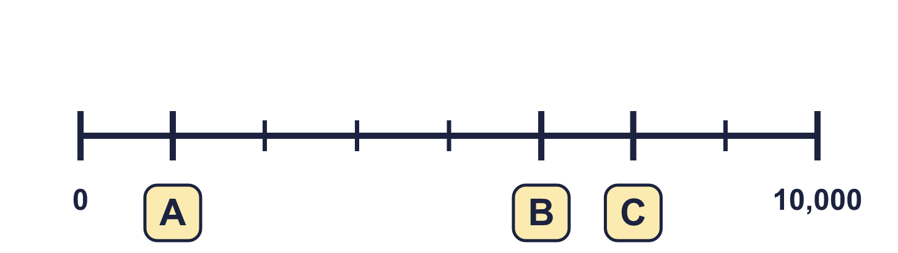
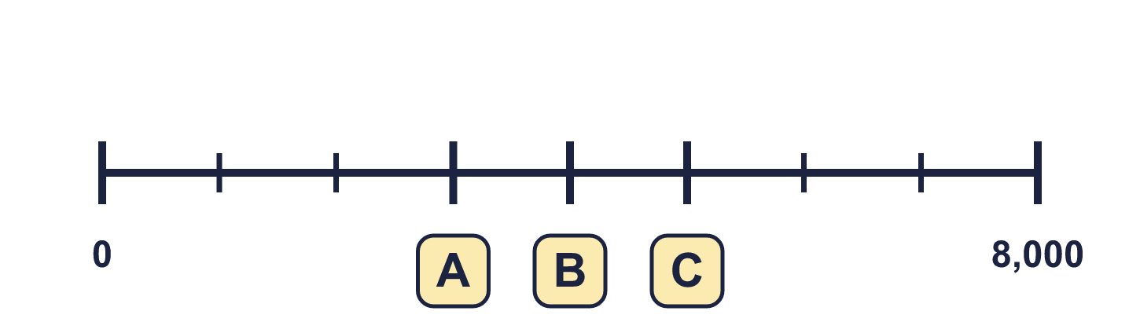
Year 4 · Place value · Step 9 · question 6
I do
You do
“I forgot to write three numbers on my number line.”
“I forgot to write three numbers on my number line.”
A = ________ B = ________ C = ________
A = ________ B = ________ C = ________
1,250, 6,250, 7,500
3,000, 4,000, 5,000
6 of 8
Notes:
Question 6 of 8. I DO: model it out loud, thinking through each step. YOU DO: click the timer (2:30, an estimate) and let pupils try the same type of question with new numbers on their whiteboards. Then click to bring in the answers one at a time: the I do working, the I do answer, then the You do answer. Ask someone who got it wrong to say which step went wrong. Top tip: Answers. I do: 1,250, 6,250, 7,500. You do: 3,000, 4,000, 5,000.

Slide 13

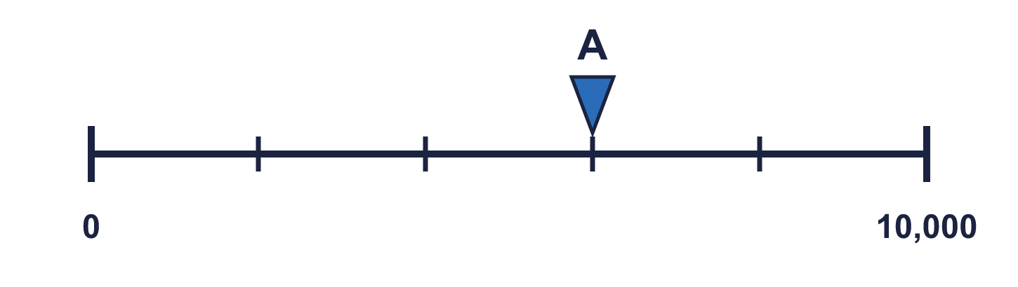
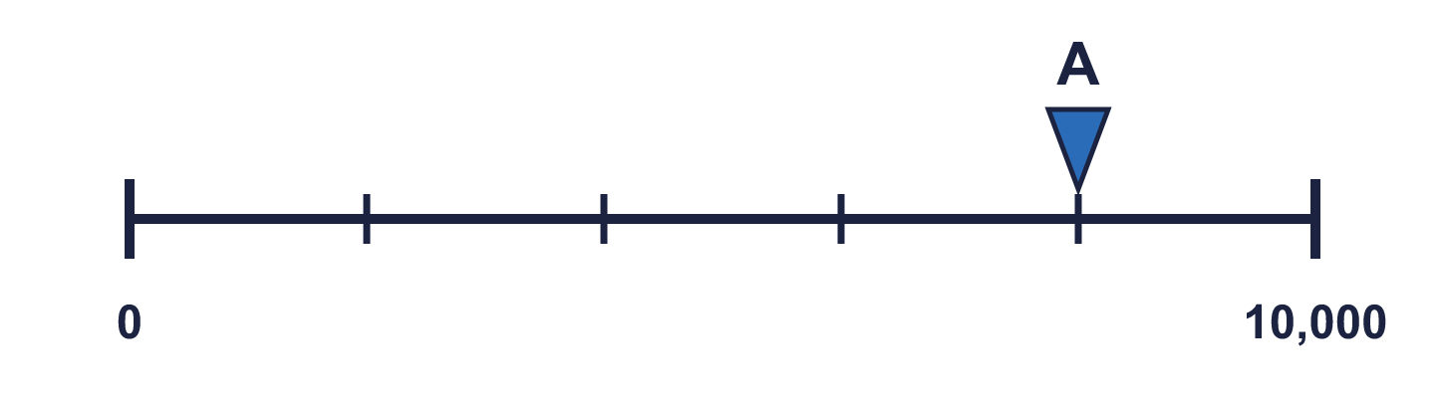
Year 4 · Place value · Step 9 · question 7
I do
You do
“I cut a number line from 0 to 10,000 into 5 equal steps.”
“I cut a number line from 0 to 10,000 into 5 equal steps.”
a) What is each step worth? ________
a) What is each step worth? ________
b) What number is arrow A pointing to? ________
b) What number is arrow A pointing to? ________
a) 2,000
b) 6,000
a) 2,000
b) 8,000
7 of 8
Notes:
Question 7 of 8. I DO: model it out loud, thinking through each step. YOU DO: click the timer (3:00, an estimate) and let pupils try the same type of question with new numbers on their whiteboards. Then click to bring in the answers one at a time: the I do working, the I do answer, then the You do answer. Ask someone who got it wrong to say which step went wrong. Top tip: Answers. I do: a) 2,000 | b) 6,000. You do: a) 2,000 | b) 8,000.

Slide 14
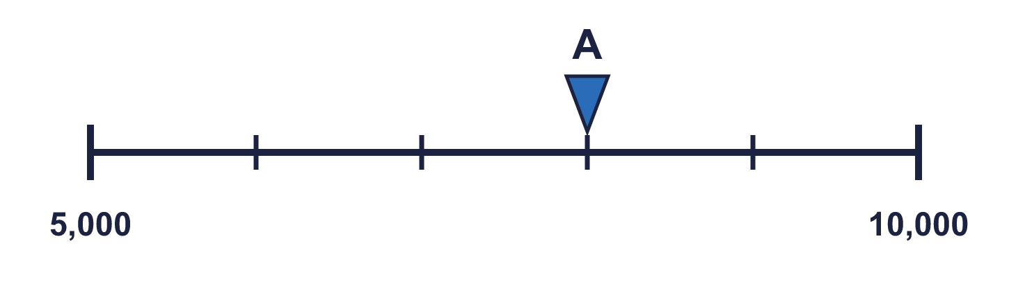
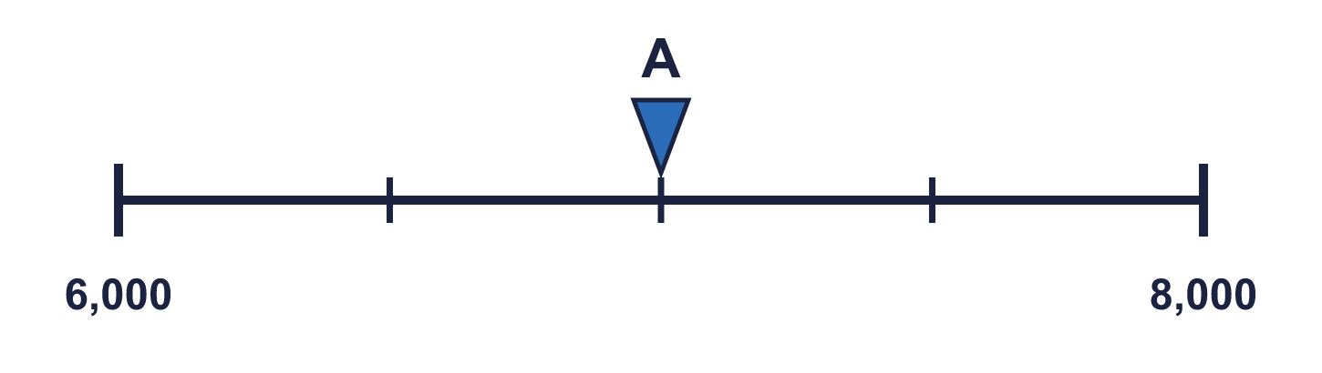
Year 4 · Place value · Step 9 · question 8
I do
You do
“There are 5 equal steps between the start and the end of the line, so I divide 10,000 by 5 to find the size of each step.”
“There are 4 equal steps between the start and the end of the line, so I divide 8,000 by 4 to find the size of each step.”
a) What mistake has Boba made?
a) What mistake has Boba made?
Explain how you know.
Explain how you know.
b) What number is arrow A pointing to? ________
b) What number is arrow A pointing to? ________
Boba divided the end number. The line does not start at 0, so each step is (10,000 − 5,000) ÷ 5 = 1,000.
b) 8,000
Boba divided the end number. The line does not start at 0, so each step is (8,000 − 6,000) ÷ 4 = 500.
b) 7,000
8 of 8
Notes:
Question 8 of 8. I DO: model it out loud, thinking through each step. YOU DO: click the timer (4:00, an estimate) and let pupils try the same type of question with new numbers on their whiteboards. Then click to bring in the answers one at a time: the I do working, the I do answer, then the You do answer. Ask someone who got it wrong to say which step went wrong. Top tip: Answers. I do: Boba divided the end number. The line does not start at 0, so each step is (10,000 − 5,000) ÷ 5 = 1,000. | b) 8,000. You do: Boba divided the end number. The line does not start at 0, so each step is (8,000 − 6,000) ÷ 4 = 500. | b) 7,000.

Slide 15

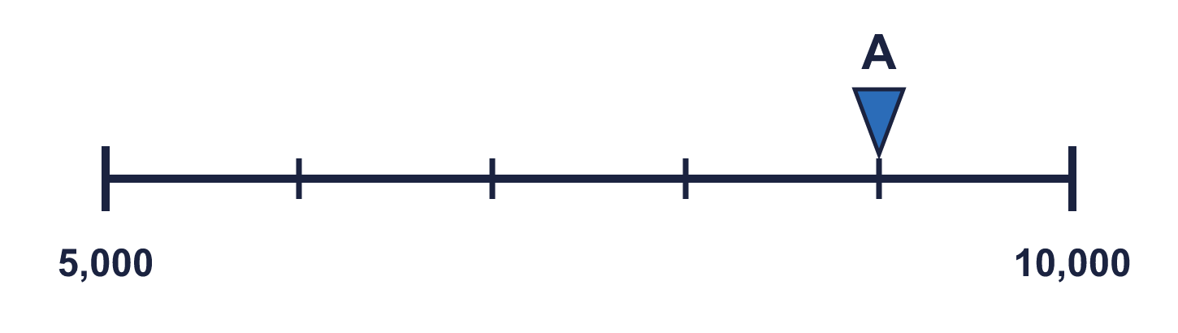


Year 4 · Place value · Step 9
Independent application
Challenge
a) What mistake has Boba made?
Explain how you know.
b) What number is arrow A pointing to? ________
Use the Step 9 worksheet.
Finished? Try the challenge.
Boba divided the end number. The line does not start at 0, so each step is (10,000 − 5,000) ÷ 5 = 1,000. b) 9,000
Notes:
Pupils now work on their own on the Step 9 worksheet from the website (scaffolded or not scaffolded). Click the 20 minute timer to start it. Pupils who finish try the challenge: click to show its answer. The Bobas bounce on their own while the slide is showing. Challenge answers: Boba divided the end number. The line does not start at 0, so each step is (10,000 − 5,000) ÷ 5 = 1,000. | b) 9,000

