Slide 1








Year 4 · Autumn · Place value · Step 7
Flexible partitioning of numbers to 10,000
I do, you do, with a timer. The questions get harder as we go.
Notes:
The Bobas are sitting at their desks, floating up and down, ready to learn. Click a timer in slideshow mode to start it.

Slide 2

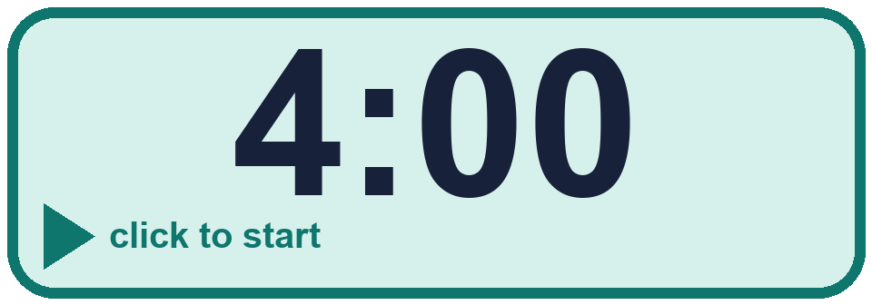
Year 4 · Place value · Step 7
Starter
Last lesson: Partition numbers to 10,000
1. Partition the number. Fill in the missing parts.
8,461 = 8,000 + _____ + 60 + _____
2. Partition the number. Fill in the missing parts.
9,803 = 9,000 + _____ + _____
400 and 1
800 and 3
3. Fill in the missing part of each number sentence.
a) 3,256 = 3,000 + _____
b) 2,195 = _____ + 190 + 5
c) 6,635 = 6,600 + _____ + 5
4. A number is made of 2 thousands, 7 ones, 2 hundreds and 3 tens. What is the number?
________
a) 256 b) 2,000 c) 30
2,237
Notes:
Starter: four quick questions to bring back last lesson (Partition numbers to 10,000). Click the timer, let pupils answer on their whiteboards, then click to show each answer in turn.

Slide 3

Year 4 · Place value · Step 7
Today we are learning…
To partition 4-digit numbers in different ways by exchanging between columns.
I can…
☐ I can exchange 1 hundred for 10 tens.
☐ I can write a number as hundreds and tens.
☐ I can partition a number in more than one way.
☐ I can say when two partitions make the same number.
Notes:
Read the objective aloud. Then ask: where might we need this outside school? The success criteria can be turned into a quick check at the end of the lesson.

Slide 4
Year 4 · Place value · Step 7
Key words
exchange
partition
thousands
hundreds
tens
ones
Notes:
Pupils say each word aloud, then use it in a sentence about today's numbers.

Slide 5

Year 4 · Place value · Step 7
The key ideas
1 hundred is the same as 10 tens.
1 thousand is the same as 10 hundreds.
You can write 3,450 as 3,000 + 400 + 50 or as 2,000 + 1,400 + 50.
Notes:
Talk through the picture first: ask pupils what they notice. Then click to bring in each statement, and the words under the picture, one at a time.

Slide 6
Year 4 · Place value · Step 7
Look out for
When you exchange one, you must add ten to the next column.
The total never changes.
Check by adding all the parts.
Notes:
Talk through the picture first: ask pupils what they notice. Then click to bring in each statement, and the words under the picture, one at a time.

Slide 7

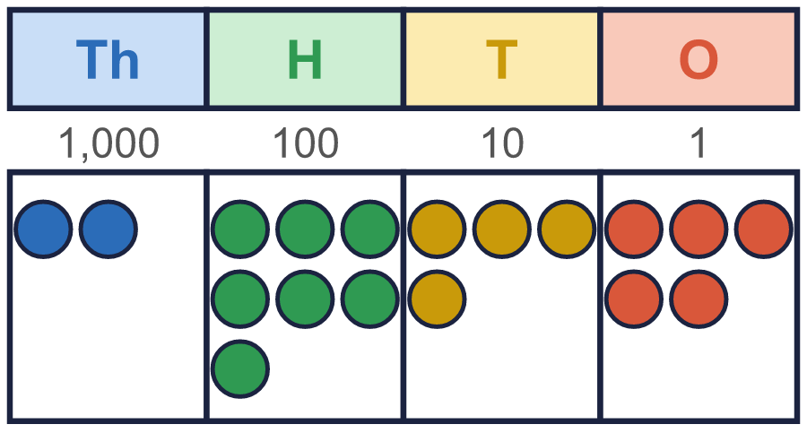
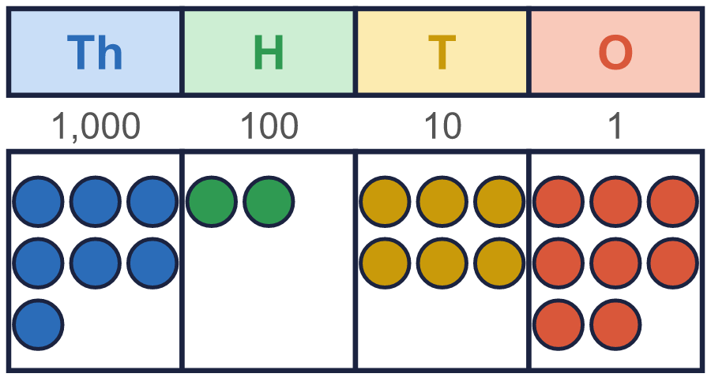
Year 4 · Place value · Step 7 · question 1
I do
You do
Dani exchanges 1 hundred for 10 tens.
Dani exchanges 1 hundred for 10 tens.
How many hundreds are there now? ____
How many hundreds are there now? ____
How many tens are there now? ____
How many tens are there now? ____
6
14
1
16
1 of 8
Notes:
Question 1 of 8. I DO: model it out loud, thinking through each step. YOU DO: click the timer (1:00, an estimate) and let pupils try the same type of question with new numbers on their whiteboards. Then click to bring in the answers one at a time: the I do working, the I do answer, then the You do answer. Ask someone who got it wrong to say which step went wrong. Top tip: Answers. I do: 6 | 14. You do: 1 | 16.

Slide 8
Year 4 · Place value · Step 7 · question 2
I do
You do
Fill in the missing part.
Fill in the missing part.
a) 9,883 = 98 hundreds + _____
a) 4,091 = 40 hundreds + _____
b) 5,549 = 553 tens + _____
b) 4,185 = 416 tens + _____
a) 83
b) 19
a) 91
b) 25
2 of 8
Notes:
Question 2 of 8. I DO: model it out loud, thinking through each step. YOU DO: click the timer (1:00, an estimate) and let pupils try the same type of question with new numbers on their whiteboards. Then click to bring in the answers one at a time: the I do working, the I do answer, then the You do answer. Ask someone who got it wrong to say which step went wrong. Top tip: Answers. I do: a) 83 | b) 19. You do: a) 91 | b) 25.

Slide 9
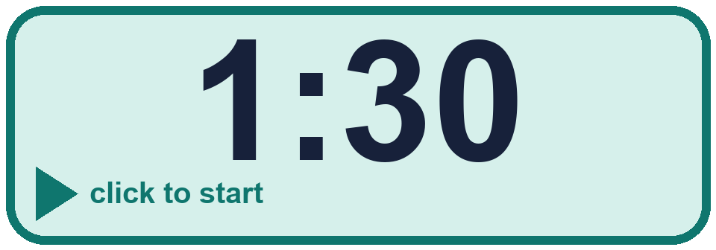
Year 4 · Place value · Step 7 · question 3
I do
You do
A hundred, or a thousand, has been exchanged. Fill in the missing part of each sentence.
A hundred, or a thousand, has been exchanged. Fill in the missing part of each sentence.
a) 8,347 = 8,000 + 200 + _____ + 7
a) 5,642 = 5,000 + 500 + _____ + 2
b) 6,815 = 5,000 + _____ + 10 + 5
b) 7,641 = 6,000 + _____ + 40 + 1
a) 140
b) 1,800
a) 140
b) 1,600
3 of 8
Notes:
Question 3 of 8. I DO: model it out loud, thinking through each step. YOU DO: click the timer (1:30, an estimate) and let pupils try the same type of question with new numbers on their whiteboards. Then click to bring in the answers one at a time: the I do working, the I do answer, then the You do answer. Ask someone who got it wrong to say which step went wrong. Top tip: Answers. I do: a) 140 | b) 1,800. You do: a) 140 | b) 1,600.

Slide 10
Year 4 · Place value · Step 7 · question 4
I do
You do
“Tommy: 32 hundreds is equal to 3,300.”
“Whitney: 24 hundreds is equal to 2,400.”
Is Tommy correct? Circle yes or no.
Is Whitney correct? Circle yes or no.
Explain how you know.
Explain how you know.
No
No. 32 hundreds is 3,200.
Yes
Yes. 24 hundreds is 2,400.
4 of 8
Notes:
Question 4 of 8. I DO: model it out loud, thinking through each step. YOU DO: click the timer (1:30, an estimate) and let pupils try the same type of question with new numbers on their whiteboards. Then click to bring in the answers one at a time: the I do working, the I do answer, then the You do answer. Ask someone who got it wrong to say which step went wrong. Top tip: Answers. I do: No | No. 32 hundreds is 3,200.. You do: Yes | Yes. 24 hundreds is 2,400..

Slide 11

Year 4 · Place value · Step 7 · question 5
I do
You do
Write three parts each time to complete the number sentences. Each sentence must add to 3,284.
Write three parts each time to complete the number sentences. Each sentence must add to 5,273.
3,284 = 3,000 + ____ + ____ + ____
5,273 = 5,000 + ____ + ____ + ____
3,284 = 2,000 + ____ + ____ + ____
5,273 = 4,000 + ____ + ____ + ____
3,284 = 1,000 + ____ + ____ + ____
5,273 = 3,000 + ____ + ____ + ____
for example 90 + 90 + 104; 420 + 430 + 434; 760 + 760 + 764
for example 90 + 90 + 93; 420 + 420 + 433; 750 + 760 + 763
5 of 8
Notes:
Question 5 of 8. I DO: model it out loud, thinking through each step. YOU DO: click the timer (2:00, an estimate) and let pupils try the same type of question with new numbers on their whiteboards. Then click to bring in the answers one at a time: the I do working, the I do answer, then the You do answer. Ask someone who got it wrong to say which step went wrong. Top tip: Answers. I do: for example 90 + 90 + 104; 420 + 430 + 434; 760 + 760 + 764. You do: for example 90 + 90 + 93; 420 + 420 + 433; 750 + 760 + 763.

Slide 12

Year 4 · Place value · Step 7 · question 6
I do
You do
“Mo: 25 hundreds is equal to 2,510.”
“Mo: 46 tens is equal to 360.”
Is Mo correct? Circle yes or no.
Is Mo correct? Circle yes or no.
Explain how you know.
Explain how you know.
No
No. 25 hundreds is 2,500.
No
No. 46 tens is 460.
6 of 8
Notes:
Question 6 of 8. I DO: model it out loud, thinking through each step. YOU DO: click the timer (2:30, an estimate) and let pupils try the same type of question with new numbers on their whiteboards. Then click to bring in the answers one at a time: the I do working, the I do answer, then the You do answer. Ask someone who got it wrong to say which step went wrong. Top tip: Answers. I do: No | No. 25 hundreds is 2,500.. You do: No | No. 46 tens is 460..

Slide 13
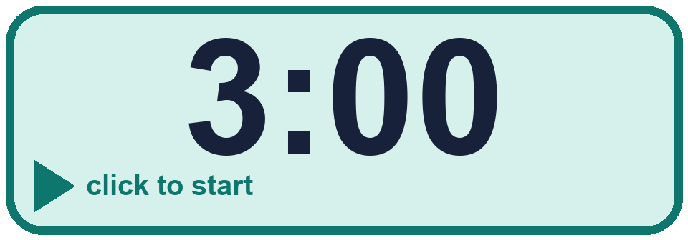
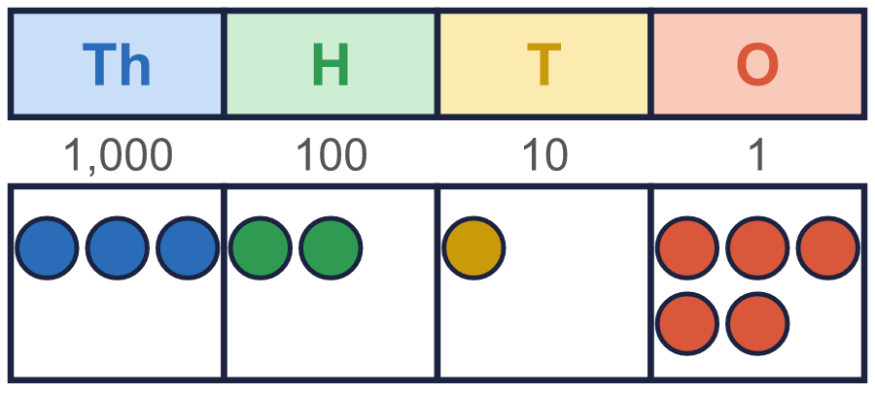
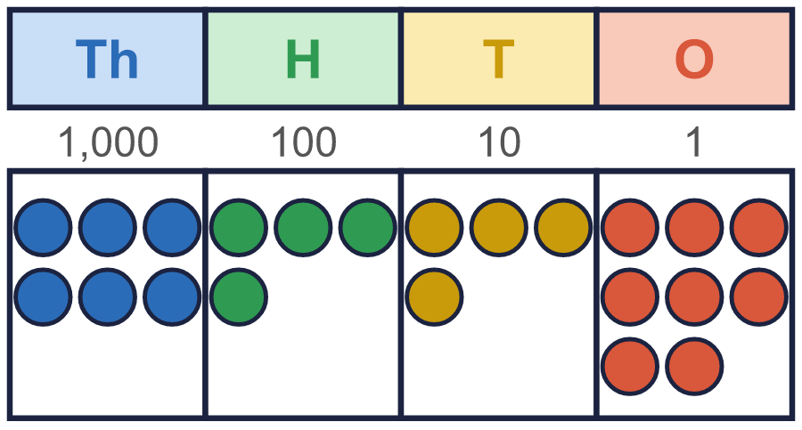
Year 4 · Place value · Step 7 · question 7
I do
You do
Tommy exchanges 1 thousand for 10 hundreds.
Tommy exchanges 1 thousand for 10 hundreds.
How many thousands are there now? ____
How many thousands are there now? ____
How many hundreds are there now? ____
How many hundreds are there now? ____
2
12
5
14
7 of 8
Notes:
Question 7 of 8. I DO: model it out loud, thinking through each step. YOU DO: click the timer (3:00, an estimate) and let pupils try the same type of question with new numbers on their whiteboards. Then click to bring in the answers one at a time: the I do working, the I do answer, then the You do answer. Ask someone who got it wrong to say which step went wrong. Top tip: Answers. I do: 2 | 12. You do: 5 | 14.

Slide 14
Year 4 · Place value · Step 7 · question 8
I do
You do
Write <, > or = in each box.
Write <, > or = in each box.
a) 6 thousands + 3 hundreds ____ 630 tens
a) 3 thousands + 2 hundreds ____ 320 tens
b) 38 hundreds ____ 398 tens
b) 45 hundreds ____ 459 tens
c) 380 tens + 18 ones ____ 3,831
c) 450 tens + 9 ones ____ 4,516
a) =
b) <
c) <
a) =
b) <
c) <
8 of 8
Notes:
Question 8 of 8. I DO: model it out loud, thinking through each step. YOU DO: click the timer (4:00, an estimate) and let pupils try the same type of question with new numbers on their whiteboards. Then click to bring in the answers one at a time: the I do working, the I do answer, then the You do answer. Ask someone who got it wrong to say which step went wrong. Top tip: Answers. I do: a) = | b) < | c) <. You do: a) = | b) < | c) <.

Slide 15
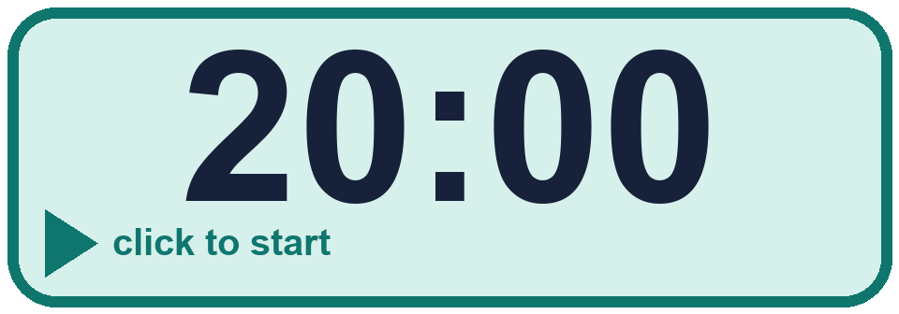


Year 4 · Place value · Step 7
Independent application
Challenge
Write <, > or = in each box.
a) 5 thousands + 6 hundreds ____ 560 tens
b) 40 hundreds ____ 416 tens
c) 400 tens + 16 ones ____ 4,028
Use the Step 7 worksheet.
Finished? Try the challenge.
a) = b) < c) <
Notes:
Pupils now work on their own on the Step 7 worksheet from the website (scaffolded or not scaffolded). Click the 20 minute timer to start it. Pupils who finish try the challenge: click to show its answer. The Bobas bounce on their own while the slide is showing. Challenge answers: a) = | b) < | c) <

