Slide 1








Year 4 · Autumn · Place value · Step 11
Compare numbers to 10,000
I do, you do, with a timer. The questions get harder as we go.
Notes:
The Bobas are sitting at their desks, floating up and down, ready to learn. Click a timer in slideshow mode to start it.

Slide 2


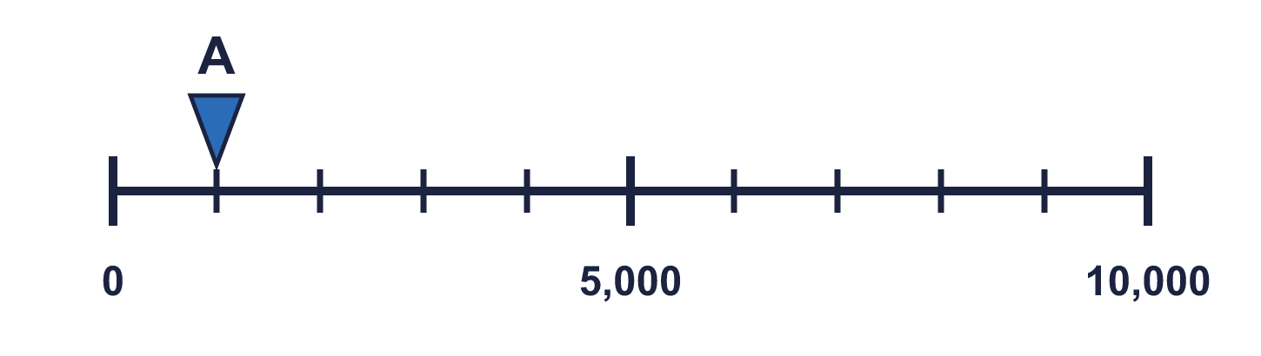
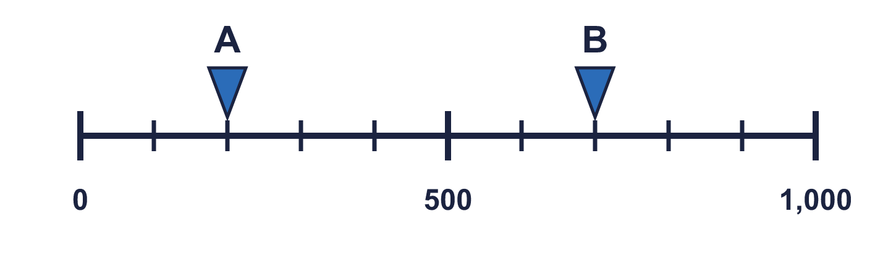
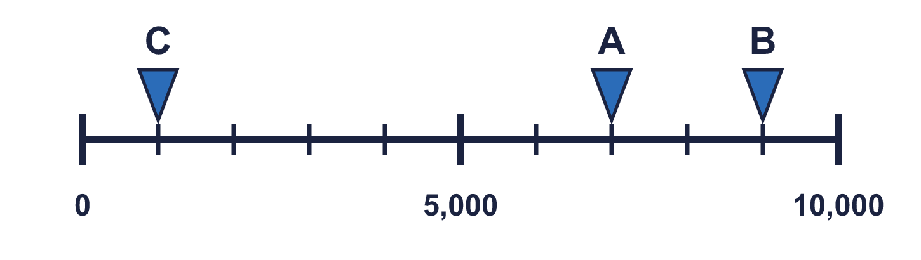
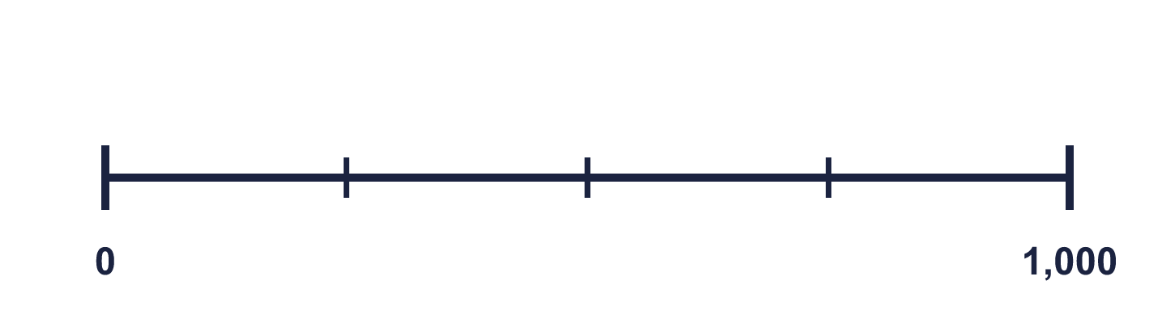
Year 4 · Place value · Step 11
Starter
Last lesson: Estimate on a number line to 10,000
1. What number is the arrow pointing to?
________
2. What numbers are the arrows pointing to?
A = ________ B = ________
1,000
A 200 B 700
3. Which arrow points to 1,000? Write its letter.
Answer: _____
4. Look at the number line.
The difference between the start and the end is ________
There are _____ equal intervals.
The line counts up in ________
C
1,000 4 250
Notes:
Starter: four quick questions to bring back last lesson (Estimate on a number line to 10,000). Click the timer, let pupils answer on their whiteboards, then click to show each answer in turn.

Slide 3

Year 4 · Place value · Step 11
Today we are learning…
To compare numbers up to 10,000.
I can…
☐ I can compare numbers with the thousands digit first.
☐ I can use <, > and = correctly.
☐ I can compare numbers in pictures and place value charts.
☐ I can put numbers in order.
Notes:
Read the objective aloud. Then ask: where might we need this outside school? The success criteria can be turned into a quick check at the end of the lesson.

Slide 4
Year 4 · Place value · Step 11
Key words
compare
order
greater than
less than
equal to
ascending
Notes:
Pupils say each word aloud, then use it in a sentence about today's numbers.

Slide 5

Year 4 · Place value · Step 11
The key ideas
Start comparing at the biggest column on the left.
If the thousands match, look at the hundreds, and so on.
The symbol always opens towards the bigger number.
Notes:
Talk through the picture first: ask pupils what they notice. Then click to bring in each statement, and the words under the picture, one at a time.

Slide 6
Year 4 · Place value · Step 11
Look out for
Do not compare the lengths of the numbers when they have the same number of digits.
Write numbers in a place value chart to line them up.
Check ascending is smallest first.
Notes:
Talk through the picture first: ask pupils what they notice. Then click to bring in each statement, and the words under the picture, one at a time.

Slide 7


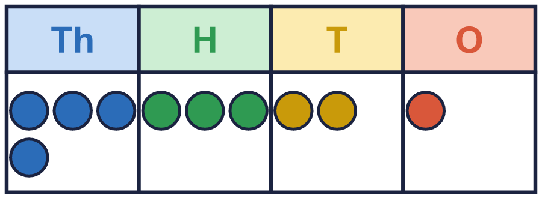
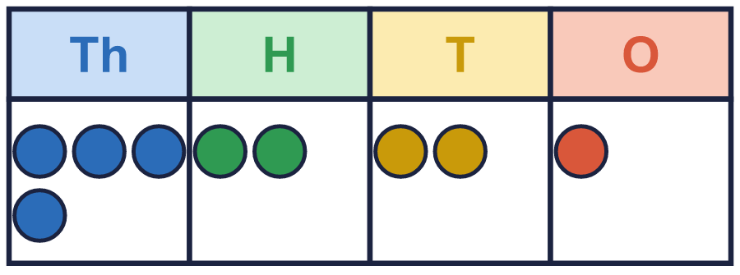
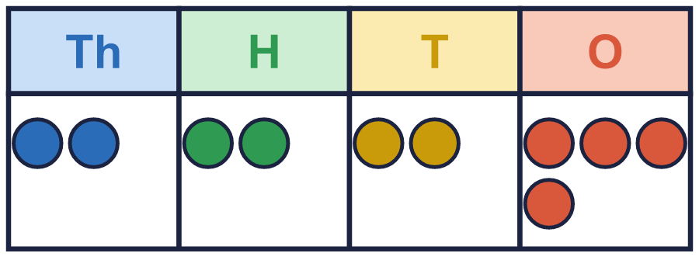
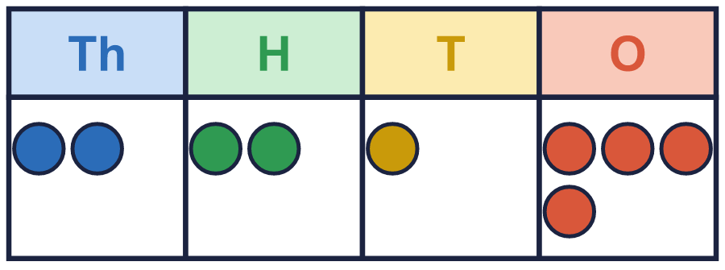
Year 4 · Place value · Step 11 · question 1
I do
You do
Write the number shown in each place value chart. Then write <, > or = to compare them.
Write the number shown in each place value chart. Then write <, > or = to compare them.
Chart A
Chart A
Chart B
Chart B
A = ________ B = ________
A = ________ B = ________
A _____ B
A _____ B
A 4,321 B 4,221
>
A 2,224 B 2,214
>
1 of 8
Notes:
Question 1 of 8. I DO: model it out loud, thinking through each step. YOU DO: click the timer (1:00, an estimate) and let pupils try the same type of question with new numbers on their whiteboards. Then click to bring in the answers one at a time: the I do working, the I do answer, then the You do answer. Ask someone who got it wrong to say which step went wrong. Top tip: Answers. I do: A 4,321 B 4,221 | >. You do: A 2,224 B 2,214 | >.

Slide 8
Year 4 · Place value · Step 11 · question 2
I do
You do
Circle the greater number in each pair. Write it.
Circle the greater number in each pair. Write it.
a) 100 or 5,000 ________
a) 600 or 8,000 ________
b) 825 or 725 ________
b) 319 or 329 ________
c) 3,946 or 3,947 ________
c) 7,661 or 7,561 ________
d) 2,999 or 4,475 ________
d) 9,399 or 5,689 ________
a) 5,000
b) 825
c) 3,947
d) 4,475
a) 8,000
b) 329
c) 7,661
d) 9,399
2 of 8
Notes:
Question 2 of 8. I DO: model it out loud, thinking through each step. YOU DO: click the timer (1:00, an estimate) and let pupils try the same type of question with new numbers on their whiteboards. Then click to bring in the answers one at a time: the I do working, the I do answer, then the You do answer. Ask someone who got it wrong to say which step went wrong. Top tip: Answers. I do: a) 5,000 | b) 825 | c) 3,947 | d) 4,475. You do: a) 8,000 | b) 329 | c) 7,661 | d) 9,399.

Slide 9

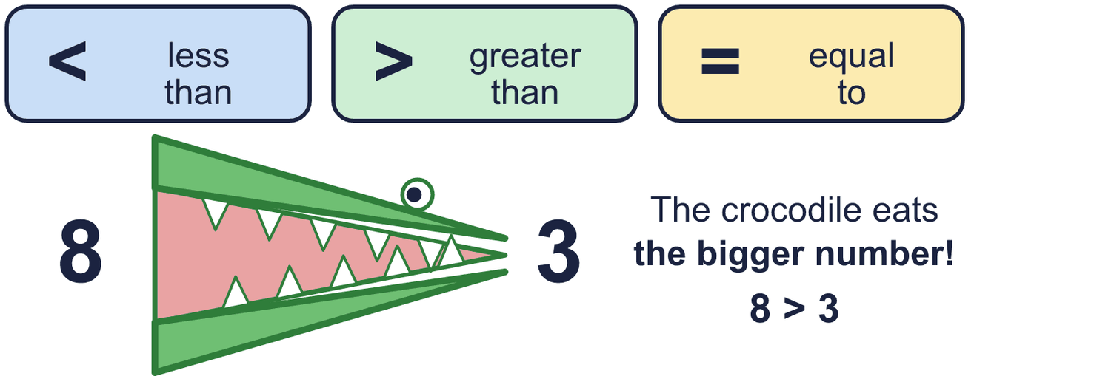
Year 4 · Place value · Step 11 · question 3
I do
You do
Write a digit in each box to make the statement correct. There may be more than one answer.
Write a digit in each box to make the statement correct. There may be more than one answer.
a) 8 ____ 3 > 876
a) 3 ____ 8 > 349
b) 9,4 ____ 1 < 9,455
b) 9,1 ____ 3 < 9,154
c) ____ ,767 > 5,767
c) ____ ,236 > 5,239
a) 8, 9
b) 0, 1, 2, 3, 4, 5
c) 6, 7, 8, 9
a) 5, 6, 7, 8, 9
b) 0, 1, 2, 3, 4, 5
c) 6, 7, 8, 9
3 of 8
Notes:
Question 3 of 8. I DO: model it out loud, thinking through each step. YOU DO: click the timer (1:30, an estimate) and let pupils try the same type of question with new numbers on their whiteboards. Then click to bring in the answers one at a time: the I do working, the I do answer, then the You do answer. Ask someone who got it wrong to say which step went wrong. Top tip: Answers. I do: a) 8, 9 | b) 0, 1, 2, 3, 4, 5 | c) 6, 7, 8, 9. You do: a) 5, 6, 7, 8, 9 | b) 0, 1, 2, 3, 4, 5 | c) 6, 7, 8, 9.

Slide 10
Year 4 · Place value · Step 11 · question 4
I do
You do
Write <, > or = in each box.
Write <, > or = in each box.
a) XCI _____ 100
a) LXV _____ 65
b) LXVII _____ 59
b) XLIII _____ 40
c) XXI _____ 18
c) LXXXV _____ 88
a) <
b) >
c) >
a) =
b) >
c) <
4 of 8
Notes:
Question 4 of 8. I DO: model it out loud, thinking through each step. YOU DO: click the timer (1:30, an estimate) and let pupils try the same type of question with new numbers on their whiteboards. Then click to bring in the answers one at a time: the I do working, the I do answer, then the You do answer. Ask someone who got it wrong to say which step went wrong. Top tip: Answers. I do: a) < | b) > | c) >. You do: a) = | b) > | c) <.

Slide 11

Year 4 · Place value · Step 11 · question 5
I do
You do
“I put these numbers in order, smallest first.”
“I put these numbers in order, smallest first.”
1,379 913 5,439 9,498
3,902 875 5,297 9,912
Is Boba correct? Circle yes or no.
Is Boba correct? Circle yes or no.
Explain how you know.
Explain how you know.
No
1,379 is bigger than 913, so it should come after it. The numbers should be: 913, 1,379, 5,439, 9,498.
No
3,902 is bigger than 875, so it should come after it. The numbers should be: 875, 3,902, 5,297, 9,912.
5 of 8
Notes:
Question 5 of 8. I DO: model it out loud, thinking through each step. YOU DO: click the timer (2:00, an estimate) and let pupils try the same type of question with new numbers on their whiteboards. Then click to bring in the answers one at a time: the I do working, the I do answer, then the You do answer. Ask someone who got it wrong to say which step went wrong. Top tip: Answers. I do: No | 1,379 is bigger than 913, so it should come after it. The numbers should be: 913, 1,379, 5,439, 9,498.. You do: No | 3,902 is bigger than 875, so it should come after it. The numbers should be: 875, 3,902, 5,297, 9,912..

Slide 12

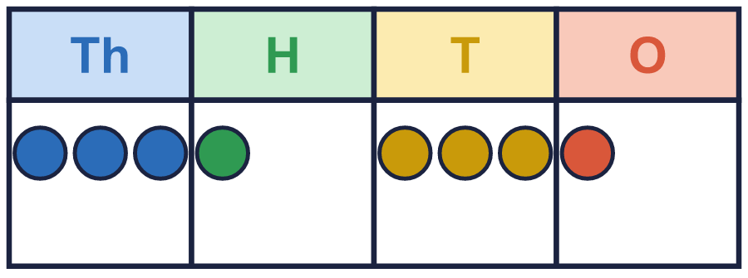
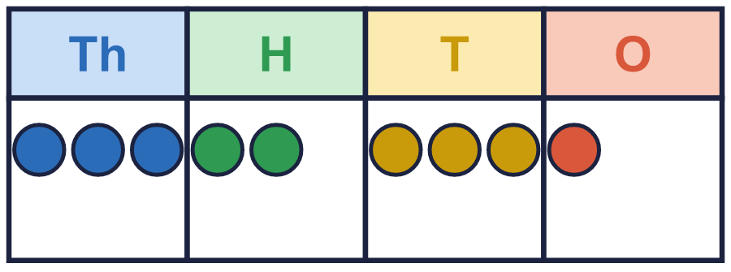
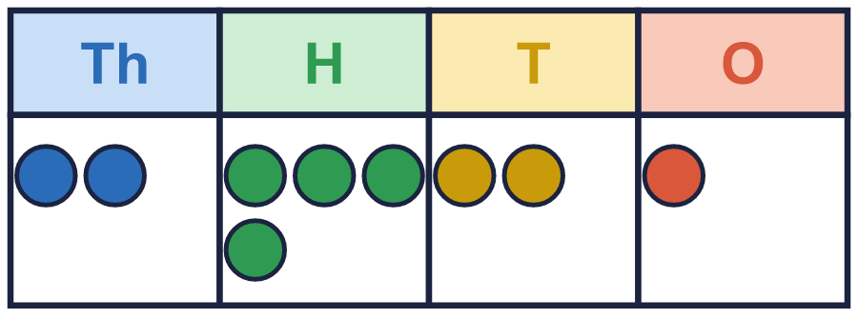
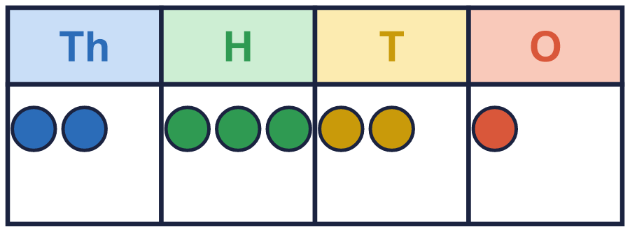
Year 4 · Place value · Step 11 · question 6
I do
You do
Look at the two place value charts.
Look at the two place value charts.
a) Which chart shows the greater number? Write A or B. _____
a) Which chart shows the greater number? Write A or B. _____
b) How much greater is it? ________
b) How much greater is it? ________
a) B
b) 100
a) A
b) 100
6 of 8
Notes:
Question 6 of 8. I DO: model it out loud, thinking through each step. YOU DO: click the timer (2:30, an estimate) and let pupils try the same type of question with new numbers on their whiteboards. Then click to bring in the answers one at a time: the I do working, the I do answer, then the You do answer. Ask someone who got it wrong to say which step went wrong. Top tip: Answers. I do: a) B | b) 100. You do: a) A | b) 100.

Slide 13

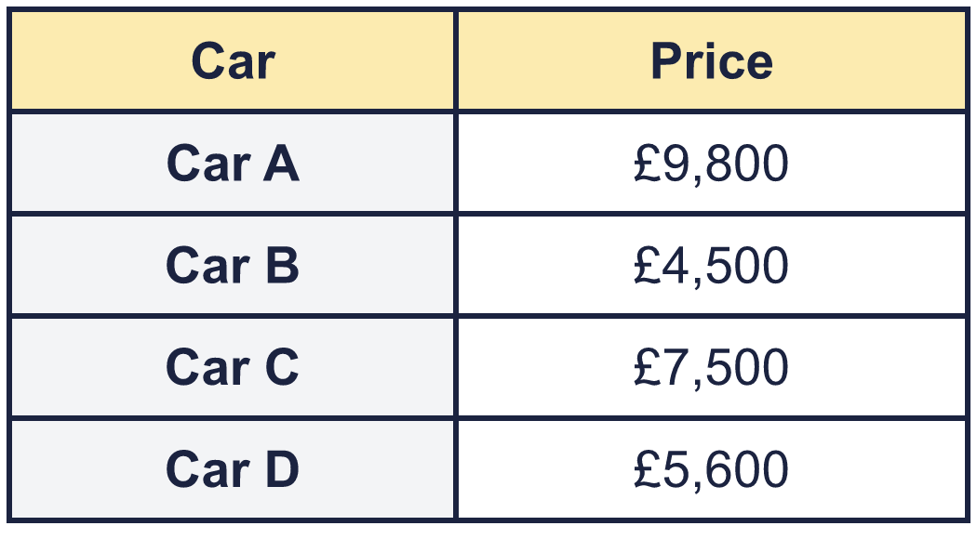
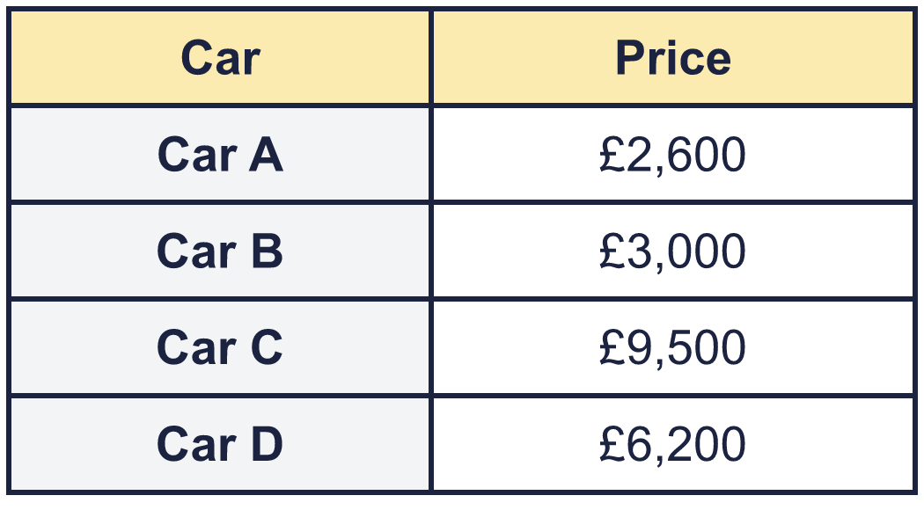
Year 4 · Place value · Step 11 · question 7
I do
You do
“I am looking at the prices of four cars.”
“I am looking at the prices of four cars.”
a) Write the cars in order, most expensive first. ____________________
a) Write the cars in order, most expensive first. ____________________
b) How much more is the most expensive car than the cheapest? ________
b) How much more is the most expensive car than the cheapest? ________
a) Car A, Car C, Car D, Car B
b) £5,300
a) Car C, Car D, Car B, Car A
b) £6,900
7 of 8
Notes:
Question 7 of 8. I DO: model it out loud, thinking through each step. YOU DO: click the timer (3:00, an estimate) and let pupils try the same type of question with new numbers on their whiteboards. Then click to bring in the answers one at a time: the I do working, the I do answer, then the You do answer. Ask someone who got it wrong to say which step went wrong. Top tip: Answers. I do: a) Car A, Car C, Car D, Car B | b) £5,300. You do: a) Car C, Car D, Car B, Car A | b) £6,900.

Slide 14
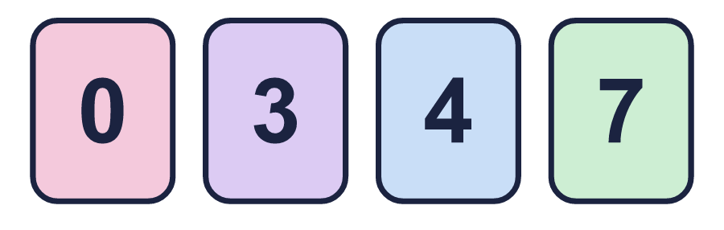
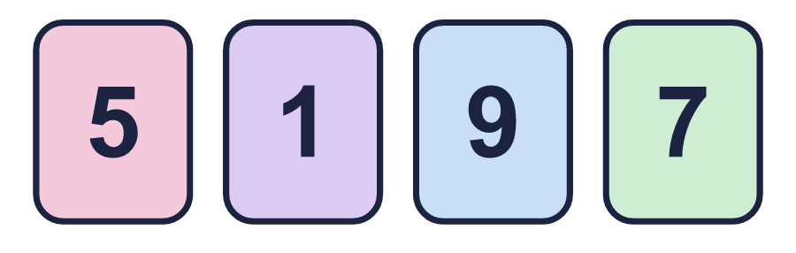
Year 4 · Place value · Step 11 · question 8
I do
You do
“I have four digit cards. I use all four cards each time.”
“I have four digit cards. I use all four cards each time.”
a) What is the largest 4-digit number I can make? ________
a) What is the largest 4-digit number I can make? ________
b) What is the smallest 4-digit number I can make? ________
b) What is the smallest 4-digit number I can make? ________
c) How much greater is the largest than the smallest? ________
c) How much greater is the largest than the smallest? ________
a) 7,430
b) 3,047
c) 4,383
a) 9,751
b) 1,579
c) 8,172
8 of 8
Notes:
Question 8 of 8. I DO: model it out loud, thinking through each step. YOU DO: click the timer (4:00, an estimate) and let pupils try the same type of question with new numbers on their whiteboards. Then click to bring in the answers one at a time: the I do working, the I do answer, then the You do answer. Ask someone who got it wrong to say which step went wrong. Top tip: Answers. I do: a) 7,430 | b) 3,047 | c) 4,383. You do: a) 9,751 | b) 1,579 | c) 8,172.

Slide 15

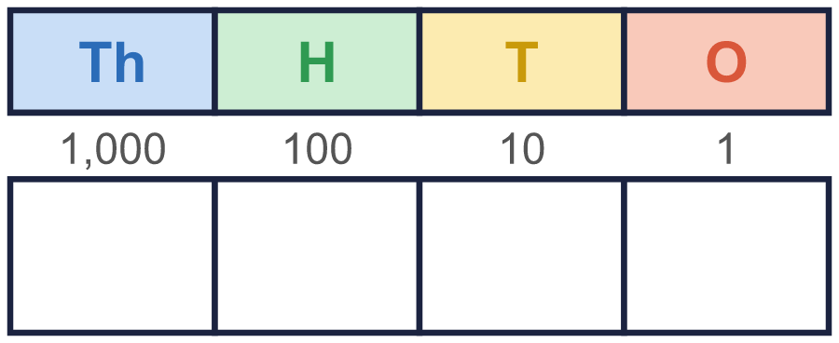


Year 4 · Place value · Step 11
Independent application
Challenge
Use five counters to make four different numbers in a place value chart. Write your numbers in order, smallest first.
Use the Step 11 worksheet.
Finished? Try the challenge.
Any four different numbers whose digits add up to 5, for example 1,004, 1,112, 2,003, 4,001
Notes:
Pupils now work on their own on the Step 11 worksheet from the website (scaffolded or not scaffolded). Click the 20 minute timer to start it. Pupils who finish try the challenge: click to show its answer. The Bobas bounce on their own while the slide is showing. Challenge answers: Any four different numbers whose digits add up to 5, for example 1,004, 1,112, 2,003, 4,001

