Slide 1








Year 4 · Autumn · Addition and subtraction · Step 8
Efficient subtraction
I do, you do, with a timer. The questions get harder as we go.
Notes:
The Bobas are sitting at their desks, floating up and down, ready to learn. Click a timer in slideshow mode to start it.

Slide 2


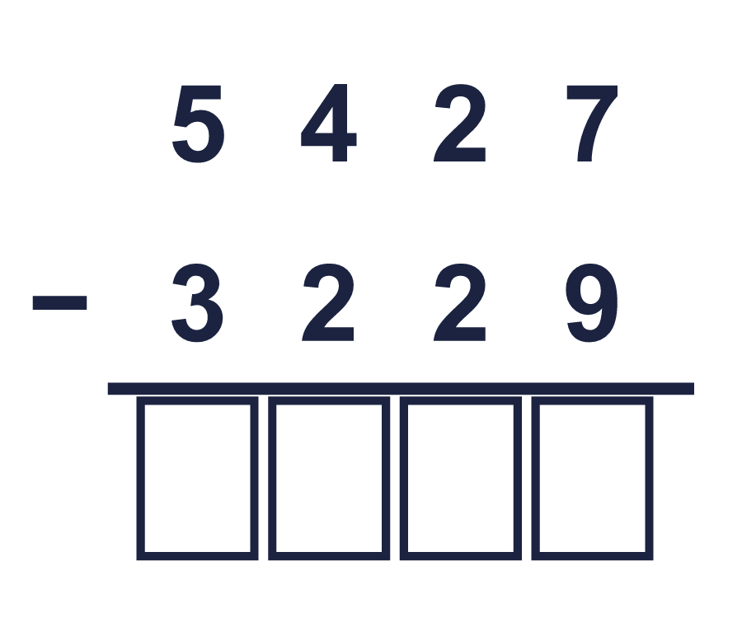
Year 4 · Addition and subtraction · Step 8
Starter
Last lesson: Subtract two 4-digit numbers with more than one exchange
1. Work out the subtractions.
a) 615 − 239 = ________
b) 1,419 − 583 = ________
c) 6,236 − 1,280 = ________
2. Work out the subtractions. They all start with 7,839.
a) 7,839 − 2,242 = ________
b) 7,839 − 2,893 = ________
c) 7,839 − 3,392 = ________
a) 376 b) 836 c) 4,956
a) 5,597 b) 4,946 c) 4,447
3. Work out the subtractions. Take care with the zeros.
a) 7,000 − 179 = ________
b) 8,005 − 1,503 = ________
c) 10,000 − 2,517 = ________
4. Complete the column subtraction. Write the missing digits in the answer.
Answer: ________
a) 6,821 b) 6,502 c) 7,483
2,198
Notes:
Starter: four quick questions to bring back last lesson (Subtract two 4-digit numbers with more than one exchange). Click the timer, let pupils answer on their whiteboards, then click to show each answer in turn.

Slide 3

Year 4 · Addition and subtraction · Step 8
Today we are learning…
To subtract efficiently by choosing a quick method.
I can…
☐ I can count on to find a small difference.
☐ I can subtract from a round number.
☐ I can change both numbers by the same amount.
☐ I can choose the quickest method.
Notes:
Read the objective aloud. Then ask: where might we need this outside school? The success criteria can be turned into a quick check at the end of the lesson.

Slide 4
Year 4 · Addition and subtraction · Step 8
Key words
count on
difference
round number
efficient
subtract
adjust
Notes:
Pupils say each word aloud, then use it in a sentence about today's numbers.

Slide 5
Year 4 · Addition and subtraction · Step 8
The key ideas
If two numbers are close, count on from the smaller to the bigger.
If you add the same to both numbers, the difference stays the same.
Choose the method that is quickest for the numbers.
Notes:
Talk through the picture first: ask pupils what they notice. Then click to bring in each statement, and the words under the picture, one at a time.

Slide 6
Year 4 · Addition and subtraction · Step 8
Look out for
Look at the numbers before choosing a method.
Do the same to both numbers.
Check by adding.
Notes:
Talk through the picture first: ask pupils what they notice. Then click to bring in each statement, and the words under the picture, one at a time.

Slide 7


Year 4 · Addition and subtraction · Step 8 · question 1
I do
You do
Work out the subtractions by counting on.
Work out the subtractions by counting on.
a) 605 − 597 = ________
a) 802 − 799 = ________
b) 4,007 − 3,993 = ________
b) 8,004 − 7,994 = ________
c) 2,003 − 1,998 = ________
c) 6,006 − 5,992 = ________
d) 802 − 791 = ________
d) 201 − 193 = ________
a) 8
b) 14
c) 5
d) 11
a) 3
b) 10
c) 14
d) 8
1 of 8
Notes:
Question 1 of 8. I DO: model it out loud, thinking through each step. YOU DO: click the timer (1:00, an estimate) and let pupils try the same type of question with new numbers on their whiteboards. Then click to bring in the answers one at a time: the I do working, the I do answer, then the You do answer. Ask someone who got it wrong to say which step went wrong. Top tip: Answers. I do: a) 8 | b) 14 | c) 5 | d) 11. You do: a) 3 | b) 10 | c) 14 | d) 8.

Slide 8
Year 4 · Addition and subtraction · Step 8 · question 2
I do
You do
Rosie works out 400 − 322 by taking 1 from both numbers. Work out both calculations.
Rosie works out 600 − 557 by taking 1 from both numbers. Work out both calculations.
a) 399 − 321 = ________
a) 599 − 556 = ________
b) 400 − 322 = ________
b) 600 − 557 = ________
a) 78
b) 78
a) 43
b) 43
2 of 8
Notes:
Question 2 of 8. I DO: model it out loud, thinking through each step. YOU DO: click the timer (1:00, an estimate) and let pupils try the same type of question with new numbers on their whiteboards. Then click to bring in the answers one at a time: the I do working, the I do answer, then the You do answer. Ask someone who got it wrong to say which step went wrong. Top tip: Answers. I do: a) 78 | b) 78. You do: a) 43 | b) 43.

Slide 9

Year 4 · Addition and subtraction · Step 8 · question 3
I do
You do
Work out the subtractions in your head. Look carefully at the second number.
Work out the subtractions in your head. Look carefully at the second number.
a) 4,179 − 997 = ________
a) 5,982 − 997 = ________
b) 7,445 − 998 = ________
b) 8,435 − 1,999 = ________
c) 7,232 − 2,999 = ________
c) 4,114 − 2,999 = ________
d) 3,462 − 1,999 = ________
d) 5,634 − 998 = ________
a) 3,182
b) 6,447
c) 4,233
d) 1,463
a) 4,985
b) 6,436
c) 1,115
d) 4,636
3 of 8
Notes:
Question 3 of 8. I DO: model it out loud, thinking through each step. YOU DO: click the timer (1:30, an estimate) and let pupils try the same type of question with new numbers on their whiteboards. Then click to bring in the answers one at a time: the I do working, the I do answer, then the You do answer. Ask someone who got it wrong to say which step went wrong. Top tip: Answers. I do: a) 3,182 | b) 6,447 | c) 4,233 | d) 1,463. You do: a) 4,985 | b) 6,436 | c) 1,115 | d) 4,636.

Slide 10
Year 4 · Addition and subtraction · Step 8 · question 4
I do
You do
Eva works out 5,261 − 2,999 by subtracting 3,000 first and then adding 1. Work out both calculations.
Eva works out 4,136 − 1,999 by subtracting 2,000 first and then adding 1. Work out both calculations.
a) 5,261 − 3,000 = ________
a) 4,136 − 2,000 = ________
b) 5,261 − 2,999 = ________
b) 4,136 − 1,999 = ________
a) 2,261
b) 2,262
a) 2,136
b) 2,137
4 of 8
Notes:
Question 4 of 8. I DO: model it out loud, thinking through each step. YOU DO: click the timer (1:30, an estimate) and let pupils try the same type of question with new numbers on their whiteboards. Then click to bring in the answers one at a time: the I do working, the I do answer, then the You do answer. Ask someone who got it wrong to say which step went wrong. Top tip: Answers. I do: a) 2,261 | b) 2,262. You do: a) 2,136 | b) 2,137.

Slide 11

Year 4 · Addition and subtraction · Step 8 · question 5
I do
You do
“To work out 8,400 − 2,997, I take away 3,000. My answer is 5,400.”
“To work out 6,300 − 2,998, I take away 3,000. My answer is 3,300.”
Is Boba correct? Circle yes or no.
Is Boba correct? Circle yes or no.
What is the correct answer? ________
What is the correct answer? ________
Explain Boba’s mistake.
Explain Boba’s mistake.
No
5,403
8,400 − 2,997 = 5,403. Boba took away 3 too many, so 3 must be added back.
No
3,302
6,300 − 2,998 = 3,302. Boba took away 2 too many, so 2 must be added back.
5 of 8
Notes:
Question 5 of 8. I DO: model it out loud, thinking through each step. YOU DO: click the timer (2:00, an estimate) and let pupils try the same type of question with new numbers on their whiteboards. Then click to bring in the answers one at a time: the I do working, the I do answer, then the You do answer. Ask someone who got it wrong to say which step went wrong. Top tip: Answers. I do: No | 5,403 | 8,400 − 2,997 = 5,403. Boba took away 3 too many, so 3 must be added back.. You do: No | 3,302 | 6,300 − 2,998 = 3,302. Boba took away 2 too many, so 2 must be added back..

Slide 12

Year 4 · Addition and subtraction · Step 8 · question 6
I do
You do
A shop has £7,000. It spends £2,994 on stock and £201 on rent.
A shop has £7,000. It spends £2,991 on stock and £301 on rent.
How much money is left? ________
How much money is left? ________
£3,805
£3,708
6 of 8
Notes:
Question 6 of 8. I DO: model it out loud, thinking through each step. YOU DO: click the timer (2:30, an estimate) and let pupils try the same type of question with new numbers on their whiteboards. Then click to bring in the answers one at a time: the I do working, the I do answer, then the You do answer. Ask someone who got it wrong to say which step went wrong. Top tip: Answers. I do: £3,805. You do: £3,708.

Slide 13

Year 4 · Addition and subtraction · Step 8 · question 7
I do
You do
Write the missing number in each calculation.
Write the missing number in each calculation.
a) 6,300 − ________ = 996
a) 7,300 − ________ = 1,999
b) ________ − 1,997 = 3,400
b) ________ − 998 = 6,800
a) 5,304
b) 5,397
a) 5,301
b) 7,798
7 of 8
Notes:
Question 7 of 8. I DO: model it out loud, thinking through each step. YOU DO: click the timer (3:00, an estimate) and let pupils try the same type of question with new numbers on their whiteboards. Then click to bring in the answers one at a time: the I do working, the I do answer, then the You do answer. Ask someone who got it wrong to say which step went wrong. Top tip: Answers. I do: a) 5,304 | b) 5,397. You do: a) 5,301 | b) 7,798.

Slide 14
Year 4 · Addition and subtraction · Step 8 · question 8
I do
You do
A tank holds 10,000 ml of water. 5,998 ml is used. Then 201 ml is added.
A tank holds 10,000 ml of water. 5,990 ml is used. Then 221 ml is added.
a) How much water is in the tank now? ________ ml
a) How much water is in the tank now? ________ ml
a) 4,203
a) 4,231
8 of 8
Notes:
Question 8 of 8. I DO: model it out loud, thinking through each step. YOU DO: click the timer (4:00, an estimate) and let pupils try the same type of question with new numbers on their whiteboards. Then click to bring in the answers one at a time: the I do working, the I do answer, then the You do answer. Ask someone who got it wrong to say which step went wrong. Top tip: Answers. I do: a) 4,203. You do: a) 4,231.

Slide 15




Year 4 · Addition and subtraction · Step 8
Independent application
Challenge
Write two different subtractions of two 4-digit numbers with an answer of exactly 99.
Use the Step 8 worksheet.
Finished? Try the challenge.
for example 4,099 − 4,000 and 5,102 − 5,003
Notes:
Pupils now work on their own on the Step 8 worksheet from the website (scaffolded or not scaffolded). Click the 20 minute timer to start it. Pupils who finish try the challenge: click to show its answer. The Bobas bounce on their own while the slide is showing. Challenge answers: for example 4,099 − 4,000 and 5,102 − 5,003

