Slide 1








Year 4 · Autumn · Addition and subtraction · Step 10
Checking strategies
I do, you do, with a timer. The questions get harder as we go.
Notes:
The Bobas are sitting at their desks, floating up and down, ready to learn. Click a timer in slideshow mode to start it.

Slide 2

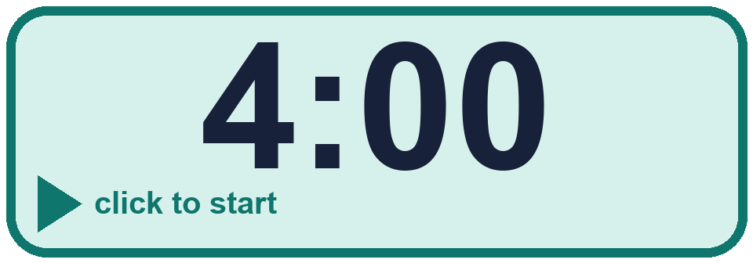
Year 4 · Addition and subtraction · Step 10
Starter
Last lesson: Estimate answers
1. Rosie rounds each number to the nearest 100 to estimate the answer. Then she works out the actual answer.
1,463 + 264. Round each number to the nearest 100.
Estimate: ________
Actual answer: ________
2. Round each number to the nearest 10 to estimate the answers.
a) 143 + 343 (nearest 10) ≈ ________
b) 534 − 77 (nearest 10) ≈ ________
c) 518 + 199 (nearest 10) ≈ ________
1,800 1,727
a) 480 b) 450 c) 720
3. Round each number to the nearest 100 to estimate the answers.
a) 7,524 + 629 (nearest 100) ≈ ________
b) 7,536 − 913 (nearest 100) ≈ ________
4. Round each number to the nearest 1,000 to estimate the answers.
a) 2,340 + 2,735 (nearest 1,000) ≈ ________
b) 9,856 − 6,129 (nearest 1,000) ≈ ________
a) 8,100 b) 6,600
a) 5,000 b) 4,000
Notes:
Starter: four quick questions to bring back last lesson (Estimate answers). Click the timer, let pupils answer on their whiteboards, then click to show each answer in turn.

Slide 3
Year 4 · Addition and subtraction · Step 10
Today we are learning…
To check answers using inverse operations and fact families.
I can…
☐ I can choose the subtractions that check an addition.
☐ I can choose the additions that check a subtraction.
☐ I can use an inverse operation to check an answer.
☐ I can complete a fact family.
Notes:
Read the objective aloud. Then ask: where might we need this outside school? The success criteria can be turned into a quick check at the end of the lesson.

Slide 4
Year 4 · Addition and subtraction · Step 10
Key words
check
inverse
fact family
addition
subtraction
mistake
Notes:
Pupils say each word aloud, then use it in a sentence about today's numbers.

Slide 5
Year 4 · Addition and subtraction · Step 10
The key ideas
Addition and subtraction are opposites, so use one to check the other.
If 271 + 516 = 787, then 787 − 271 = 516 and 787 − 516 = 271.
Checking with the same calculation again can repeat the same mistake.
Notes:
Talk through the picture first: ask pupils what they notice. Then click to bring in each statement, and the words under the picture, one at a time.

Slide 6

Year 4 · Addition and subtraction · Step 10
Look out for
Check with the inverse, not the same calculation.
Line up the digits in the columns.
Say if the answer is correct.
Notes:
Talk through the picture first: ask pupils what they notice. Then click to bring in each statement, and the words under the picture, one at a time.

Slide 7


Year 4 · Addition and subtraction · Step 10 · question 1
I do
You do
Circle the subtractions that can be used to check the addition 601 + 199 = 800.
Circle the subtractions that can be used to check the addition 700 + 513 = 1,213.
A) 800 − 601
A) 1,213 − 700
B) 601 − 800
B) 700 − 513
C) 601 − 199
C) 1,213 − 513
D) 800 − 199
D) 700 − 1,213
The calculations that check it are ________
The calculations that check it are ________
A, D
A, C
1 of 8
Notes:
Question 1 of 8. I DO: model it out loud, thinking through each step. YOU DO: click the timer (1:00, an estimate) and let pupils try the same type of question with new numbers on their whiteboards. Then click to bring in the answers one at a time: the I do working, the I do answer, then the You do answer. Ask someone who got it wrong to say which step went wrong. Top tip: Answers. I do: A, D. You do: A, C.

Slide 8
Year 4 · Addition and subtraction · Step 10 · question 2
I do
You do
Work out each calculation. Then check it with the inverse operation.
Work out each calculation. Then check it with the inverse operation.
a) 652 + 7,727 = ________
a) 464 + 7,374 = ________
Check: your answer − 7,727 = ________
Check: your answer − 7,374 = ________
b) 8,323 − 940 = ________
b) 5,630 − 355 = ________
Check: your answer + 940 = ________
Check: your answer + 355 = ________
a) 8,379
652
b) 7,383
8,323
a) 7,838
464
b) 5,275
5,630
2 of 8
Notes:
Question 2 of 8. I DO: model it out loud, thinking through each step. YOU DO: click the timer (1:00, an estimate) and let pupils try the same type of question with new numbers on their whiteboards. Then click to bring in the answers one at a time: the I do working, the I do answer, then the You do answer. Ask someone who got it wrong to say which step went wrong. Top tip: Answers. I do: a) 8,379 | 652 | b) 7,383 | 8,323. You do: a) 7,838 | 464 | b) 5,275 | 5,630.

Slide 9
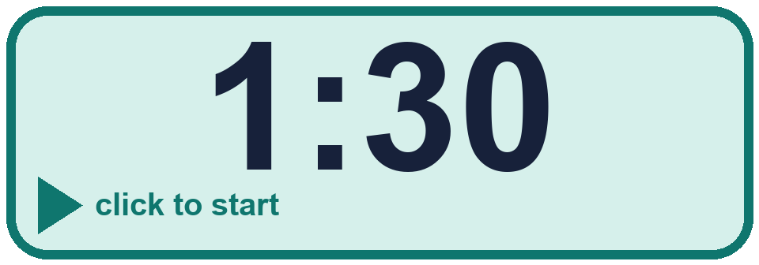
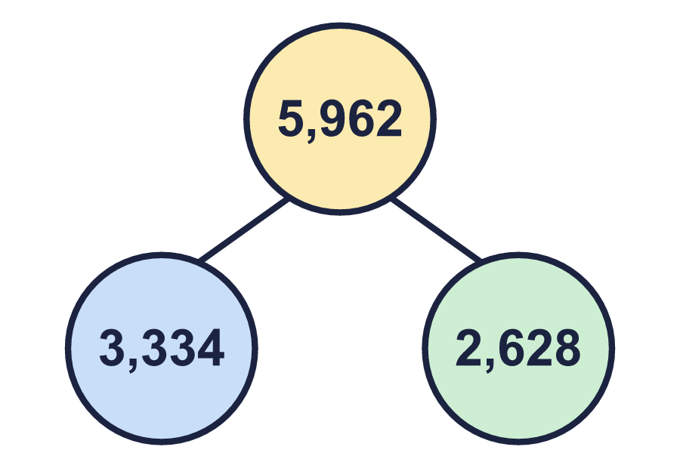
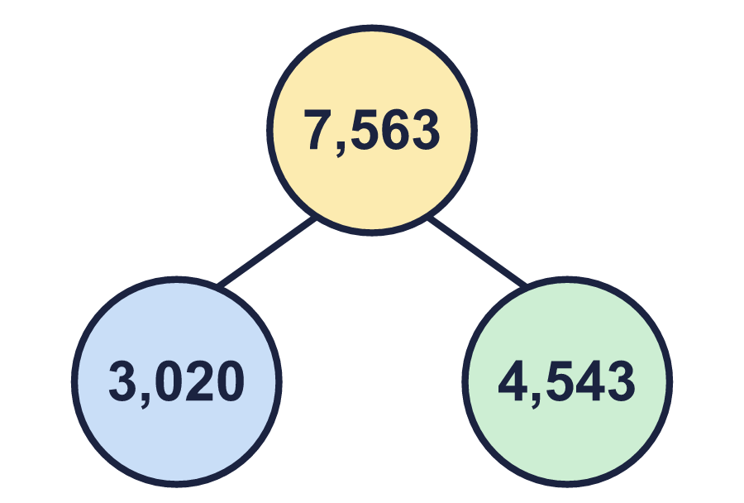
Year 4 · Addition and subtraction · Step 10 · question 3
I do
You do
Complete the fact family for the part-whole model.
Complete the fact family for the part-whole model.
a) 3,334 + 2,628 = ________
a) 3,020 + 4,543 = ________
b) 2,628 + 3,334 = ________
b) 4,543 + 3,020 = ________
c) 5,962 − 3,334 = ________
c) 7,563 − 3,020 = ________
d) 5,962 − 2,628 = ________
d) 7,563 − 4,543 = ________
a) 5,962
b) 5,962
c) 2,628
d) 3,334
a) 7,563
b) 7,563
c) 4,543
d) 3,020
3 of 8
Notes:
Question 3 of 8. I DO: model it out loud, thinking through each step. YOU DO: click the timer (1:30, an estimate) and let pupils try the same type of question with new numbers on their whiteboards. Then click to bring in the answers one at a time: the I do working, the I do answer, then the You do answer. Ask someone who got it wrong to say which step went wrong. Top tip: Answers. I do: a) 5,962 | b) 5,962 | c) 2,628 | d) 3,334. You do: a) 7,563 | b) 7,563 | c) 4,543 | d) 3,020.

Slide 10
Year 4 · Addition and subtraction · Step 10 · question 4
I do
You do
Use inverse operations to find the missing numbers.
Use inverse operations to find the missing numbers.
a) ________ + 2,235 = 7,088
a) ________ + 1,176 = 2,462
b) ________ − 437 = 4,853
b) ________ − 151 = 1,286
c) 7,088 − ________ = 4,853
c) 2,462 − ________ = 1,286
a) 4,853
b) 5,290
c) 2,235
a) 1,286
b) 1,437
c) 1,176
4 of 8
Notes:
Question 4 of 8. I DO: model it out loud, thinking through each step. YOU DO: click the timer (1:30, an estimate) and let pupils try the same type of question with new numbers on their whiteboards. Then click to bring in the answers one at a time: the I do working, the I do answer, then the You do answer. Ask someone who got it wrong to say which step went wrong. Top tip: Answers. I do: a) 4,853 | b) 5,290 | c) 2,235. You do: a) 1,286 | b) 1,437 | c) 1,176.

Slide 11

Year 4 · Addition and subtraction · Step 10 · question 5
I do
You do
“Filip works out 3,319 + 811. Filip checks the calculation using the same addition.”
“Filip works out 5,538 + 382. Filip checks the calculation using the same addition.”
Is this a good idea? Circle yes or no.
Is this a good idea? Circle yes or no.
Explain why.
Explain why.
No
No. Doing the same addition again can repeat the same mistake. Filip should check with a subtraction: 4,130 − 811 should make 3,319.
No
No. Doing the same addition again can repeat the same mistake. Filip should check with a subtraction: 5,920 − 382 should make 5,538.
5 of 8
Notes:
Question 5 of 8. I DO: model it out loud, thinking through each step. YOU DO: click the timer (2:00, an estimate) and let pupils try the same type of question with new numbers on their whiteboards. Then click to bring in the answers one at a time: the I do working, the I do answer, then the You do answer. Ask someone who got it wrong to say which step went wrong. Top tip: Answers. I do: No | No. Doing the same addition again can repeat the same mistake. Filip should check with a subtraction: 4,130 − 811 should make 3,319.. You do: No | No. Doing the same addition again can repeat the same mistake. Filip should check with a subtraction: 5,920 − 382 should make 5,538..

Slide 12

Year 4 · Addition and subtraction · Step 10 · question 6
I do
You do
“To work out 9,800 − 1,997, I take away 2,000. My answer is 7,800.”
“To work out 9,900 − 4,998, I take away 5,000. My answer is 4,900.”
Check: 7,800 + 1,997 = ________
Check: 4,900 + 4,998 = ________
Is Boba correct? Circle yes or no.
Is Boba correct? Circle yes or no.
What is the correct answer? ________
What is the correct answer? ________
9,797
No
7,803
9,898
No
4,902
6 of 8
Notes:
Question 6 of 8. I DO: model it out loud, thinking through each step. YOU DO: click the timer (2:30, an estimate) and let pupils try the same type of question with new numbers on their whiteboards. Then click to bring in the answers one at a time: the I do working, the I do answer, then the You do answer. Ask someone who got it wrong to say which step went wrong. Top tip: Answers. I do: 9,797 | No | 7,803. You do: 9,898 | No | 4,902.

Slide 13
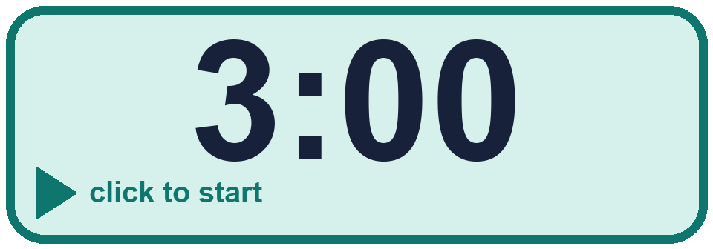
Year 4 · Addition and subtraction · Step 10 · question 7
I do
You do
Write an addition that you can use to check the subtraction 7,940 − 3,100.
Write an addition that you can use to check the subtraction 8,920 − 2,800.
3,100 + 4,840 = 7,940
2,800 + 6,120 = 8,920
7 of 8
Notes:
Question 7 of 8. I DO: model it out loud, thinking through each step. YOU DO: click the timer (3:00, an estimate) and let pupils try the same type of question with new numbers on their whiteboards. Then click to bring in the answers one at a time: the I do working, the I do answer, then the You do answer. Ask someone who got it wrong to say which step went wrong. Top tip: Answers. I do: 3,100 + 4,840 = 7,940. You do: 2,800 + 6,120 = 8,920.

Slide 14
Year 4 · Addition and subtraction · Step 10 · question 8
I do
You do
“5,336 − 1,862 = 5,236.”
“6,392 − 1,635 = 7,392.”
Use an addition to check Boba’s answer.
Use an addition to check Boba’s answer.
Check: 5,236 + 1,862 = ________
Check: 7,392 + 1,635 = ________
Is the subtraction correct? Circle yes or no.
Is the subtraction correct? Circle yes or no.
The correct answer is ________
The correct answer is ________
7,098
No
3,474
9,027
No
4,757
8 of 8
Notes:
Question 8 of 8. I DO: model it out loud, thinking through each step. YOU DO: click the timer (4:00, an estimate) and let pupils try the same type of question with new numbers on their whiteboards. Then click to bring in the answers one at a time: the I do working, the I do answer, then the You do answer. Ask someone who got it wrong to say which step went wrong. Top tip: Answers. I do: 7,098 | No | 3,474. You do: 9,027 | No | 4,757.

Slide 15



Year 4 · Addition and subtraction · Step 10
Independent application
Challenge
What number did I start with? ________
Check your answer by adding.
Use the Step 10 worksheet.
Finished? Try the challenge.
5,159
Notes:
Pupils now work on their own on the Step 10 worksheet from the website (scaffolded or not scaffolded). Click the 20 minute timer to start it. Pupils who finish try the challenge: click to show its answer. The Bobas bounce on their own while the slide is showing. Challenge answers: 5,159

