Slide 1



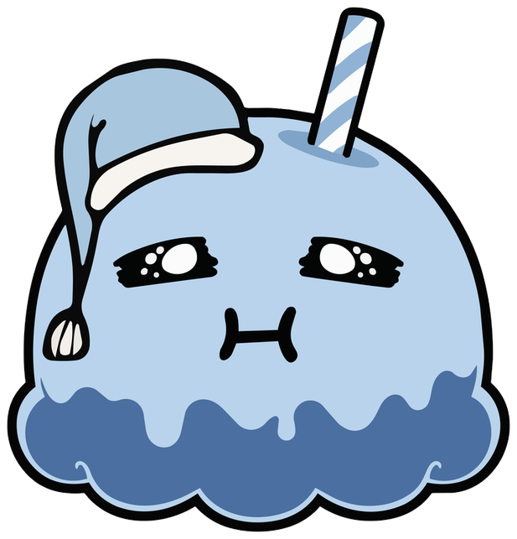

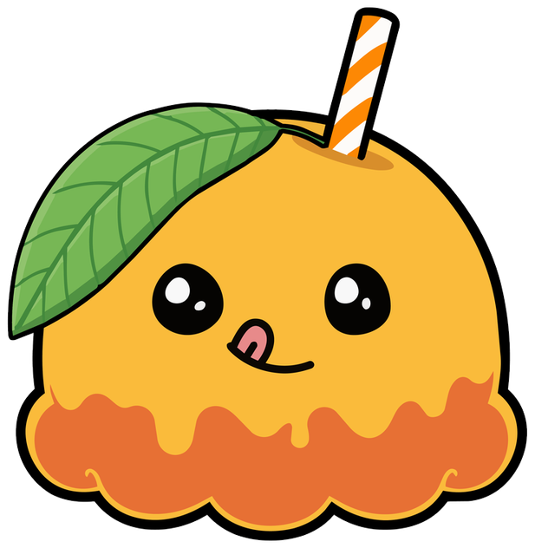


Year 6 · Spring · Vocabulary
Antonyms
I do, you do, with a timer. The questions get harder as we go.

Slide 2

Year 6 · SPaG · Vocabulary · Antonyms
Learning objective
Learning objective
To recognise antonyms and to make opposites with the prefixes un-, dis-, in-, im-, il- and ir-.
Success criteria
☐ I can find antonyms and make opposites.
☐ I can answer questions on it, from easy to hard.
☐ I can use it in my own writing.
Notes:
Read the objective aloud, then ask pupils what they already know about it.

Slide 3
Year 6 · SPaG · Vocabulary · Antonyms
Key words
Key words
antonym
a word with the opposite meaning
opposite
as different as possible
prefix
letters added to the start of a word
negative prefix
a prefix that means not, such as un- or dis-
Notes:
Pupils say each word aloud, then use it in a sentence of their own.

Slide 4

Year 6 · SPaG · Vocabulary · Antonyms
Starter
Starter: a quick look back at Synonyms.
1. Which word has a similar meaning to tired?
○ antique ○ small ○ brilliant ○ weary
✔ weary
2. Which word is closest in meaning to the word in bold in this sentence?
Tom felt glum when his friend moved away.
○ curious ○ grubby ○ large ○ downcast
✔ downcast
3. Tick the two words that have a similar meaning to cheerful.
○ pleased ○ happy ○ weary ○ scrumptious ○ fast
✔ pleased; happy
4. Which word has a similar meaning to wander?
○ mention ○ stride ○ gobble ○ shine
✔ stride
5. Which word has the weakest meaning?
○ stare ○ glance ○ look
✔ glance
Notes:
Click the timer (2:00) to start it. Pupils answer on whiteboards. Then click once per question to show each answer.

Slide 5

Year 6 · SPaG · Vocabulary · Antonyms
Teach
Antonyms
Antonyms are words with opposite meanings. Some antonyms are different words (hot, cold). Others are made by adding a prefix (happy, unhappy).
The soup was hot. → The soup was cold.
It was possible. → It was impossible.
Notes:
Talk through each idea with an example before moving on.

Slide 6
Year 6 · SPaG · Vocabulary · Antonyms
Key ideas
Key ideas
different words
hot / cold, fast / slow, victory / defeat
un-, dis-
happy → unhappy, agree → disagree
im-, il-, ir-, in-
possible → impossible, legal → illegal, regular → irregular, correct → incorrect
careful
not every word has one antonym
Notes:
Ask pupils to say each idea in their own words before showing the example.

Slide 7

Year 6 · SPaG · Vocabulary · Antonyms
Varied fluency 1
I do
You do
Which word is the opposite of happy?
Which word is the opposite of heavy?
☐ glad
☐ generous
☐ generous
☐ refuse
☐ sad
✔ sad
☐ fast
☐ open
☐ light
✔ light
1 of 12
Notes:
Question 1 of 12. I DO: model it out loud, thinking through each step. YOU DO: click the timer (1:00) to start it and let pupils try the same type of question on their whiteboards. Then click once per answer: the I do answers first, then the You do answers. Ask someone who got it wrong to say which step went wrong.

Slide 8
Year 6 · SPaG · Vocabulary · Antonyms
Varied fluency 2
I do
You do
Draw a line to match each word to its opposite.
Draw a line to match each word to its opposite.
open
weak
hot
empty
hot
closed
fast
cold
strong
cold
strong
weak
early
late
full
slow
2 of 12
Notes:
Question 2 of 12. I DO: model it out loud, thinking through each step. YOU DO: click the timer (1:00) to start it and let pupils try the same type of question on their whiteboards. Then click once per answer: the I do answers first, then the You do answers. Ask someone who got it wrong to say which step went wrong.

Slide 9
Year 6 · SPaG · Vocabulary · Antonyms
Varied fluency 3
I do
You do
Write the opposite of the word in bold by adding a prefix.
Write the opposite of the word in bold by adding a prefix.
like
appear
dislike
disappear
3 of 12
Notes:
Question 3 of 12. I DO: model it out loud, thinking through each step. YOU DO: click the timer (1:00) to start it and let pupils try the same type of question on their whiteboards. Then click once per answer: the I do answers first, then the You do answers. Ask someone who got it wrong to say which step went wrong.

Slide 10
Year 6 · SPaG · Vocabulary · Antonyms
Varied fluency 4
I do
You do
Is the statement correct? Tick one box. Then explain how you know.
Is the statement correct? Tick one box. Then explain how you know.
A prefix such as 'un' can turn a word into its opposite.
The opposite of 'early' is 'late'.
☐ Yes, it is correct.
✔ Yes, it is correct.
☐ Yes, it is correct.
✔ Yes, it is correct.
☐ No, it is not correct.
☐ No, it is not correct.
Explain how you know.
Explain how you know.
Early and late are antonyms.
Accept any answer that gives the same reason.
For example: happy and unhappy.
Accept any answer that gives the same reason.
4 of 12
Notes:
Question 4 of 12. I DO: model it out loud, thinking through each step. YOU DO: click the timer (1:00) to start it and let pupils try the same type of question on their whiteboards. Then click once per answer: the I do answers first, then the You do answers. Ask someone who got it wrong to say which step went wrong.

Slide 11
Year 6 · SPaG · Vocabulary · Antonyms
Varied fluency 5
I do
You do
Which word is the opposite of brave?
Which word is the opposite of full?
☐ optimist
☐ empty
✔ empty
☐ heroic
☐ rich
☐ strong
☐ old
☐ cowardly
✔ cowardly
☐ big
5 of 12
Notes:
Question 5 of 12. I DO: model it out loud, thinking through each step. YOU DO: click the timer (1:00) to start it and let pupils try the same type of question on their whiteboards. Then click once per answer: the I do answers first, then the You do answers. Ask someone who got it wrong to say which step went wrong.

Slide 12
Year 6 · SPaG · Vocabulary · Antonyms
Varied fluency 6
I do
You do
Which prefix turns honest into its opposite?
Which prefix turns visible into its opposite?
☐ im
☐ dis
☐ il
☐ im
☐ un
☐ un
☐ dis
✔ dis
☐ in
✔ in
6 of 12
Notes:
Question 6 of 12. I DO: model it out loud, thinking through each step. YOU DO: click the timer (1:00) to start it and let pupils try the same type of question on their whiteboards. Then click once per answer: the I do answers first, then the You do answers. Ask someone who got it wrong to say which step went wrong.

Slide 13
Year 6 · SPaG · Vocabulary · Antonyms
Varied fluency 7
I do
You do
Rewrite the sentence, replacing the underlined word with its opposite.
Rewrite the sentence, replacing the underlined word with its opposite.
It was a thick book.
It was a wide road.
It was a thin book.
Accept any suitable opposite.
It was a narrow road.
Accept any suitable opposite.
7 of 12
Notes:
Question 7 of 12. I DO: model it out loud, thinking through each step. YOU DO: click the timer (1:00) to start it and let pupils try the same type of question on their whiteboards. Then click once per answer: the I do answers first, then the You do answers. Ask someone who got it wrong to say which step went wrong.

Slide 14
Year 6 · SPaG · Vocabulary · Antonyms
Varied fluency 8
I do
You do
Tick the two words that are the opposite of hot.
Tick the two words that are the opposite of difficult.
☐ cold
✔ cold
☐ fact
☐ ancient
☐ fast
☐ open
☐ big
☐ icy
✔ icy
☐ easy
✔ easy
☐ maximum
☐ straightforward
✔ straightforward
8 of 12
Notes:
Question 8 of 12. I DO: model it out loud, thinking through each step. YOU DO: click the timer (1:00) to start it and let pupils try the same type of question on their whiteboards. Then click once per answer: the I do answers first, then the You do answers. Ask someone who got it wrong to say which step went wrong.

Slide 15
Year 6 · SPaG · Vocabulary · Antonyms
Reasoning 1
I do
You do
Write the opposite of the word in bold by adding a prefix.
Write the opposite of the word in bold by adding a prefix.
sensitive
patient
insensitive
impatient
9 of 12
Notes:
Question 9 of 12. I DO: model it out loud, thinking through each step. YOU DO: click the timer (1:00) to start it and let pupils try the same type of question on their whiteboards. Then click once per answer: the I do answers first, then the You do answers. Ask someone who got it wrong to say which step went wrong.

Slide 16
Year 6 · SPaG · Vocabulary · Antonyms
Reasoning 2
I do
You do
Which word is the opposite of refuse?
Which word is the opposite of guilty?
☐ sell
☐ old
☐ accept
✔ accept
☐ innocent
✔ innocent
☐ expensive
☐ fast
☐ new
☐ down
10 of 12
Notes:
Question 10 of 12. I DO: model it out loud, thinking through each step. YOU DO: click the timer (1:00) to start it and let pupils try the same type of question on their whiteboards. Then click once per answer: the I do answers first, then the You do answers. Ask someone who got it wrong to say which step went wrong.

Slide 17
Year 6 · SPaG · Vocabulary · Antonyms
Reasoning 3
I do
You do
Rewrite the sentence, replacing the underlined word with its opposite.
Rewrite the sentence, replacing the underlined word with its opposite.
He was a rich man.
The pool was deep.
He was a poor man.
Accept any suitable opposite.
The pool was shallow.
Accept any suitable opposite.
11 of 12
Notes:
Question 11 of 12. I DO: model it out loud, thinking through each step. YOU DO: click the timer (1:00) to start it and let pupils try the same type of question on their whiteboards. Then click once per answer: the I do answers first, then the You do answers. Ask someone who got it wrong to say which step went wrong.

Slide 18
Year 6 · SPaG · Vocabulary · Antonyms
Reasoning 4
I do
You do
Is the statement correct? Tick one box. Then explain how you know.
Is the statement correct? Tick one box. Then explain how you know.
'Ascend' and 'descend' are antonyms.
'Immature' is the opposite of 'mature'.
☐ Yes, it is correct.
✔ Yes, it is correct.
☐ Yes, it is correct.
✔ Yes, it is correct.
☐ No, it is not correct.
☐ No, it is not correct.
Explain how you know.
Explain how you know.
Ascend means to go up and descend means to go down.
Accept any answer that gives the same reason.
The prefix 'im' is used before 'm' and 'p'.
Accept any answer that gives the same reason.
12 of 12
Notes:
Question 12 of 12. I DO: model it out loud, thinking through each step. YOU DO: click the timer (1:00) to start it and let pupils try the same type of question on their whiteboards. Then click once per answer: the I do answers first, then the You do answers. Ask someone who got it wrong to say which step went wrong.

Slide 19
Year 6 · SPaG · Vocabulary · Antonyms
Plenary
Remember
1. different words: hot / cold, fast / slow, victory / defeat
2. un-, dis-: happy → unhappy, agree → disagree
3. im-, il-, ir-, in-: possible → impossible, legal → illegal, regular → irregular, correct → incorrect
Notes:
Three things to remember. Ask pupils to give one example of each in their own sentence.

Slide 20

Year 6 · SPaG · Vocabulary · Antonyms
Challenge
Challenge
Write ten sentences that each contain a pair of antonyms, such as 'The hot soup cooled until it was cold.' Underline each pair.
Notes:
Pupils write for ten minutes (click the timer to start it). Look for the skill from today's lesson in every sentence.

