Slide 1






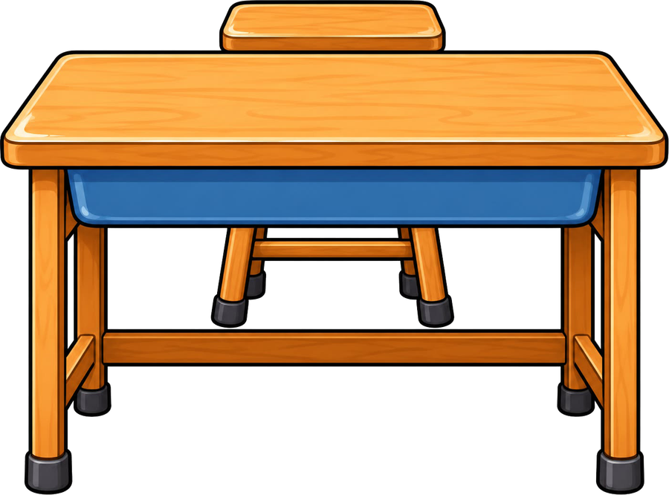

Year 6 · Autumn · Phrases and clauses
Relative clauses
I do, you do, with a timer. The questions get harder as we go.

Slide 2

Year 6 · SPaG · Phrases and clauses · Relative clauses
Learning objective
Learning objective
To learn about relative clauses.
Success criteria
☐ I can spot and use relative clauses.
☐ I can answer questions on it, from easy to hard.
☐ I can use it in my own writing.
Notes:
Read the objective aloud, then ask pupils what they already know about it.

Slide 3


Year 6 · SPaG · Phrases and clauses · Relative clauses
Starter
Starter: a quick look back at Coordinating and subordinating conjunctions.
1. Circle the coordinating conjunction in the sentence below.
We had tea and then we went to bed.
✔ and
2. Circle the subordinating conjunction in the sentence below.
After we finished lunch, we played football.
✔ After
3. What kind of conjunction is the underlined word?
She was tired so she went to bed early.
○ coordinating conjunction ○ subordinating conjunction
✔ coordinating conjunction
4. Circle the conjunction that completes the sentence.
I revised every night I would pass the test.
○ but ○ unless ○ although ○ so that
✔ so that
5. Circle the conjunction that completes the sentence.
the road was icy, the bus arrived on time.
○ Although ○ Unless ○ Because ○ Until
✔ Although
Notes:
Click the timer (2:00) to start it. Pupils answer on whiteboards. Then click once per question to show each answer.

Slide 4
Year 6 · SPaG · Phrases and clauses · Relative clauses
Teach
Relative clauses
A relative clause is a subordinate clause that gives extra information about a noun. It begins with a relative pronoun and comes straight after the noun it describes.
If the clause is extra information, it goes between commas. If it is needed to say which one is meant, there are no commas.
Our teacher, who loves music, plays the piano.
The book that I borrowed is very exciting. (the pronoun can be left out: The book I borrowed is very exciting.)
Notes:
Talk through each idea with an example before moving on.

Slide 5
Year 6 · SPaG · Phrases and clauses · Relative clauses
Key ideas
Key ideas
who, whom
for people: the girl who won, the girl whom we met
whose
for belonging: the boy whose kite flew away
which
for things: the castle which stands on the hill
that
for people or things, when the clause is needed (no commas): the book that I borrowed
where, when
for places and times: the park where we play, Friday, when we swim
Notes:
Ask pupils to say each idea in their own words before showing the example.

Slide 6


Year 6 · SPaG · Phrases and clauses · Relative clauses
Varied fluency 1
I do
You do
Circle the relative pronoun in the sentence below.
Circle the relative pronoun in the sentence below.
The bridge, which is made of stone, is very narrow.
The bridge, which is made of stone, is very narrow.
My cousin, who collects stamps, is two years older than me.
My cousin, who collects stamps, is two years older than me.
1 of 12
Notes:
Question 1 of 12. I DO: model it out loud, thinking through each step. YOU DO: click the timer (1:00) to start it and let pupils try the same type of question on their whiteboards. Then click once per answer: the I do answers first, then the You do answers. Ask someone who got it wrong to say which step went wrong.

Slide 7
Year 6 · SPaG · Phrases and clauses · Relative clauses
Varied fluency 2
I do
You do
Circle the relative pronoun that fits the gap.
Circle the relative pronoun that fits the gap.
The castle, ______ was built by the Normans, attracts many visitors.
The bridge, ______ is made of stone, is a famous landmark.
the
where
they
the
how
which
which
which
which
where
2 of 12
Notes:
Question 2 of 12. I DO: model it out loud, thinking through each step. YOU DO: click the timer (1:00) to start it and let pupils try the same type of question on their whiteboards. Then click once per answer: the I do answers first, then the You do answers. Ask someone who got it wrong to say which step went wrong.

Slide 8
Year 6 · SPaG · Phrases and clauses · Relative clauses
Varied fluency 3
I do
You do
Underline the relative pronoun in the sentence below.
Underline the relative pronoun in the sentence below.
The captain, who led the team, lifted the trophy.
The captain, who led the team, lifted the trophy.
The castle, which was built by the Normans, is very old.
The castle, which was built by the Normans, is very old.
3 of 12
Notes:
Question 3 of 12. I DO: model it out loud, thinking through each step. YOU DO: click the timer (1:00) to start it and let pupils try the same type of question on their whiteboards. Then click once per answer: the I do answers first, then the You do answers. Ask someone who got it wrong to say which step went wrong.

Slide 9
Year 6 · SPaG · Phrases and clauses · Relative clauses
Varied fluency 4
I do
You do
Underline the relative clause in the sentence below.
Underline the relative clause in the sentence below.
The boat, which floats on the lake, is very old.
The boat, which floats on the lake, is very old.
My gran, who bakes the best cakes, is coming to tea.
My gran, who bakes the best cakes, is coming to tea.
4 of 12
Notes:
Question 4 of 12. I DO: model it out loud, thinking through each step. YOU DO: click the timer (1:00) to start it and let pupils try the same type of question on their whiteboards. Then click once per answer: the I do answers first, then the You do answers. Ask someone who got it wrong to say which step went wrong.

Slide 10
Year 6 · SPaG · Phrases and clauses · Relative clauses
Varied fluency 5
I do
You do
Tick the relative clause that fits the gap.
Tick the relative clause that fits the gap.
Saturday, ______, is my favourite day.
The village, ______, has one shop.
☐ which my gran grew up
☐ we visit my gran
☐ my gran grew up
☐ which we visit my gran
☐ where my gran grew up
✔ where my gran grew up
☐ when we visit my gran
✔ when we visit my gran
5 of 12
Notes:
Question 5 of 12. I DO: model it out loud, thinking through each step. YOU DO: click the timer (1:00) to start it and let pupils try the same type of question on their whiteboards. Then click once per answer: the I do answers first, then the You do answers. Ask someone who got it wrong to say which step went wrong.

Slide 11
Year 6 · SPaG · Phrases and clauses · Relative clauses
Varied fluency 6
I do
You do
Add two commas to show where the relative clause starts and ends.
Add two commas to show where the relative clause starts and ends.
My gran whose garden is full of roses sends us postcards.
My gran, whose garden is full of roses, sends us postcards.
The clock which hangs in the hall is always right.
The clock, which hangs in the hall, is always right.
6 of 12
Notes:
Question 6 of 12. I DO: model it out loud, thinking through each step. YOU DO: click the timer (1:00) to start it and let pupils try the same type of question on their whiteboards. Then click once per answer: the I do answers first, then the You do answers. Ask someone who got it wrong to say which step went wrong.

Slide 12
Year 6 · SPaG · Phrases and clauses · Relative clauses
Varied fluency 7
I do
You do
Tick the sentence that contains a relative clause.
Tick the sentence that contains a relative clause.
☐ The library where we do our homework opens at nine.
✔ The library where we do our homework opens at nine.
☐ The cat on the wall watched the birds.
☐ The farmer with the muddy boots waved to us.
☐ The pencil that has a sharp point is on the shelf.
✔ The pencil that has a sharp point is on the shelf.
☐ Mia hoped that it would not rain.
☐ Mia hoped that it would not rain.
☐ Ben packed his bag before he left.
☐ We stayed inside because it was raining.
7 of 12
Notes:
Question 7 of 12. I DO: model it out loud, thinking through each step. YOU DO: click the timer (1:00) to start it and let pupils try the same type of question on their whiteboards. Then click once per answer: the I do answers first, then the You do answers. Ask someone who got it wrong to say which step went wrong.

Slide 13
Year 6 · SPaG · Phrases and clauses · Relative clauses
Varied fluency 8
I do
You do
The relative pronoun has been left out of this sentence. Write the sentence again with the relative pronoun put back in.
The relative pronoun has been left out of this sentence. Write the sentence again with the relative pronoun put back in.
The cake Mum baked disappeared quickly.
The kite Dad bought me belongs to my brother.
The cake that Mum baked disappeared quickly.
'which' is also correct.
The kite that Dad bought me belongs to my brother.
'which' is also correct.
8 of 12
Notes:
Question 8 of 12. I DO: model it out loud, thinking through each step. YOU DO: click the timer (1:00) to start it and let pupils try the same type of question on their whiteboards. Then click once per answer: the I do answers first, then the You do answers. Ask someone who got it wrong to say which step went wrong.

Slide 14
Year 6 · SPaG · Phrases and clauses · Relative clauses
Reasoning 1
I do
You do
Match each beginning to the ending that completes the sentence. Draw a line between them.
Match each beginning to the ending that completes the sentence. Draw a line between them.
Our teacher,
which barked all night, loves long walks.
The market,
where we buy our vegetables, sells fresh fish.
Friday,
who loves music, plays the piano.
Saturday,
when we visit my gran, is my favourite day.
The dog,
when the market opens, is always busy.
The captain,
who led the team, lifted the trophy.
9 of 12
Notes:
Question 9 of 12. I DO: model it out loud, thinking through each step. YOU DO: click the timer (1:00) to start it and let pupils try the same type of question on their whiteboards. Then click once per answer: the I do answers first, then the You do answers. Ask someone who got it wrong to say which step went wrong.

Slide 15
Year 6 · SPaG · Phrases and clauses · Relative clauses
Reasoning 2
I do
You do
Join the two sentences into one sentence. Use where as the relative pronoun and add commas where they are needed.
Join the two sentences into one sentence. Use whom as the relative pronoun and add commas where they are needed.
The park closes at six.
Our teacher plays the piano.
My dad walks his dog in the park.
We met our teacher last year.
Our teacher, whom we met last year, plays the piano.
1 mark for a correct relative clause after the noun, 1 mark for the two commas. Accept any correct wording.
The park, where my dad walks his dog, closes at six.
1 mark for a correct relative clause after the noun, 1 mark for the two commas. Accept any correct wording.
10 of 12
Notes:
Question 10 of 12. I DO: model it out loud, thinking through each step. YOU DO: click the timer (1:00) to start it and let pupils try the same type of question on their whiteboards. Then click once per answer: the I do answers first, then the You do answers. Ask someone who got it wrong to say which step went wrong.

Slide 16
Year 6 · SPaG · Phrases and clauses · Relative clauses
Reasoning 3
I do
You do
Read the sentence. The relative clause is underlined. Is it extra information that could be taken out?
Read the sentence. The relative clause is underlined. Is it extra information that could be taken out?
The old man, who lives opposite us, sat on the bench.
The dog, which belongs to our neighbour, loves long walks.
☐ Yes, it only adds extra information.
✔ Yes, it only adds extra information.
☐ Yes, it only adds extra information.
✔ Yes, it only adds extra information.
☐ No, it is needed to show which one is meant.
☐ No, it is needed to show which one is meant.
Now write the sentence again without the underlined clause.
Now write the sentence again without the underlined clause.
The old man sat on the bench.
The dog loves long walks.
11 of 12
Notes:
Question 11 of 12. I DO: model it out loud, thinking through each step. YOU DO: click the timer (1:00) to start it and let pupils try the same type of question on their whiteboards. Then click once per answer: the I do answers first, then the You do answers. Ask someone who got it wrong to say which step went wrong.

Slide 17
Year 6 · SPaG · Phrases and clauses · Relative clauses
Reasoning 4
I do
You do
Tick the sentence that uses whose or who's correctly.
Tick the sentence that uses whose or who's correctly.
☐ The girl, whose been to Paris, waved at us.
☐ The lady, who's a champion swimmer, knows everyone in town.
✔ The lady, who's a champion swimmer, knows everyone in town.
☐ The girl, who's been to Paris, waved at us.
✔ The girl, who's been to Paris, waved at us.
☐ The lady, whose a champion swimmer, knows everyone in town.
Explain how you know.
Explain how you know.
'Who's' is short for 'who is' or 'who has' ('who has been to Paris' makes sense). 'Whose' shows belonging, and nothing belongs to anyone here.
Accept any answer that explains that 'who's' means 'who is / who has' and 'whose' shows belonging.
'Who's' is short for 'who is' or 'who has' ('who is a champion swimmer' makes sense). 'Whose' shows belonging, and nothing belongs to anyone here.
Accept any answer that explains that 'who's' means 'who is / who has' and 'whose' shows belonging.
12 of 12
Notes:
Question 12 of 12. I DO: model it out loud, thinking through each step. YOU DO: click the timer (1:00) to start it and let pupils try the same type of question on their whiteboards. Then click once per answer: the I do answers first, then the You do answers. Ask someone who got it wrong to say which step went wrong.

Slide 18
Year 6 · SPaG · Phrases and clauses · Relative clauses
Plenary
Remember
1. who, whom: for people: the girl who won, the girl whom we met
2. whose: for belonging: the boy whose kite flew away
3. which: for things: the castle which stands on the hill
Notes:
Three things to remember. Ask pupils to give one example of each in their own sentence.

Slide 19

Year 6 · SPaG · Phrases and clauses · Relative clauses
Challenge
Challenge
Write a short recount of your first day in Year 6. Use at least five relative clauses, with a different relative pronoun each time (who, which, whose, where, when or that). Say how you felt and what you did.
Notes:
Pupils write for ten minutes (click the timer to start it). Look for the skill from today's lesson in every sentence.

