Slide 1






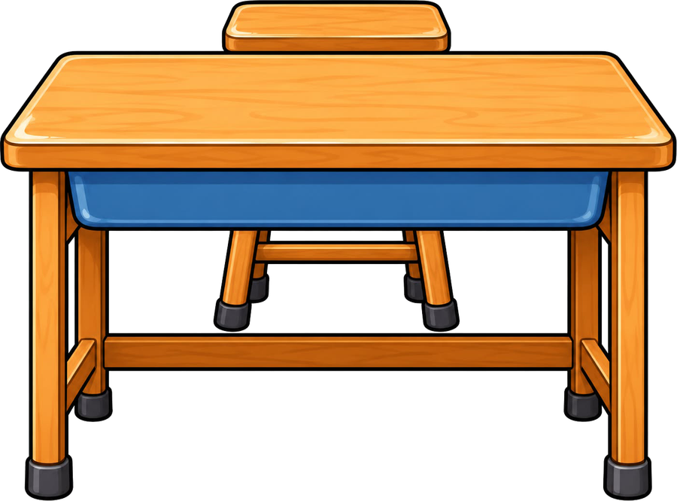
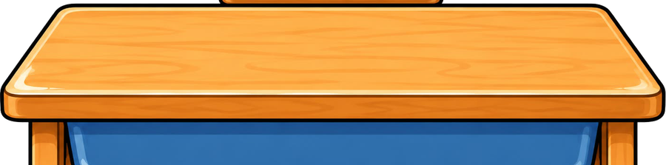
Year 5 · SPaG · Relative clauses
Using relative clauses
I do, you do, with a timer. The questions get harder as we go.

Slide 2
Year 5 · SPaG · Relative clauses · Using relative clauses
Learning objective
Learning objective
To add a relative clause to a sentence, using a relative pronoun and commas where they are needed.
Success criteria
☐ I can write a sentence with a relative clause.
☐ I can answer questions on it, from easy to hard.
☐ I can use it in my own writing.
Notes:
Read the objective aloud, then ask pupils what they already know about it.

Slide 3
Year 5 · SPaG · Relative clauses · Using relative clauses
Key words
Key words
relative clause
a clause that gives extra information about a noun
relative pronoun
who, which, whose, where, when or that: it starts the clause
noun
the person, place or thing the clause describes
embedded
in the middle of a sentence
Notes:
Pupils say each word aloud, then use it in a sentence of their own.

Slide 4


Year 5 · SPaG · Relative clauses · Using relative clauses
Starter
Starter: a quick look back at Recognising relative clauses.
1. Circle the relative pronoun in the sentence below.
The cake, which has pink icing, disappeared quickly.
✔ which
2. Underline the relative pronoun in the sentence below.
The pencil, which has a sharp point, is nearly new.
✔ The pencil, which has a sharp point, is nearly new.
3. Underline the relative clause in the sentence below.
The captain, who wore the yellow shirt, lifted the trophy.
✔ The captain, who wore the yellow shirt, lifted the trophy.
4. Tick the sentence that contains a relative clause.
○ The boy, who plays the drums, left early. ○ We stayed inside because it was raining. ○ Ravi knew that the gate was open. ○ The farmer with the muddy boots waved to us.
✔ The boy, who plays the drums, left early.
5. Underline the relative clause in the sentence below.
The bicycle, which leans against the wall, belongs to my sister.
✔ The bicycle, which leans against the wall, belongs to my sister.
Notes:
Click the timer (2:00) to start it. Pupils answer on whiteboards. Then click once per question to show each answer.

Slide 5

Year 5 · SPaG · Relative clauses · Using relative clauses
Teach
Relative clauses
A relative clause gives extra information about a noun. It starts with a relative pronoun and comes straight after the noun it describes.
If the clause is extra information, put it between commas. If it is needed to say which one you mean, use no commas.
Our teacher, who loves music, plays the piano.
The book that I borrowed is very exciting.
Notes:
Talk through each idea with an example before moving on.

Slide 6
Year 5 · SPaG · Relative clauses · Using relative clauses
Key ideas
Key ideas
who
for people: the girl who won the race
which
for things: the castle which stands on the hill
whose
for belonging: the boy whose kite flew away
where
for places: the park where we play
when
for times: Friday, when we swim
that
for people or things, when the clause is needed: the book that I borrowed
Notes:
Ask pupils to say each idea in their own words before showing the example.

Slide 7


Year 5 · SPaG · Relative clauses · Using relative clauses
Varied fluency 1
I do
You do
Circle the relative pronoun that fits the gap.
Circle the relative pronoun that fits the gap.
The kite, ______ has a long red tail, is in the shed.
The captain, ______ led the team, lifted the trophy.
which
which
with
through
will
where
will
who
who
which
1 of 12
Notes:
Question 1 of 12. I DO: model it out loud, thinking through each step. YOU DO: click the timer (1:00) to start it and let pupils try the same type of question on their whiteboards. Then click once per answer: the I do answers first, then the You do answers. Ask someone who got it wrong to say which step went wrong.

Slide 8
Year 5 · SPaG · Relative clauses · Using relative clauses
Varied fluency 2
I do
You do
Add two commas to show where the relative clause starts and ends.
Add two commas to show where the relative clause starts and ends.
The bicycle which leans against the wall belongs to my sister.
The bicycle, which leans against the wall, belongs to my sister.
The farmer who owns the field waved to us.
The farmer, who owns the field, waved to us.
2 of 12
Notes:
Question 2 of 12. I DO: model it out loud, thinking through each step. YOU DO: click the timer (1:00) to start it and let pupils try the same type of question on their whiteboards. Then click once per answer: the I do answers first, then the You do answers. Ask someone who got it wrong to say which step went wrong.

Slide 9
Year 5 · SPaG · Relative clauses · Using relative clauses
Varied fluency 3
I do
You do
Tick the relative clause that fits the gap.
Tick the relative clause that fits the gap.
The old man, ______, sat on the bench.
The bridge, ______, needs mending.
☐ where was built long ago
☐ who walks with a stick
✔ who walks with a stick
☐ which was built long ago
✔ which was built long ago
☐ where walks with a stick
☐ was built long ago
☐ walks with a stick
3 of 12
Notes:
Question 3 of 12. I DO: model it out loud, thinking through each step. YOU DO: click the timer (1:00) to start it and let pupils try the same type of question on their whiteboards. Then click once per answer: the I do answers first, then the You do answers. Ask someone who got it wrong to say which step went wrong.

Slide 10
Year 5 · SPaG · Relative clauses · Using relative clauses
Varied fluency 4
I do
You do
Add two commas to show where the relative clause starts and ends.
Add two commas to show where the relative clause starts and ends.
The lady whose stall is by the station knows everyone in town.
The lady, whose stall is by the station, knows everyone in town.
The boat which floats on the lake is tied to the jetty.
The boat, which floats on the lake, is tied to the jetty.
4 of 12
Notes:
Question 4 of 12. I DO: model it out loud, thinking through each step. YOU DO: click the timer (1:00) to start it and let pupils try the same type of question on their whiteboards. Then click once per answer: the I do answers first, then the You do answers. Ask someone who got it wrong to say which step went wrong.

Slide 11
Year 5 · SPaG · Relative clauses · Using relative clauses
Varied fluency 5
I do
You do
Tick the relative clause that fits the gap.
Tick the relative clause that fits the gap.
The market, ______, sells fresh fish.
December, ______, is the busiest month at the shop.
☐ when we buy our vegetables
☐ the nights are longest
☐ we buy our vegetables
☐ when the nights are longest
✔ when the nights are longest
☐ where we buy our vegetables
✔ where we buy our vegetables
☐ which the nights are longest
5 of 12
Notes:
Question 5 of 12. I DO: model it out loud, thinking through each step. YOU DO: click the timer (1:00) to start it and let pupils try the same type of question on their whiteboards. Then click once per answer: the I do answers first, then the You do answers. Ask someone who got it wrong to say which step went wrong.

Slide 12
Year 5 · SPaG · Relative clauses · Using relative clauses
Varied fluency 6
I do
You do
Circle the relative pronoun that fits the gap.
Circle the relative pronoun that fits the gap.
The station, ______ Dad catches his train, is a short walk away.
The girl, ______ painting won a prize, lives next door.
they
which
they
where
where
where
have
with
whose
whose
6 of 12
Notes:
Question 6 of 12. I DO: model it out loud, thinking through each step. YOU DO: click the timer (1:00) to start it and let pupils try the same type of question on their whiteboards. Then click once per answer: the I do answers first, then the You do answers. Ask someone who got it wrong to say which step went wrong.

Slide 13
Year 5 · SPaG · Relative clauses · Using relative clauses
Varied fluency 7
I do
You do
Add two commas to show where the relative clause starts and ends.
Add two commas to show where the relative clause starts and ends.
The castle which was built by the Normans is very old.
The castle, which was built by the Normans, is very old.
Our teacher who loves music plays the piano.
Our teacher, who loves music, plays the piano.
7 of 12
Notes:
Question 7 of 12. I DO: model it out loud, thinking through each step. YOU DO: click the timer (1:00) to start it and let pupils try the same type of question on their whiteboards. Then click once per answer: the I do answers first, then the You do answers. Ask someone who got it wrong to say which step went wrong.

Slide 14
Year 5 · SPaG · Relative clauses · Using relative clauses
Varied fluency 8
I do
You do
The relative pronoun has been left out of this sentence. Write the sentence again with the relative pronoun put back in.
The relative pronoun has been left out of this sentence. Write the sentence again with the relative pronoun put back in.
The kite Dad bought me was a birthday present.
The bicycle Dad repaired is in the garage.
The kite that Dad bought me was a birthday present.
'which' is also correct.
The bicycle that Dad repaired is in the garage.
'which' is also correct.
8 of 12
Notes:
Question 8 of 12. I DO: model it out loud, thinking through each step. YOU DO: click the timer (1:00) to start it and let pupils try the same type of question on their whiteboards. Then click once per answer: the I do answers first, then the You do answers. Ask someone who got it wrong to say which step went wrong.

Slide 15
Year 5 · SPaG · Relative clauses · Using relative clauses
Reasoning 1
I do
You do
Join the two sentences into one sentence. Use when as the relative pronoun and add commas where they are needed.
Join the two sentences into one sentence. Use which as the relative pronoun and add commas where they are needed.
Monday is always a busy day.
The dog loves long walks.
We start the new topic on Monday.
The dog barked all night.
The dog, which barked all night, loves long walks.
1 mark for a correct relative clause after the noun, 1 mark for the two commas. Accept any correct wording.
Monday, when we start the new topic, is always a busy day.
1 mark for a correct relative clause after the noun, 1 mark for the two commas. Accept any correct wording.
9 of 12
Notes:
Question 9 of 12. I DO: model it out loud, thinking through each step. YOU DO: click the timer (1:00) to start it and let pupils try the same type of question on their whiteboards. Then click once per answer: the I do answers first, then the You do answers. Ask someone who got it wrong to say which step went wrong.

Slide 16
Year 5 · SPaG · Relative clauses · Using relative clauses
Reasoning 2
I do
You do
Match each beginning to the ending that completes the sentence. Draw a line between them.
Match each beginning to the ending that completes the sentence. Draw a line between them.
My gran,
when the days are long, is my favourite season.
The book,
where my dad walks his dog, is full of ducks.
Summer,
where we built a sandcastle, is covered in pebbles.
Summer,
which has a blue cover, belongs to Mia.
The beach,
who collects old coins, is coming to tea.
The park,
when we go camping, is far too short.
10 of 12
Notes:
Question 10 of 12. I DO: model it out loud, thinking through each step. YOU DO: click the timer (1:00) to start it and let pupils try the same type of question on their whiteboards. Then click once per answer: the I do answers first, then the You do answers. Ask someone who got it wrong to say which step went wrong.

Slide 17
Year 5 · SPaG · Relative clauses · Using relative clauses
Reasoning 3
I do
You do
Join the two sentences into one sentence. Use where as the relative pronoun and add commas where they are needed.
Join the two sentences into one sentence. Use where as the relative pronoun and add commas where they are needed.
The library opens at nine.
The library has a children's corner.
I borrowed this book from the library.
We do our homework in the library.
The library, where I borrowed this book, opens at nine.
1 mark for a correct relative clause after the noun, 1 mark for the two commas. Accept any correct wording.
The library, where we do our homework, has a children's corner.
1 mark for a correct relative clause after the noun, 1 mark for the two commas. Accept any correct wording.
11 of 12
Notes:
Question 11 of 12. I DO: model it out loud, thinking through each step. YOU DO: click the timer (1:00) to start it and let pupils try the same type of question on their whiteboards. Then click once per answer: the I do answers first, then the You do answers. Ask someone who got it wrong to say which step went wrong.

Slide 18
Year 5 · SPaG · Relative clauses · Using relative clauses
Reasoning 4
I do
You do
Read the sentence. The relative clause is underlined. Is it extra information that could be taken out?
Read the sentence. The relative clause is underlined. Is it extra information that could be taken out?
My cousin, who collects stamps, is two years older than me.
The boy, who sits behind me, is in my class.
☐ Yes, it only adds extra information.
✔ Yes, it only adds extra information.
☐ Yes, it only adds extra information.
✔ Yes, it only adds extra information.
☐ No, it is needed to show which one is meant.
☐ No, it is needed to show which one is meant.
Now write the sentence again without the underlined clause.
Now write the sentence again without the underlined clause.
My cousin is two years older than me.
The boy is in my class.
12 of 12
Notes:
Question 12 of 12. I DO: model it out loud, thinking through each step. YOU DO: click the timer (1:00) to start it and let pupils try the same type of question on their whiteboards. Then click once per answer: the I do answers first, then the You do answers. Ask someone who got it wrong to say which step went wrong.

Slide 19
Year 5 · SPaG · Relative clauses · Using relative clauses
Plenary
Remember
1. who: for people: the girl who won the race
2. which: for things: the castle which stands on the hill
3. whose: for belonging: the boy whose kite flew away
Notes:
Three things to remember. Ask pupils to give one example of each in their own sentence.

Slide 20

Year 5 · SPaG · Relative clauses · Using relative clauses
Challenge
Challenge
Write about an animal you like. Join two short sentences into one with a relative clause at least five times. Check your commas.
Notes:
Pupils write for ten minutes (click the timer to start it). Look for the skill from today's lesson in every sentence.

