Slide 1






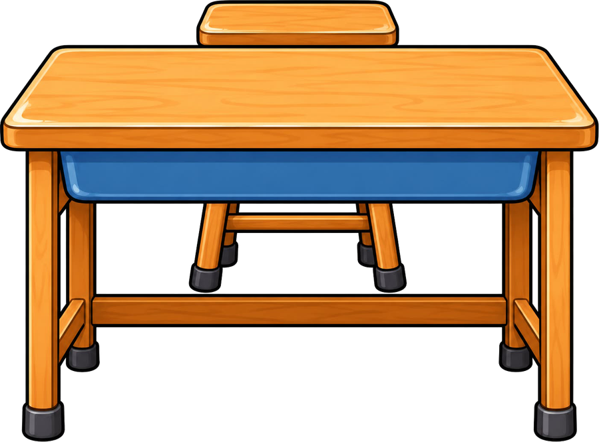

Year 5 · SPaG · Relative clauses
Relative pronouns
I do, you do, with a timer. The questions get harder as we go.

Slide 2

Year 5 · SPaG · Relative clauses · Relative pronouns
Learning objective
Learning objective
To choose the right relative pronoun (who, which, whose, where, when or that) for the noun it follows.
Success criteria
☐ I can choose the right relative pronoun.
☐ I can answer questions on it, from easy to hard.
☐ I can use it in my own writing.
Notes:
Read the objective aloud, then ask pupils what they already know about it.

Slide 3
Year 5 · SPaG · Relative clauses · Relative pronouns
Key words
Key words
relative clause
a clause that gives extra information about a noun
relative pronoun
who, which, whose, where, when or that: it starts the clause
noun
the person, place or thing the clause describes
embedded
in the middle of a sentence
Notes:
Pupils say each word aloud, then use it in a sentence of their own.

Slide 4


Year 5 · SPaG · Relative clauses · Relative pronouns
Starter
Starter: a quick look back at Parenthesis together.
1. Underline the parenthesis in the sentence below.
Our cat – Whiskers – sleeps on the sofa.
✔ Our cat – Whiskers – sleeps on the sofa.
2. Which sentence uses punctuation correctly to show the extra information?
○ My grandad (who is seventy still plays football. ○ My grandad (who is seventy) still plays football. ○ My grandad who is seventy still plays football. ○ My grandad (who) is seventy still plays football.
✔ My grandad (who is seventy) still plays football.
3. Use a pair of commas to show the extra information (the parenthesis).
The explorers tired and hungry reached the camp at dusk.
✔ The explorers, tired and hungry, reached the camp at dusk.
4. Which punctuation marks the parenthesis in the sentence below?
The explorers – tired and hungry – reached the camp at dusk.
○ a pair of commas ○ brackets ○ a pair of dashes
✔ a pair of dashes
5. Which sentence uses punctuation correctly to show the extra information?
○ My teacher (Mrs) Khan is very kind. ○ My teacher Mrs Khan is very kind. ○ My teacher (Mrs Khan) is very kind. ○ My teacher (Mrs Khan is very kind.
✔ My teacher (Mrs Khan) is very kind.
Notes:
Click the timer (2:00) to start it. Pupils answer on whiteboards. Then click once per question to show each answer.

Slide 5

Year 5 · SPaG · Relative clauses · Relative pronouns
Teach
Relative clauses
A relative clause gives extra information about a noun. It starts with a relative pronoun and comes straight after the noun it describes.
If the clause is extra information, put it between commas. If it is needed to say which one you mean, use no commas.
Our teacher, who loves music, plays the piano.
The book that I borrowed is very exciting.
Notes:
Talk through each idea with an example before moving on.

Slide 6
Year 5 · SPaG · Relative clauses · Relative pronouns
Key ideas
Key ideas
who
for people: the girl who won the race
which
for things: the castle which stands on the hill
whose
for belonging: the boy whose kite flew away
where
for places: the park where we play
when
for times: Friday, when we swim
that
for people or things, when the clause is needed: the book that I borrowed
Notes:
Ask pupils to say each idea in their own words before showing the example.

Slide 7

Year 5 · SPaG · Relative clauses · Relative pronouns
Varied fluency 1
I do
You do
Circle the relative pronoun in the sentence below.
Circle the relative pronoun in the sentence below.
The kite, which flew over the fence, belongs to my brother.
The kite, which flew over the fence, belongs to my brother.
The captain, who led the team, lifted the trophy.
The captain, who led the team, lifted the trophy.
1 of 12
Notes:
Question 1 of 12. I DO: model it out loud, thinking through each step. YOU DO: click the timer (1:00) to start it and let pupils try the same type of question on their whiteboards. Then click once per answer: the I do answers first, then the You do answers. Ask someone who got it wrong to say which step went wrong.

Slide 8
Year 5 · SPaG · Relative clauses · Relative pronouns
Varied fluency 2
I do
You do
Circle the relative pronoun that fits the gap.
Circle the relative pronoun that fits the gap.
The bicycle, ______ leans against the wall, belongs to my sister.
The farmer, ______ owns the field, waved to us.
where
how
who
who
with
the
which
which
the
where
2 of 12
Notes:
Question 2 of 12. I DO: model it out loud, thinking through each step. YOU DO: click the timer (1:00) to start it and let pupils try the same type of question on their whiteboards. Then click once per answer: the I do answers first, then the You do answers. Ask someone who got it wrong to say which step went wrong.

Slide 9
Year 5 · SPaG · Relative clauses · Relative pronouns
Varied fluency 3
I do
You do
Underline the relative pronoun in the sentence below.
Underline the relative pronoun in the sentence below.
The old man, who lives opposite us, sat on the bench.
The old man, who lives opposite us, sat on the bench.
The bridge, which was built long ago, needs mending.
The bridge, which was built long ago, needs mending.
3 of 12
Notes:
Question 3 of 12. I DO: model it out loud, thinking through each step. YOU DO: click the timer (1:00) to start it and let pupils try the same type of question on their whiteboards. Then click once per answer: the I do answers first, then the You do answers. Ask someone who got it wrong to say which step went wrong.

Slide 10
Year 5 · SPaG · Relative clauses · Relative pronouns
Varied fluency 4
I do
You do
Circle the relative pronoun that fits the gap.
Circle the relative pronoun that fits the gap.
The lady, ______ sells flowers, knows everyone in town.
The boat, ______ floats on the lake, is tied to the jetty.
which
the
who
the
who
who
they
have
which
which
4 of 12
Notes:
Question 4 of 12. I DO: model it out loud, thinking through each step. YOU DO: click the timer (1:00) to start it and let pupils try the same type of question on their whiteboards. Then click once per answer: the I do answers first, then the You do answers. Ask someone who got it wrong to say which step went wrong.

Slide 11
Year 5 · SPaG · Relative clauses · Relative pronouns
Varied fluency 5
I do
You do
Tick the relative clause that fits the gap.
Tick the relative clause that fits the gap.
The market, ______, sells fresh fish.
December, ______, is the busiest month at the shop.
☐ when we buy our vegetables
☐ the nights are longest
☐ we buy our vegetables
☐ when the nights are longest
✔ when the nights are longest
☐ where we buy our vegetables
✔ where we buy our vegetables
☐ which the nights are longest
5 of 12
Notes:
Question 5 of 12. I DO: model it out loud, thinking through each step. YOU DO: click the timer (1:00) to start it and let pupils try the same type of question on their whiteboards. Then click once per answer: the I do answers first, then the You do answers. Ask someone who got it wrong to say which step went wrong.

Slide 12
Year 5 · SPaG · Relative clauses · Relative pronouns
Varied fluency 6
I do
You do
Circle the relative pronoun that fits the gap.
Circle the relative pronoun that fits the gap.
The station, ______ Dad catches his train, is a short walk away.
The girl, ______ painting won a prize, lives next door.
they
which
they
where
where
where
have
with
whose
whose
6 of 12
Notes:
Question 6 of 12. I DO: model it out loud, thinking through each step. YOU DO: click the timer (1:00) to start it and let pupils try the same type of question on their whiteboards. Then click once per answer: the I do answers first, then the You do answers. Ask someone who got it wrong to say which step went wrong.

Slide 13
Year 5 · SPaG · Relative clauses · Relative pronouns
Varied fluency 7
I do
You do
Circle the relative pronoun that fits the gap.
Circle the relative pronoun that fits the gap.
The castle, ______ was built by the Normans, is very old.
Our teacher, ______ loves music, plays the piano.
where
will
we
where
with
which
which
have
who
who
7 of 12
Notes:
Question 7 of 12. I DO: model it out loud, thinking through each step. YOU DO: click the timer (1:00) to start it and let pupils try the same type of question on their whiteboards. Then click once per answer: the I do answers first, then the You do answers. Ask someone who got it wrong to say which step went wrong.

Slide 14
Year 5 · SPaG · Relative clauses · Relative pronouns
Varied fluency 8
I do
You do
Tick the sentence that contains a relative clause.
Tick the sentence that contains a relative clause.
☐ The clock, which strikes every hour, is always right.
✔ The clock, which strikes every hour, is always right.
☐ Saturday, when we visit my gran, is my favourite day.
✔ Saturday, when we visit my gran, is my favourite day.
☐ If you hurry, we can catch the bus.
☐ The girl in the red coat won the race.
☐ She said that the shop closes at six.
☐ Tom waited until the bell rang.
☐ The cat on the wall watched the birds.
☐ The teacher told us that the bell had rung.
8 of 12
Notes:
Question 8 of 12. I DO: model it out loud, thinking through each step. YOU DO: click the timer (1:00) to start it and let pupils try the same type of question on their whiteboards. Then click once per answer: the I do answers first, then the You do answers. Ask someone who got it wrong to say which step went wrong.

Slide 15
Year 5 · SPaG · Relative clauses · Relative pronouns
Reasoning 1
I do
You do
Match each beginning to the ending that completes the sentence. Draw a line between them.
Match each beginning to the ending that completes the sentence. Draw a line between them.
The boy,
which has a red sail, is very old.
Monday,
where my dad walks his dog, is next to the school.
The boat,
where we hold the summer fair, is near the river.
The park,
when we start the new topic, is always a busy day.
Our school,
whose kite flew away, left early.
The doctor,
who works at the surgery, was kind to everyone.
9 of 12
Notes:
Question 9 of 12. I DO: model it out loud, thinking through each step. YOU DO: click the timer (1:00) to start it and let pupils try the same type of question on their whiteboards. Then click once per answer: the I do answers first, then the You do answers. Ask someone who got it wrong to say which step went wrong.

Slide 16
Year 5 · SPaG · Relative clauses · Relative pronouns
Reasoning 2
I do
You do
Tick the sentence that uses whose or who's correctly.
Tick the sentence that uses whose or who's correctly.
☐ The girl, who's a police officer, lives next door.
✔ The girl, who's a police officer, lives next door.
☐ My gran, who's garden is full of roses, is coming to tea.
☐ The girl, whose a police officer, lives next door.
☐ My gran, whose garden is full of roses, is coming to tea.
✔ My gran, whose garden is full of roses, is coming to tea.
Explain how you know.
Explain how you know.
'Who's' is short for 'who is' or 'who has' ('who is a police officer' makes sense). 'Whose' shows belonging, and nothing belongs to anyone here.
Accept any answer that explains that 'who's' means 'who is / who has' and 'whose' shows belonging.
'Whose' shows that something belongs to someone ('whose garden'). 'Who's' means 'who is' or 'who has', which does not make sense here.
Accept any answer that explains that 'who's' means 'who is / who has' and 'whose' shows belonging.
10 of 12
Notes:
Question 10 of 12. I DO: model it out loud, thinking through each step. YOU DO: click the timer (1:00) to start it and let pupils try the same type of question on their whiteboards. Then click once per answer: the I do answers first, then the You do answers. Ask someone who got it wrong to say which step went wrong.

Slide 17
Year 5 · SPaG · Relative clauses · Relative pronouns
Reasoning 3
I do
You do
Match each beginning to the ending that completes the sentence. Draw a line between them.
Match each beginning to the ending that completes the sentence. Draw a line between them.
My gran,
which Mum baked, disappeared quickly.
The market,
where we buy our vegetables, is busy on Saturdays.
The cake,
whose garden is full of roses, is coming to tea.
The boy,
who won the race, smiled at us.
December,
when we decorate the tree, is the busiest month at the shop.
The bicycle,
which leans against the wall, is in the garage.
11 of 12
Notes:
Question 11 of 12. I DO: model it out loud, thinking through each step. YOU DO: click the timer (1:00) to start it and let pupils try the same type of question on their whiteboards. Then click once per answer: the I do answers first, then the You do answers. Ask someone who got it wrong to say which step went wrong.

Slide 18
Year 5 · SPaG · Relative clauses · Relative pronouns
Reasoning 4
I do
You do
Tick the sentence that uses whose or who's correctly.
Tick the sentence that uses whose or who's correctly.
☐ Our teacher, whose car is bright red, wears a red scarf.
✔ Our teacher, whose car is bright red, wears a red scarf.
☐ The old man, who's very good at chess, smiled at us.
✔ The old man, who's very good at chess, smiled at us.
☐ Our teacher, who's car is bright red, wears a red scarf.
☐ The old man, whose very good at chess, smiled at us.
Explain how you know.
Explain how you know.
'Whose' shows that something belongs to someone ('whose car'). 'Who's' means 'who is' or 'who has', which does not make sense here.
Accept any answer that explains that 'who's' means 'who is / who has' and 'whose' shows belonging.
'Who's' is short for 'who is' or 'who has' ('who is very good at chess' makes sense). 'Whose' shows belonging, and nothing belongs to anyone here.
Accept any answer that explains that 'who's' means 'who is / who has' and 'whose' shows belonging.
12 of 12
Notes:
Question 12 of 12. I DO: model it out loud, thinking through each step. YOU DO: click the timer (1:00) to start it and let pupils try the same type of question on their whiteboards. Then click once per answer: the I do answers first, then the You do answers. Ask someone who got it wrong to say which step went wrong.

Slide 19
Year 5 · SPaG · Relative clauses · Relative pronouns
Plenary
Remember
1. who: for people: the girl who won the race
2. which: for things: the castle which stands on the hill
3. whose: for belonging: the boy whose kite flew away
Notes:
Three things to remember. Ask pupils to give one example of each in their own sentence.

Slide 20


Year 5 · SPaG · Relative clauses · Relative pronouns
Challenge
Challenge
Write a short description of a place you know well. Use five different relative pronouns (who, which, whose, where, when or that), each in a sentence of its own.
Notes:
Pupils write for ten minutes (click the timer to start it). Look for the skill from today's lesson in every sentence.

