Slide 1






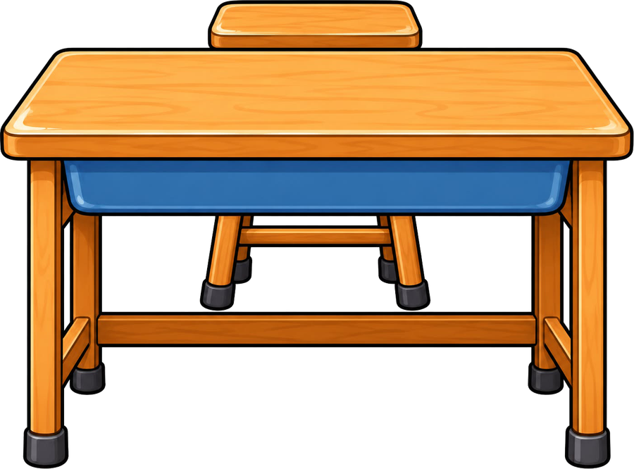

Year 4 · SPaG · Determiners, adverbs and prepositions
Prepositional phrases
I do, you do, with a timer. The questions get harder as we go.

Slide 2

Year 4 · SPaG · Determiners, adverbs and prepositions · Prepositional phrases
Learning objective
Learning objective
To use prepositional phrases to say where, when or why, and to find them in sentences.
Success criteria
☐ I can find and use prepositional phrases.
☐ I can answer questions on it, from easy to hard.
☐ I can use it in my own writing.
Notes:
Read the objective aloud, then ask pupils what they already know about it.

Slide 3
Year 4 · SPaG · Determiners, adverbs and prepositions · Prepositional phrases
Key words
Key words
preposition
shows how a noun or pronoun is related to another word
prepositional phrase
a preposition and the noun that follows it
time
when
place
where
cause
why
Notes:
Pupils say each word aloud, then use it in a sentence of their own.

Slide 4

Year 4 · SPaG · Determiners, adverbs and prepositions · Prepositional phrases
Starter
Starter: a quick look back at Expanding sentences with prepositions.
1. Which of these is a preposition of time?
○ because of ○ during ○ above
✔ during
2. Circle the preposition that completes the sentence.
She put the book the shelf.
○ so ○ on ○ gently ○ while
✔ on
3. Which of these is a preposition of place?
○ until ○ between ○ due to
✔ between
4. Circle the preposition that completes the sentence.
We waited the bus stop for an hour.
○ at ○ yet ○ although ○ after
✔ at
5. Which of these is a preposition of place?
○ as a result of ○ since ○ beside
✔ beside
Notes:
Click the timer (2:00) to start it. Pupils answer on whiteboards. Then click once per question to show each answer.

Slide 5

Year 4 · SPaG · Determiners, adverbs and prepositions · Prepositional phrases
Teach
Prepositions
A preposition shows how a noun or pronoun is related to another word. Prepositions of time (before, after, during, until), place (under, behind, beside, between) and cause (because of, due to). A preposition is followed by a noun or pronoun: behind the shed, during lunch.
The dog slept under the table.
The match was cancelled due to the weather.
Notes:
Talk through each idea with an example before moving on.

Slide 6
Year 4 · SPaG · Determiners, adverbs and prepositions · Prepositional phrases
Key ideas
Key ideas
time
We played during lunch. Wait until Friday.
place
The cat hid under the bed. She sat beside me.
cause
We stayed in because of the rain.
Notes:
Ask pupils to say each idea in their own words before showing the example.

Slide 7


Year 4 · SPaG · Determiners, adverbs and prepositions · Prepositional phrases
Varied fluency 1
I do
You do
Circle the preposition in the sentence below.
Circle the preposition in the sentence below.
The dog slept under the table.
The dog slept under the table.
Some children walked across the bridge.
Some children walked across the bridge.
1 of 12
Notes:
Question 1 of 12. I DO: model it out loud, thinking through each step. YOU DO: click the timer (1:00) to start it and let pupils try the same type of question on their whiteboards. Then click once per answer: the I do answers first, then the You do answers. Ask someone who got it wrong to say which step went wrong.

Slide 8
Year 4 · SPaG · Determiners, adverbs and prepositions · Prepositional phrases
Varied fluency 2
I do
You do
Circle the preposition that completes the sentence.
Circle the preposition that completes the sentence.
We walked ______ the bridge to the other side.
The plane flew ______ the clouds.
bright
until
although
across
across
above
above
or
slowly
but
2 of 12
Notes:
Question 2 of 12. I DO: model it out loud, thinking through each step. YOU DO: click the timer (1:00) to start it and let pupils try the same type of question on their whiteboards. Then click once per answer: the I do answers first, then the You do answers. Ask someone who got it wrong to say which step went wrong.

Slide 9
Year 4 · SPaG · Determiners, adverbs and prepositions · Prepositional phrases
Varied fluency 3
I do
You do
Underline the preposition in the sentence below.
Underline all the prepositions in the sentence below.
Some children walked across the bridge.
Some children walked across the bridge.
The cat jumped onto the wall and sat beside a flowerpot.
The cat jumped onto the wall and sat beside a flowerpot.
3 of 12
Notes:
Question 3 of 12. I DO: model it out loud, thinking through each step. YOU DO: click the timer (1:00) to start it and let pupils try the same type of question on their whiteboards. Then click once per answer: the I do answers first, then the You do answers. Ask someone who got it wrong to say which step went wrong.

Slide 10
Year 4 · SPaG · Determiners, adverbs and prepositions · Prepositional phrases
Varied fluency 4
I do
You do
Join the sentences into one sentence. Use an expanded noun phrase with an adjective and a prepositional phrase.
Join the sentences into one sentence. Use an expanded noun phrase with an adjective and a prepositional phrase.
The kite was red.
The kite was above the park.
The kite fell.
The bird was brown.
The bird was by the pond.
The bird hopped.
The red kite above the park fell.
Accept any correct order of the adjectives, with a comma between two adjectives.
The brown bird by the pond hopped.
Accept any correct order of the adjectives, with a comma between two adjectives.
4 of 12
Notes:
Question 4 of 12. I DO: model it out loud, thinking through each step. YOU DO: click the timer (1:00) to start it and let pupils try the same type of question on their whiteboards. Then click once per answer: the I do answers first, then the You do answers. Ask someone who got it wrong to say which step went wrong.

Slide 11
Year 4 · SPaG · Determiners, adverbs and prepositions · Prepositional phrases
Varied fluency 5
I do
You do
Join the sentences into one sentence. Use an expanded noun phrase with an adjective and a prepositional phrase.
Join the sentences into one sentence. Use an expanded noun phrase with an adjective and a prepositional phrase.
The kite was paper.
The kite was over the hill.
The kite dipped.
The rabbit was tiny.
The rabbit was behind the shed.
The rabbit nibbled.
The paper kite over the hill dipped.
Accept any correct order of the adjectives, with a comma between two adjectives.
The tiny rabbit behind the shed nibbled.
Accept any correct order of the adjectives, with a comma between two adjectives.
5 of 12
Notes:
Question 5 of 12. I DO: model it out loud, thinking through each step. YOU DO: click the timer (1:00) to start it and let pupils try the same type of question on their whiteboards. Then click once per answer: the I do answers first, then the You do answers. Ask someone who got it wrong to say which step went wrong.

Slide 12
Year 4 · SPaG · Determiners, adverbs and prepositions · Prepositional phrases
Varied fluency 6
I do
You do
Which of these is a preposition of time?
Which of these is a preposition of time?
☐ as a result of
☐ among
☐ during
✔ during
☐ on account of
☐ above
☐ during
✔ during
6 of 12
Notes:
Question 6 of 12. I DO: model it out loud, thinking through each step. YOU DO: click the timer (1:00) to start it and let pupils try the same type of question on their whiteboards. Then click once per answer: the I do answers first, then the You do answers. Ask someone who got it wrong to say which step went wrong.

Slide 13
Year 4 · SPaG · Determiners, adverbs and prepositions · Prepositional phrases
Varied fluency 7
I do
You do
Circle the preposition in the sentence below.
Circle the preposition in the sentence below.
Her dog barked when the postman walked towards the door.
Her dog barked when the postman walked towards the door.
After we had finished our lesson, we walked along the river and counted two ducks.
After we had finished our lesson, we walked along the river and counted two ducks.
7 of 12
Notes:
Question 7 of 12. I DO: model it out loud, thinking through each step. YOU DO: click the timer (1:00) to start it and let pupils try the same type of question on their whiteboards. Then click once per answer: the I do answers first, then the You do answers. Ask someone who got it wrong to say which step went wrong.

Slide 14
Year 4 · SPaG · Determiners, adverbs and prepositions · Prepositional phrases
Varied fluency 8
I do
You do
Circle the preposition that completes the sentence.
Circle the preposition that completes the sentence.
A fox crept ______ the fence and into the garden.
We waited ______ the bus stop for an hour.
unless
but
at
at
yet
under
under
because
after
although
8 of 12
Notes:
Question 8 of 12. I DO: model it out loud, thinking through each step. YOU DO: click the timer (1:00) to start it and let pupils try the same type of question on their whiteboards. Then click once per answer: the I do answers first, then the You do answers. Ask someone who got it wrong to say which step went wrong.

Slide 15
Year 4 · SPaG · Determiners, adverbs and prepositions · Prepositional phrases
Reasoning 1
I do
You do
Underline the preposition in the sentence below.
Underline the preposition in the sentence below.
Both brothers sat between their parents and watched the match.
Both brothers sat between their parents and watched the match.
Those apples fell from the tree because the wind was strong.
Those apples fell from the tree because the wind was strong.
9 of 12
Notes:
Question 9 of 12. I DO: model it out loud, thinking through each step. YOU DO: click the timer (1:00) to start it and let pupils try the same type of question on their whiteboards. Then click once per answer: the I do answers first, then the You do answers. Ask someone who got it wrong to say which step went wrong.

Slide 16
Year 4 · SPaG · Determiners, adverbs and prepositions · Prepositional phrases
Reasoning 2
I do
You do
Join the sentences into one sentence. Use an expanded noun phrase with an adjective and a prepositional phrase.
Join the sentences into one sentence. Use an expanded noun phrase with an adjective and a prepositional phrase.
The tree was tall.
The tree was by the river.
The tree creaked.
The box was dusty.
The box was under the bed.
The box fell open.
The tall tree by the river creaked.
Accept any correct order of the adjectives, with a comma between two adjectives.
The dusty box under the bed fell open.
Accept any correct order of the adjectives, with a comma between two adjectives.
10 of 12
Notes:
Question 10 of 12. I DO: model it out loud, thinking through each step. YOU DO: click the timer (1:00) to start it and let pupils try the same type of question on their whiteboards. Then click once per answer: the I do answers first, then the You do answers. Ask someone who got it wrong to say which step went wrong.

Slide 17
Year 4 · SPaG · Determiners, adverbs and prepositions · Prepositional phrases
Reasoning 3
I do
You do
Join the sentences into one sentence. Use an expanded noun phrase with an adjective and a prepositional phrase.
Join the sentences into one sentence. Use an expanded noun phrase with an adjective and a prepositional phrase.
The kite was paper.
The kite was over the hill.
The kite fell.
The kite was red.
The kite was in the sky.
The kite dipped.
The paper kite over the hill fell.
Accept any correct order of the adjectives, with a comma between two adjectives.
The red kite in the sky dipped.
Accept any correct order of the adjectives, with a comma between two adjectives.
11 of 12
Notes:
Question 11 of 12. I DO: model it out loud, thinking through each step. YOU DO: click the timer (1:00) to start it and let pupils try the same type of question on their whiteboards. Then click once per answer: the I do answers first, then the You do answers. Ask someone who got it wrong to say which step went wrong.

Slide 18
Year 4 · SPaG · Determiners, adverbs and prepositions · Prepositional phrases
Reasoning 4
I do
You do
Which of these is a preposition of time?
Which of these is a preposition of time?
☐ beneath
☐ owing to
☐ before
✔ before
☐ throughout the day
✔ throughout the day
☐ on account of
☐ below
12 of 12
Notes:
Question 12 of 12. I DO: model it out loud, thinking through each step. YOU DO: click the timer (1:00) to start it and let pupils try the same type of question on their whiteboards. Then click once per answer: the I do answers first, then the You do answers. Ask someone who got it wrong to say which step went wrong.

Slide 19
Year 4 · SPaG · Determiners, adverbs and prepositions · Prepositional phrases
Plenary
Remember
1. time: We played during lunch. Wait until Friday.
2. place: The cat hid under the bed. She sat beside me.
3. cause: We stayed in because of the rain.
Notes:
Three things to remember. Ask pupils to give one example of each in their own sentence.

Slide 20


Year 4 · SPaG · Determiners, adverbs and prepositions · Prepositional phrases
Challenge
Challenge
Write eight sentences about a picture of a park. Each one must have a prepositional phrase, and underline it.
Notes:
Pupils write for ten minutes (click the timer to start it). Look for the skill from today's lesson in every sentence.

