Slide 1






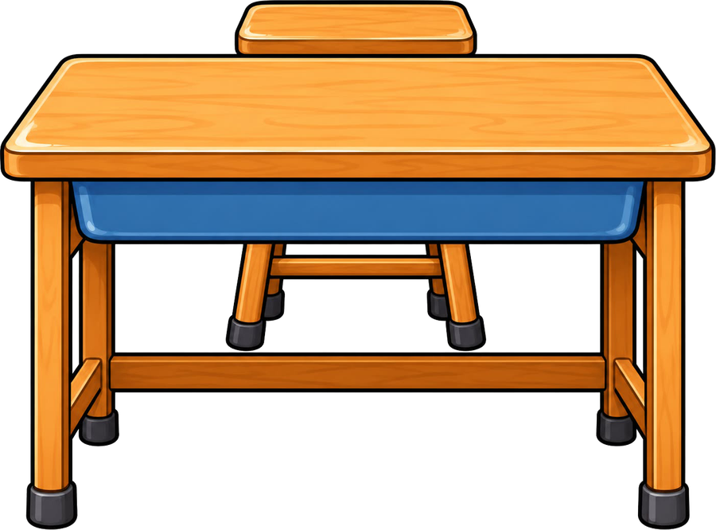

Year 4 · SPaG · Nouns and pronouns
Pronoun or noun?
I do, you do, with a timer. The questions get harder as we go.

Slide 2
Year 4 · SPaG · Nouns and pronouns · Pronoun or noun?
Learning objective
Learning objective
To decide whether a noun or a pronoun is better, so that the writing is clear and not repetitive.
Success criteria
☐ I can choose between a noun and a pronoun.
☐ I can answer questions on it, from easy to hard.
☐ I can use it in my own writing.
Notes:
Read the objective aloud, then ask pupils what they already know about it.

Slide 3
Year 4 · SPaG · Nouns and pronouns · Pronoun or noun?
Key words
Key words
pronoun
takes the place of a noun
personal pronoun
I, you, he, she, it, we, they, me, him, her, us, them
possessive pronoun
mine, yours, his, hers, ours, theirs
singular
just one
plural
more than one
Notes:
Pupils say each word aloud, then use it in a sentence of their own.

Slide 4


Year 4 · SPaG · Nouns and pronouns · Pronoun or noun?
Starter
Starter: a quick look back at Using pronouns.
1. Circle the pronoun in the sentence below.
Mia packed her bag, and she left.
✔ she
2. Which pronoun could replace the underlined words as the subject of the sentence?
Ben built the narrow bridge.
○ she ○ he ○ it ○ they
✔ he
3. Which pronoun could replace the underlined words as the object in the sentence?
The noisy driver opened the golden door.
○ them ○ it ○ her ○ him
✔ it
4. Underline the personal pronoun in the sentence below.
I found my coat under the bed.
✔ I found my coat under the bed.
5. Which version has the least repetition and is still clear?
○ Ravi and Priya made a model. Ravi and Priya painted the model red. ○ It made a model. They painted it red. ○ Ravi and Priya made a model. It painted it red. ○ Ravi and Priya made a model. They painted it red.
✔ Ravi and Priya made a model. They painted it red.
Notes:
Click the timer (2:00) to start it. Pupils answer on whiteboards. Then click once per question to show each answer.

Slide 5

Year 4 · SPaG · Nouns and pronouns · Pronoun or noun?
Teach
Pronouns
A pronoun takes the place of a noun so that we do not repeat it. Personal pronouns are I, you, he, she, it, we, they (and me, him, her, us, them). Possessive pronouns show who owns something: mine, yours, his, hers, ours, theirs. Use a singular pronoun for one and a plural pronoun for many.
Mia lost her key, so she searched the garden.
The twins said they were tired.
Notes:
Talk through each idea with an example before moving on.

Slide 6
Year 4 · SPaG · Nouns and pronouns · Pronoun or noun?
Key ideas
Key ideas
personal
She gave him a book.
possessive
That coat is mine. These are theirs.
singular / plural
The boy lost his coat. The boys lost their coats.
Notes:
Ask pupils to say each idea in their own words before showing the example.

Slide 7


Year 4 · SPaG · Nouns and pronouns · Pronoun or noun?
Varied fluency 1
I do
You do
The noun is repeated too often. Rewrite the sentences using pronouns so that the writing is less repetitive.
The noun is repeated too often. Rewrite the sentences using pronouns so that the writing is less repetitive.
Mia has a dog. Mia walks the dog every morning.
Zara lost her scarf. Zara looked for the scarf everywhere.
Mia has a dog. She walks it every morning.
Accept any correct use of pronouns that keeps the meaning.
Zara lost her scarf. She looked for it everywhere.
Accept any correct use of pronouns that keeps the meaning.
1 of 12
Notes:
Question 1 of 12. I DO: model it out loud, thinking through each step. YOU DO: click the timer (1:00) to start it and let pupils try the same type of question on their whiteboards. Then click once per answer: the I do answers first, then the You do answers. Ask someone who got it wrong to say which step went wrong.

Slide 8
Year 4 · SPaG · Nouns and pronouns · Pronoun or noun?
Varied fluency 2
I do
You do
Which version has the least repetition and is still clear?
Which version has the least repetition and is still clear?
☐ It lost her scarf. She looked for it everywhere.
☐ The children found a box. The children opened the box.
☐ Zara lost her scarf. He looked for it everywhere.
☐ The children found a box. They opened it.
✔ The children found a box. They opened it.
☐ Zara lost her scarf. Zara looked for the scarf everywhere.
☐ The children found a box. It opened it.
☐ Zara lost her scarf. She looked for it everywhere.
✔ Zara lost her scarf. She looked for it everywhere.
☐ It found a box. They opened it.
2 of 12
Notes:
Question 2 of 12. I DO: model it out loud, thinking through each step. YOU DO: click the timer (1:00) to start it and let pupils try the same type of question on their whiteboards. Then click once per answer: the I do answers first, then the You do answers. Ask someone who got it wrong to say which step went wrong.

Slide 9
Year 4 · SPaG · Nouns and pronouns · Pronoun or noun?
Varied fluency 3
I do
You do
Is the statement correct? Tick one box. Then explain how you know.
Is the statement correct? Tick one box. Then explain how you know.
A pronoun must match the noun it replaces.
Using a pronoun instead of repeating a noun can make writing flow better.
☐ Yes, it is correct.
✔ Yes, it is correct.
☐ Yes, it is correct.
✔ Yes, it is correct.
☐ No, it is not correct.
☐ No, it is not correct.
Explain how you know.
Explain how you know.
For example, 'they' for more than one, 'he' for a boy.
Accept any answer that gives the same reason.
It avoids repetition, so the text reads smoothly.
Accept any answer that gives the same reason.
3 of 12
Notes:
Question 3 of 12. I DO: model it out loud, thinking through each step. YOU DO: click the timer (1:00) to start it and let pupils try the same type of question on their whiteboards. Then click once per answer: the I do answers first, then the You do answers. Ask someone who got it wrong to say which step went wrong.

Slide 10
Year 4 · SPaG · Nouns and pronouns · Pronoun or noun?
Varied fluency 4
I do
You do
The noun is repeated too often. Rewrite the sentences using pronouns so that the writing is less repetitive.
The noun is repeated too often. Rewrite the sentences using pronouns so that the writing is less repetitive.
Dad baked a cake. Dad put the cake on the table.
Tom picked up the ball. Tom kicked the ball over the fence.
Dad baked a cake. He put it on the table.
Accept any correct use of pronouns that keeps the meaning.
Tom picked up the ball. He kicked it over the fence.
Accept any correct use of pronouns that keeps the meaning.
4 of 12
Notes:
Question 4 of 12. I DO: model it out loud, thinking through each step. YOU DO: click the timer (1:00) to start it and let pupils try the same type of question on their whiteboards. Then click once per answer: the I do answers first, then the You do answers. Ask someone who got it wrong to say which step went wrong.

Slide 11
Year 4 · SPaG · Nouns and pronouns · Pronoun or noun?
Varied fluency 5
I do
You do
The noun is repeated too often. Rewrite the sentences using pronouns so that the writing is less repetitive.
The noun is repeated too often. Rewrite the sentences using pronouns so that the writing is less repetitive.
The captain saw the storm. The captain ordered the crew to prepare for the storm.
The boys built a den. The boys hid in the den all afternoon.
The boys built a den. They hid in it all afternoon.
Accept any correct use of pronouns that keeps the meaning.
The captain saw the storm. He ordered the crew to prepare for it.
Accept any correct use of pronouns that keeps the meaning.
5 of 12
Notes:
Question 5 of 12. I DO: model it out loud, thinking through each step. YOU DO: click the timer (1:00) to start it and let pupils try the same type of question on their whiteboards. Then click once per answer: the I do answers first, then the You do answers. Ask someone who got it wrong to say which step went wrong.

Slide 12
Year 4 · SPaG · Nouns and pronouns · Pronoun or noun?
Varied fluency 6
I do
You do
Which version has the least repetition and is still clear?
Which version has the least repetition and is still clear?
☐ Aisha saw the new library. He thought it was wonderful.
☐ The captain saw the storm. The captain ordered the crew to prepare for the storm.
☐ It saw the new library. She thought it was wonderful.
☐ The captain saw the storm. She ordered the crew to prepare for it.
☐ Aisha saw the new library. Aisha thought the library was wonderful.
☐ It saw the storm. He ordered the crew to prepare for it.
☐ The captain saw the storm. He ordered the crew to prepare for it.
✔ The captain saw the storm. He ordered the crew to prepare for it.
☐ Aisha saw the new library. She thought it was wonderful.
✔ Aisha saw the new library. She thought it was wonderful.
6 of 12
Notes:
Question 6 of 12. I DO: model it out loud, thinking through each step. YOU DO: click the timer (1:00) to start it and let pupils try the same type of question on their whiteboards. Then click once per answer: the I do answers first, then the You do answers. Ask someone who got it wrong to say which step went wrong.

Slide 13
Year 4 · SPaG · Nouns and pronouns · Pronoun or noun?
Varied fluency 7
I do
You do
Is the statement correct? Tick one box. Then explain how you know.
Is the statement correct? Tick one box. Then explain how you know.
In 'The teacher told Mia that she was late', it is not completely clear who 'she' is.
A synonym or a different noun phrase can replace a repeated noun.
☐ Yes, it is correct.
✔ Yes, it is correct.
☐ Yes, it is correct.
✔ Yes, it is correct.
☐ No, it is not correct.
☐ No, it is not correct.
Explain how you know.
Explain how you know.
'She' could mean the teacher or Mia.
Accept any answer that gives the same reason.
For example: the dog → the animal.
Accept any answer that gives the same reason.
7 of 12
Notes:
Question 7 of 12. I DO: model it out loud, thinking through each step. YOU DO: click the timer (1:00) to start it and let pupils try the same type of question on their whiteboards. Then click once per answer: the I do answers first, then the You do answers. Ask someone who got it wrong to say which step went wrong.

Slide 14
Year 4 · SPaG · Nouns and pronouns · Pronoun or noun?
Varied fluency 8
I do
You do
The noun is repeated too often. Rewrite the sentences using pronouns so that the writing is less repetitive.
The noun is repeated too often. Rewrite the sentences using pronouns so that the writing is less repetitive.
The teacher read a story. The teacher asked the class a question about the story.
Aisha saw the new library. Aisha thought the library was wonderful.
The teacher read a story. She asked the class a question about it.
Accept any correct use of pronouns that keeps the meaning.
Aisha saw the new library. She thought it was wonderful.
Accept any correct use of pronouns that keeps the meaning.
8 of 12
Notes:
Question 8 of 12. I DO: model it out loud, thinking through each step. YOU DO: click the timer (1:00) to start it and let pupils try the same type of question on their whiteboards. Then click once per answer: the I do answers first, then the You do answers. Ask someone who got it wrong to say which step went wrong.

Slide 15
Year 4 · SPaG · Nouns and pronouns · Pronoun or noun?
Reasoning 1
I do
You do
Which version has the least repetition and is still clear?
Which version has the least repetition and is still clear?
☐ It bought some flowers. She put them in a vase.
☐ The teacher read a story. He asked the class a question about it.
☐ Mum bought some flowers. She put them in a vase.
☐ The teacher read a story. The teacher asked the class a question about the story.
✔ Mum bought some flowers. She put them in a vase.
☐ The teacher read a story. She asked the class a question about it.
☐ Mum bought some flowers. He put them in a vase.
✔ The teacher read a story. She asked the class a question about it.
☐ It read a story. She asked the class a question about it.
☐ Mum bought some flowers. Mum put the flowers in a vase.
9 of 12
Notes:
Question 9 of 12. I DO: model it out loud, thinking through each step. YOU DO: click the timer (1:00) to start it and let pupils try the same type of question on their whiteboards. Then click once per answer: the I do answers first, then the You do answers. Ask someone who got it wrong to say which step went wrong.

Slide 16
Year 4 · SPaG · Nouns and pronouns · Pronoun or noun?
Reasoning 2
I do
You do
Which version has the least repetition and is still clear?
Which version has the least repetition and is still clear?
☐ The boys built a den. It hid in it all afternoon.
☐ Ravi and Priya made a model. It painted it red.
☐ The boys built a den. The boys hid in the den all afternoon.
☐ Ravi and Priya made a model. They painted it red.
✔ Ravi and Priya made a model. They painted it red.
☐ The boys built a den. They hid in it all afternoon.
✔ The boys built a den. They hid in it all afternoon.
☐ It made a model. They painted it red.
☐ Ravi and Priya made a model. Ravi and Priya painted the model red.
☐ It built a den. They hid in it all afternoon.
10 of 12
Notes:
Question 10 of 12. I DO: model it out loud, thinking through each step. YOU DO: click the timer (1:00) to start it and let pupils try the same type of question on their whiteboards. Then click once per answer: the I do answers first, then the You do answers. Ask someone who got it wrong to say which step went wrong.

Slide 17
Year 4 · SPaG · Nouns and pronouns · Pronoun or noun?
Reasoning 3
I do
You do
The noun is repeated too often. Rewrite the sentences using pronouns so that the writing is less repetitive.
The noun is repeated too often. Rewrite the sentences using pronouns so that the writing is less repetitive.
Ravi and Priya made a model. Ravi and Priya painted the model red.
The explorers reached the mountain. The explorers decided to climb the mountain at dawn.
Ravi and Priya made a model. They painted it red.
Accept any correct use of pronouns that keeps the meaning.
The explorers reached the mountain. They decided to climb it at dawn.
Accept any correct use of pronouns that keeps the meaning.
11 of 12
Notes:
Question 11 of 12. I DO: model it out loud, thinking through each step. YOU DO: click the timer (1:00) to start it and let pupils try the same type of question on their whiteboards. Then click once per answer: the I do answers first, then the You do answers. Ask someone who got it wrong to say which step went wrong.

Slide 18
Year 4 · SPaG · Nouns and pronouns · Pronoun or noun?
Reasoning 4
I do
You do
Is the statement correct? Tick one box. Then explain how you know.
Is the statement correct? Tick one box. Then explain how you know.
Replacing every noun with a pronoun always makes the meaning clearer.
A pronoun can come before the noun it refers to.
☐ Yes, it is correct.
☐ Yes, it is correct.
✔ Yes, it is correct.
☐ No, it is not correct.
✔ No, it is not correct.
☐ No, it is not correct.
Explain how you know.
Explain how you know.
Too many pronouns can leave the reader unsure who or what is meant.
Accept any answer that gives the same reason.
For example: When he arrived, Tom took off his coat.
Accept any answer that gives the same reason.
12 of 12
Notes:
Question 12 of 12. I DO: model it out loud, thinking through each step. YOU DO: click the timer (1:00) to start it and let pupils try the same type of question on their whiteboards. Then click once per answer: the I do answers first, then the You do answers. Ask someone who got it wrong to say which step went wrong.

Slide 19
Year 4 · SPaG · Nouns and pronouns · Pronoun or noun?
Plenary
Remember
1. personal: She gave him a book.
2. possessive: That coat is mine. These are theirs.
3. singular / plural: The boy lost his coat. The boys lost their coats.
Notes:
Three things to remember. Ask pupils to give one example of each in their own sentence.

Slide 20

Year 4 · SPaG · Nouns and pronouns · Pronoun or noun?
Challenge
Challenge
Write six sentences about two friends. Decide each time whether to use a name or a pronoun so that it is always clear who you mean.
Notes:
Pupils write for ten minutes (click the timer to start it). Look for the skill from today's lesson in every sentence.

