Slide 1




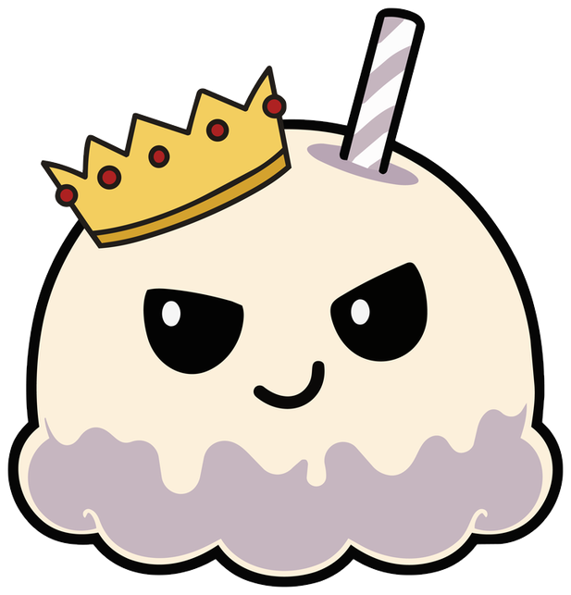



Year 3 · SPaG · Prefixes and word families
Root words, prefixes and suffixes
I do, you do, with a timer. The questions get harder as we go.

Slide 2
Year 3 · SPaG · Prefixes and word families · Root words, prefixes and suffixes
Learning objective
Learning objective
To find the root word and to tell a prefix from a suffix.
Success criteria
☐ I can find the root of a word.
☐ I can answer questions on it, from easy to hard.
☐ I can use it in my own writing.
Notes:
Read the objective aloud, then ask pupils what they already know about it.

Slide 3
Year 3 · SPaG · Prefixes and word families · Root words, prefixes and suffixes
Key words
Key words
root word
the main part of a word
prefix
letters added to the start of a word
suffix
letters added to the end of a word
word family
words that share a root
Notes:
Pupils say each word aloud, then use it in a sentence of their own.

Slide 4


Year 3 · SPaG · Prefixes and word families · Root words, prefixes and suffixes
Starter
Starter: a quick look back at Using different types of nouns.
1. Which of these is an abstract noun?
○ pencil ○ sadness
✔ sadness
2. Circle the word that completes the sentence.
Leo was full of .
○ angry ○ anger ○ gentle
✔ anger
3. Rewrite the sentence, adding two adjectives to the underlined noun phrase.
My cat sat on the wall.
✔ My lazy ginger cat sat on the wall.
4. Which of these is a concrete noun?
○ anger ○ window
✔ window
5. Which abstract noun is made from the adjective strong?
○ bravery ○ sadness ○ strength
✔ strength
Notes:
Click the timer (2:00) to start it. Pupils answer on whiteboards. Then click once per question to show each answer.

Slide 5

Year 3 · SPaG · Prefixes and word families · Root words, prefixes and suffixes
Teach
Root words, prefixes and suffixes
A root word is the main part of a word. A prefix is added to the start of a root and a suffix is added to the end. Both change the meaning: unhappy (prefix), helpful (suffix).
The root of unkind is kind.
The root of helpful is help.
Notes:
Talk through each idea with an example before moving on.

Slide 6
Year 3 · SPaG · Prefixes and word families · Root words, prefixes and suffixes
Key ideas
Key ideas
root word
happy, help, kind
prefix
unhappy, replay, disagree
suffix
helpful, kindness, quickly
Notes:
Ask pupils to say each idea in their own words before showing the example.

Slide 7


Year 3 · SPaG · Prefixes and word families · Root words, prefixes and suffixes
Varied fluency 1
I do
You do
Draw a line to match each prefix or suffix to its meaning.
Draw a line to match each prefix or suffix to its meaning.
dis-
again
-ful
without
re-
full of
-less
the state of being
-ful
not or the opposite of
-ness
not or the opposite of
un-
not
dis-
full of
1 of 12
Notes:
Question 1 of 12. I DO: model it out loud, thinking through each step. YOU DO: click the timer (1:00) to start it and let pupils try the same type of question on their whiteboards. Then click once per answer: the I do answers first, then the You do answers. Ask someone who got it wrong to say which step went wrong.

Slide 8
Year 3 · SPaG · Prefixes and word families · Root words, prefixes and suffixes
Varied fluency 2
I do
You do
Make a new word. Write it on the line.
Make a new word. Write it on the line.
Add the suffix -ness to sad.
Add the suffix -ful to colour.
sadness
colourful
2 of 12
Notes:
Question 2 of 12. I DO: model it out loud, thinking through each step. YOU DO: click the timer (1:00) to start it and let pupils try the same type of question on their whiteboards. Then click once per answer: the I do answers first, then the You do answers. Ask someone who got it wrong to say which step went wrong.

Slide 9
Year 3 · SPaG · Prefixes and word families · Root words, prefixes and suffixes
Varied fluency 3
I do
You do
Which word means full of care?
Which word means full of care?
☐ carement
☐ careless
☐ careless
☐ careness
☐ careful
✔ careful
☐ carement
☐ careness
☐ careful
✔ careful
3 of 12
Notes:
Question 3 of 12. I DO: model it out loud, thinking through each step. YOU DO: click the timer (1:00) to start it and let pupils try the same type of question on their whiteboards. Then click once per answer: the I do answers first, then the You do answers. Ask someone who got it wrong to say which step went wrong.

Slide 10
Year 3 · SPaG · Prefixes and word families · Root words, prefixes and suffixes
Varied fluency 4
I do
You do
Tick one box in each row to show whether the word has a prefix or a suffix.
Tick one box in each row to show whether the word has a prefix or a suffix.
Prefix
Suffix
Prefix
Suffix
unlock
✔
teacher
✔
careful
✔
unfair
✔
happily
✔
helpless
✔
kindness
✔
kindness
✔
4 of 12
Notes:
Question 4 of 12. I DO: model it out loud, thinking through each step. YOU DO: click the timer (1:00) to start it and let pupils try the same type of question on their whiteboards. Then click once per answer: the I do answers first, then the You do answers. Ask someone who got it wrong to say which step went wrong.

Slide 11
Year 3 · SPaG · Prefixes and word families · Root words, prefixes and suffixes
Varied fluency 5
I do
You do
Make a new word. Write it on the line.
Make a new word. Write it on the line.
Add the suffix -ness to kind. Take care with the spelling.
Add the suffix -ly to easy. Take care with the spelling.
kindness
easily
5 of 12
Notes:
Question 5 of 12. I DO: model it out loud, thinking through each step. YOU DO: click the timer (1:00) to start it and let pupils try the same type of question on their whiteboards. Then click once per answer: the I do answers first, then the You do answers. Ask someone who got it wrong to say which step went wrong.

Slide 12
Year 3 · SPaG · Prefixes and word families · Root words, prefixes and suffixes
Varied fluency 6
I do
You do
Which word has the prefix re-, meaning 'again'?
Which word has the prefix un-, meaning 'not'?
☐ dishonest
☐ runner
☐ fearless
☐ unfair
✔ unfair
☐ rebuild
✔ rebuild
☐ easily
☐ painter
☐ disappear
6 of 12
Notes:
Question 6 of 12. I DO: model it out loud, thinking through each step. YOU DO: click the timer (1:00) to start it and let pupils try the same type of question on their whiteboards. Then click once per answer: the I do answers first, then the You do answers. Ask someone who got it wrong to say which step went wrong.

Slide 13
Year 3 · SPaG · Prefixes and word families · Root words, prefixes and suffixes
Varied fluency 7
I do
You do
Is the statement correct? Tick one box. Then explain how you know.
Is the statement correct? Tick one box. Then explain how you know.
The word 'carefully' has a prefix.
The prefix 'mis' means 'wrongly', as in 'misspell'.
☐ Yes, it is correct.
☐ Yes, it is correct.
✔ Yes, it is correct.
☐ No, it is not correct.
✔ No, it is not correct.
☐ No, it is not correct.
Explain how you know.
Explain how you know.
It has two suffixes: -ful and -ly.
Accept any answer that gives the same reason.
To misspell is to spell wrongly.
Accept any answer that gives the same reason.
7 of 12
Notes:
Question 7 of 12. I DO: model it out loud, thinking through each step. YOU DO: click the timer (1:00) to start it and let pupils try the same type of question on their whiteboards. Then click once per answer: the I do answers first, then the You do answers. Ask someone who got it wrong to say which step went wrong.

Slide 14
Year 3 · SPaG · Prefixes and word families · Root words, prefixes and suffixes
Varied fluency 8
I do
You do
Make a new word. Write it on the line.
Make a new word. Write it on the line.
Add the prefix under- to line.
Add the prefix under- to water.
underline
underwater
8 of 12
Notes:
Question 8 of 12. I DO: model it out loud, thinking through each step. YOU DO: click the timer (1:00) to start it and let pupils try the same type of question on their whiteboards. Then click once per answer: the I do answers first, then the You do answers. Ask someone who got it wrong to say which step went wrong.

Slide 15
Year 3 · SPaG · Prefixes and word families · Root words, prefixes and suffixes
Reasoning 1
I do
You do
Which word means to spell wrongly?
Which word means in a quick way?
☐ unspell
☐ quickness
☐ respell
☐ quickly
✔ quickly
☐ overspell
☐ quickful
☐ misspell
✔ misspell
☐ quickment
9 of 12
Notes:
Question 9 of 12. I DO: model it out loud, thinking through each step. YOU DO: click the timer (1:00) to start it and let pupils try the same type of question on their whiteboards. Then click once per answer: the I do answers first, then the You do answers. Ask someone who got it wrong to say which step went wrong.

Slide 16
Year 3 · SPaG · Prefixes and word families · Root words, prefixes and suffixes
Reasoning 2
I do
You do
Make a new word. Write it on the line.
Make a new word. Write it on the line.
Add the suffix -ful to beauty. Take care with the spelling.
Add the suffix -ful to hope. Take care with the spelling.
beautiful
hopeful
10 of 12
Notes:
Question 10 of 12. I DO: model it out loud, thinking through each step. YOU DO: click the timer (1:00) to start it and let pupils try the same type of question on their whiteboards. Then click once per answer: the I do answers first, then the You do answers. Ask someone who got it wrong to say which step went wrong.

Slide 17
Year 3 · SPaG · Prefixes and word families · Root words, prefixes and suffixes
Reasoning 3
I do
You do
Tick one box in each row to show whether the word has a prefix or a suffix.
Tick one box in each row to show whether the word has a prefix or a suffix.
Prefix
Suffix
Prefix
Suffix
preheat
✔
enjoyment
✔
overcook
✔
underline
✔
painter
✔
disobey
✔
joyful
✔
preheat
✔
quickly
✔
misspell
✔
11 of 12
Notes:
Question 11 of 12. I DO: model it out loud, thinking through each step. YOU DO: click the timer (1:00) to start it and let pupils try the same type of question on their whiteboards. Then click once per answer: the I do answers first, then the You do answers. Ask someone who got it wrong to say which step went wrong.

Slide 18
Year 3 · SPaG · Prefixes and word families · Root words, prefixes and suffixes
Reasoning 4
I do
You do
Is the statement correct? Tick one box. Then explain how you know.
Is the statement correct? Tick one box. Then explain how you know.
Adding a prefix changes the spelling of the root word.
When 'happy' takes the suffix '-ness', the 'y' changes to 'i'.
☐ Yes, it is correct.
☐ Yes, it is correct.
✔ Yes, it is correct.
☐ No, it is not correct.
✔ No, it is not correct.
☐ No, it is not correct.
Explain how you know.
Explain how you know.
A prefix does not change the root word: dis + appear = disappear.
Accept any answer that gives the same reason.
The word is 'happiness'.
Accept any answer that gives the same reason.
12 of 12
Notes:
Question 12 of 12. I DO: model it out loud, thinking through each step. YOU DO: click the timer (1:00) to start it and let pupils try the same type of question on their whiteboards. Then click once per answer: the I do answers first, then the You do answers. Ask someone who got it wrong to say which step went wrong.

Slide 19
Year 3 · SPaG · Prefixes and word families · Root words, prefixes and suffixes
Plenary
Remember
1. root word: happy, help, kind
2. prefix: unhappy, replay, disagree
3. suffix: helpful, kindness, quickly
Notes:
Three things to remember. Ask pupils to give one example of each in their own sentence.

Slide 20

Year 3 · SPaG · Prefixes and word families · Root words, prefixes and suffixes
Challenge
Challenge
Choose five root words. Add a prefix or a suffix to each one and write a sentence for each new word.
Notes:
Pupils write for ten minutes (click the timer to start it). Look for the skill from today's lesson in every sentence.

