Slide 1



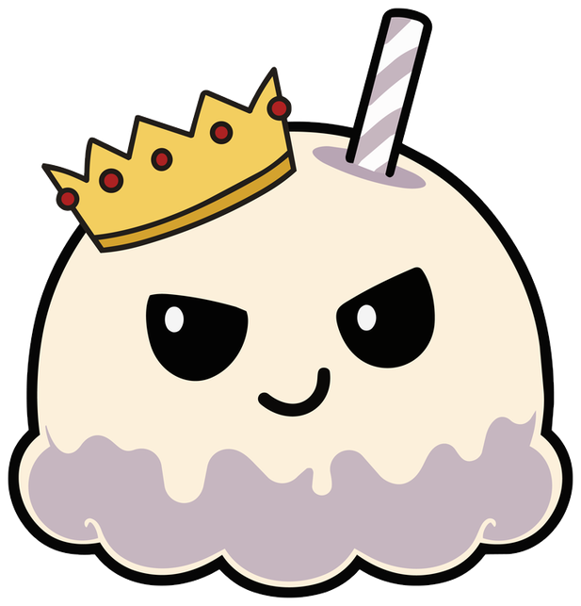




Year 3 · SPaG · Nouns and noun phrases
Using abstract nouns
I do, you do, with a timer. The questions get harder as we go.

Slide 2

Year 3 · SPaG · Nouns and noun phrases · Using abstract nouns
Learning objective
Learning objective
To make abstract nouns from adjectives and to use them in sentences.
Success criteria
☐ I can use an abstract noun.
☐ I can answer questions on it, from easy to hard.
☐ I can use it in my own writing.
Notes:
Read the objective aloud, then ask pupils what they already know about it.

Slide 3
Year 3 · SPaG · Nouns and noun phrases · Using abstract nouns
Key words
Key words
abstract noun
names an idea or a feeling
concrete noun
names something you can see or touch
adjective
a describing word
feeling
how you feel inside
Notes:
Pupils say each word aloud, then use it in a sentence of their own.

Slide 4

Year 3 · SPaG · Nouns and noun phrases · Using abstract nouns
Starter
Starter: a quick look back at Recognising abstract nouns.
1. Which of these is an abstract noun?
○ kindness ○ window
✔ kindness
2. Which of these is an abstract noun?
○ happiness ○ pencil
✔ happiness
3. Which of these is a concrete noun?
○ sadness ○ apple
✔ apple
Notes:
Click the timer (2:00) to start it. Pupils answer on whiteboards. Then click once per question to show each answer.

Slide 5
Year 3 · SPaG · Nouns and noun phrases · Using abstract nouns
Teach
Abstract nouns
An abstract noun names an idea or a feeling that you cannot see or touch: bravery, kindness, sadness, friendship. A concrete noun names something you can see or touch: table, dog, apple. Many abstract nouns are made from adjectives: brave → bravery, kind → kindness.
She showed great bravery.
Their friendship is strong.
Notes:
Talk through each idea with an example before moving on.

Slide 6
Year 3 · SPaG · Nouns and noun phrases · Using abstract nouns
Key ideas
Key ideas
abstract
bravery, kindness, sadness, happiness, friendship
concrete
table, dog, apple, river
from adjectives
brave → bravery, sad → sadness, strong → strength
Notes:
Ask pupils to say each idea in their own words before showing the example.

Slide 7


Year 3 · SPaG · Nouns and noun phrases · Using abstract nouns
Varied fluency 1
I do
You do
Write the abstract noun.
Write the abstract noun.
Write the abstract noun that is made from the adjective kind.
Write the abstract noun that is made from the adjective angry.
kindness
anger
1 of 12
Notes:
Question 1 of 12. I DO: model it out loud, thinking through each step. YOU DO: click the timer (1:00) to start it and let pupils try the same type of question on their whiteboards. Then click once per answer: the I do answers first, then the You do answers. Ask someone who got it wrong to say which step went wrong.

Slide 8
Year 3 · SPaG · Nouns and noun phrases · Using abstract nouns
Varied fluency 2
I do
You do
Which abstract noun is made from the adjective happy?
Which abstract noun is made from the adjective sad?
☐ strength
☐ bravery
☐ sadness
☐ wisdom
☐ happiness
✔ happiness
☐ sadness
✔ sadness
2 of 12
Notes:
Question 2 of 12. I DO: model it out loud, thinking through each step. YOU DO: click the timer (1:00) to start it and let pupils try the same type of question on their whiteboards. Then click once per answer: the I do answers first, then the You do answers. Ask someone who got it wrong to say which step went wrong.

Slide 9
Year 3 · SPaG · Nouns and noun phrases · Using abstract nouns
Varied fluency 3
I do
You do
Circle the word that completes the sentence.
Circle the word that completes the sentence.
Mia was full of ______.
Zara was full of ______.
sad
kind
angry
brave
kindness
kindness
bravery
bravery
3 of 12
Notes:
Question 3 of 12. I DO: model it out loud, thinking through each step. YOU DO: click the timer (1:00) to start it and let pupils try the same type of question on their whiteboards. Then click once per answer: the I do answers first, then the You do answers. Ask someone who got it wrong to say which step went wrong.

Slide 10
Year 3 · SPaG · Nouns and noun phrases · Using abstract nouns
Varied fluency 4
I do
You do
Is the statement correct? Tick one box. Then explain how you know.
Is the statement correct? Tick one box. Then explain how you know.
The noun 'sadness' is an abstract noun made from the adjective 'sad'.
The noun 'strength' is an abstract noun made from the adjective 'strong'.
☐ Yes, it is correct.
✔ Yes, it is correct.
☐ Yes, it is correct.
✔ Yes, it is correct.
☐ No, it is not correct.
☐ No, it is not correct.
Explain how you know.
Explain how you know.
'sadness' is made from 'sad'.
Accept any answer that gives the same reason.
'strength' is made from 'strong'.
Accept any answer that gives the same reason.
4 of 12
Notes:
Question 4 of 12. I DO: model it out loud, thinking through each step. YOU DO: click the timer (1:00) to start it and let pupils try the same type of question on their whiteboards. Then click once per answer: the I do answers first, then the You do answers. Ask someone who got it wrong to say which step went wrong.

Slide 11
Year 3 · SPaG · Nouns and noun phrases · Using abstract nouns
Varied fluency 5
I do
You do
Write the abstract noun.
Write the abstract noun.
Write the abstract noun that is made from the adjective brave.
Write the abstract noun that is made from the adjective strong.
bravery
strength
5 of 12
Notes:
Question 5 of 12. I DO: model it out loud, thinking through each step. YOU DO: click the timer (1:00) to start it and let pupils try the same type of question on their whiteboards. Then click once per answer: the I do answers first, then the You do answers. Ask someone who got it wrong to say which step went wrong.

Slide 12
Year 3 · SPaG · Nouns and noun phrases · Using abstract nouns
Varied fluency 6
I do
You do
Circle the word that completes the sentence.
Circle the word that completes the sentence.
Zara was full of ______.
Ben spoke with great ______.
brave
honest
bravery
bravery
polite
bravery
bravery
brave
6 of 12
Notes:
Question 6 of 12. I DO: model it out loud, thinking through each step. YOU DO: click the timer (1:00) to start it and let pupils try the same type of question on their whiteboards. Then click once per answer: the I do answers first, then the You do answers. Ask someone who got it wrong to say which step went wrong.

Slide 13
Year 3 · SPaG · Nouns and noun phrases · Using abstract nouns
Varied fluency 7
I do
You do
Which abstract noun is made from the adjective gentle?
Which abstract noun is made from the adjective brave?
☐ wisdom
☐ bravery
✔ bravery
☐ gentleness
✔ gentleness
☐ generosity
☐ kindness
☐ wisdom
7 of 12
Notes:
Question 7 of 12. I DO: model it out loud, thinking through each step. YOU DO: click the timer (1:00) to start it and let pupils try the same type of question on their whiteboards. Then click once per answer: the I do answers first, then the You do answers. Ask someone who got it wrong to say which step went wrong.

Slide 14
Year 3 · SPaG · Nouns and noun phrases · Using abstract nouns
Varied fluency 8
I do
You do
Write the abstract noun.
Write the abstract noun.
Write the abstract noun that is made from the adjective wise.
Write the abstract noun that is made from the adjective honest.
wisdom
honesty
8 of 12
Notes:
Question 8 of 12. I DO: model it out loud, thinking through each step. YOU DO: click the timer (1:00) to start it and let pupils try the same type of question on their whiteboards. Then click once per answer: the I do answers first, then the You do answers. Ask someone who got it wrong to say which step went wrong.

Slide 15
Year 3 · SPaG · Nouns and noun phrases · Using abstract nouns
Reasoning 1
I do
You do
Is the statement correct? Tick one box. Then explain how you know.
Is the statement correct? Tick one box. Then explain how you know.
The noun 'honesty' is an abstract noun made from the adjective 'honest'.
The noun 'bravery' is an abstract noun made from the adjective 'kind'.
☐ Yes, it is correct.
✔ Yes, it is correct.
☐ Yes, it is correct.
☐ No, it is not correct.
☐ No, it is not correct.
✔ No, it is not correct.
Explain how you know.
Explain how you know.
'honesty' is made from 'honest'.
Accept any answer that gives the same reason.
'bravery' is made from 'brave'.
Accept any answer that gives the same reason.
9 of 12
Notes:
Question 9 of 12. I DO: model it out loud, thinking through each step. YOU DO: click the timer (1:00) to start it and let pupils try the same type of question on their whiteboards. Then click once per answer: the I do answers first, then the You do answers. Ask someone who got it wrong to say which step went wrong.

Slide 16
Year 3 · SPaG · Nouns and noun phrases · Using abstract nouns
Reasoning 2
I do
You do
Circle the word that completes the sentence.
Circle the word that completes the sentence.
Leo spoke with great ______.
Leo was full of ______.
angry
happy
strong
strength
strength
happiness
happiness
wise
10 of 12
Notes:
Question 10 of 12. I DO: model it out loud, thinking through each step. YOU DO: click the timer (1:00) to start it and let pupils try the same type of question on their whiteboards. Then click once per answer: the I do answers first, then the You do answers. Ask someone who got it wrong to say which step went wrong.

Slide 17
Year 3 · SPaG · Nouns and noun phrases · Using abstract nouns
Reasoning 3
I do
You do
Which abstract noun is made from the adjective sad?
Which abstract noun is made from the adjective honest?
☐ sadness
✔ sadness
☐ honesty
✔ honesty
☐ generosity
☐ happiness
☐ politeness
☐ generosity
11 of 12
Notes:
Question 11 of 12. I DO: model it out loud, thinking through each step. YOU DO: click the timer (1:00) to start it and let pupils try the same type of question on their whiteboards. Then click once per answer: the I do answers first, then the You do answers. Ask someone who got it wrong to say which step went wrong.

Slide 18
Year 3 · SPaG · Nouns and noun phrases · Using abstract nouns
Reasoning 4
I do
You do
Is the statement correct? Tick one box. Then explain how you know.
Is the statement correct? Tick one box. Then explain how you know.
The noun 'anger' is an abstract noun made from the adjective 'angry'.
The noun 'strength' is an abstract noun made from the adjective 'gentle'.
☐ Yes, it is correct.
✔ Yes, it is correct.
☐ Yes, it is correct.
☐ No, it is not correct.
☐ No, it is not correct.
✔ No, it is not correct.
Explain how you know.
Explain how you know.
'anger' is made from 'angry'.
Accept any answer that gives the same reason.
'strength' is made from 'strong'.
Accept any answer that gives the same reason.
12 of 12
Notes:
Question 12 of 12. I DO: model it out loud, thinking through each step. YOU DO: click the timer (1:00) to start it and let pupils try the same type of question on their whiteboards. Then click once per answer: the I do answers first, then the You do answers. Ask someone who got it wrong to say which step went wrong.

Slide 19
Year 3 · SPaG · Nouns and noun phrases · Using abstract nouns
Plenary
Remember
1. abstract: bravery, kindness, sadness, happiness, friendship
2. concrete: table, dog, apple, river
3. from adjectives: brave → bravery, sad → sadness, strong → strength
Notes:
Three things to remember. Ask pupils to give one example of each in their own sentence.

Slide 20

Year 3 · SPaG · Nouns and noun phrases · Using abstract nouns
Challenge
Challenge
Choose five adjectives. Make an abstract noun from each one and write a sentence that uses it.
Notes:
Pupils write for ten minutes (click the timer to start it). Look for the skill from today's lesson in every sentence.

